Slide 1
Data Investigation Cycle

Slide 2
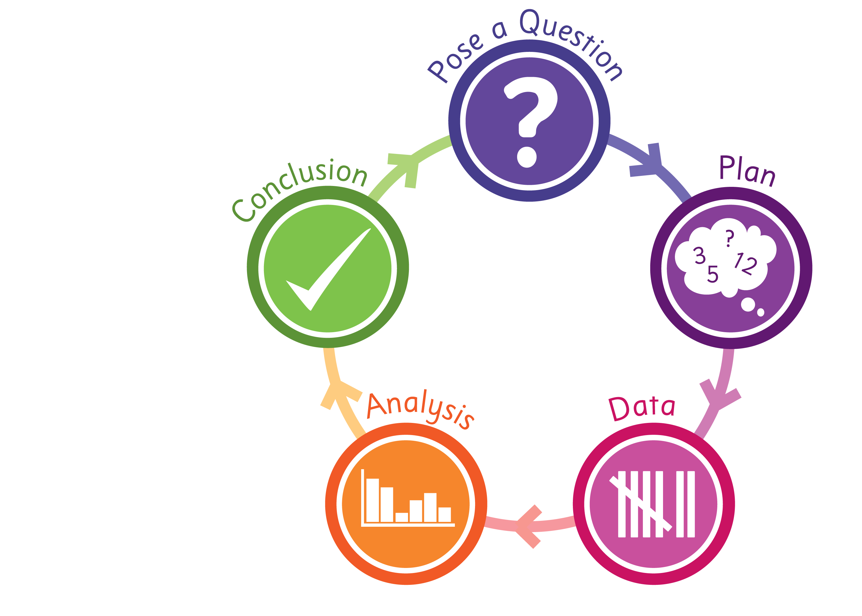
Data Investigation Cycle

Slide 3
Pose a question
What is the question we want to answer?
How will we find out the answer?

Slide 4
Plan
What data do we need to collect?
Who will collect the data?
Who should we collect it from?
How will we collect it?
How will we record and organise the data?

Slide 5
Data
Is the data organised?
Did you use a table?
Is the data clear and easy to read?

Slide 6
Analysis
What are your greatest and least values?
What graph (and scale) will you use to display the data?
Will you draw it by hand? Use a PCM? Use a digital device?
Do you have enough space for each symbol or block to equal one response?
If not, what should each symbol or block equal?
Will you graph a title? Labels? A key?
What other graph type would be suitable? Would it be better?

Slide 7
Conclusion
Have you answered the original question?
What else does the graph tell you?
What is interesting or surprising about the data? Any patterns?
Who might be interested in this information? Explain why.
How could this information be shared with others? Poster? Digital slides?
Has this investigation made you think of other questions you would like to answer?

