Slide 2
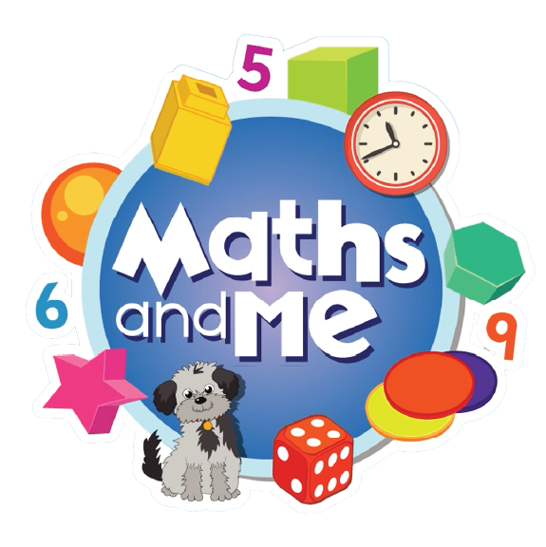
Contents
How to Use These Slides
Rationale
Counting & Numeration
Picture Books & Read Alouds
Games

Slide 3
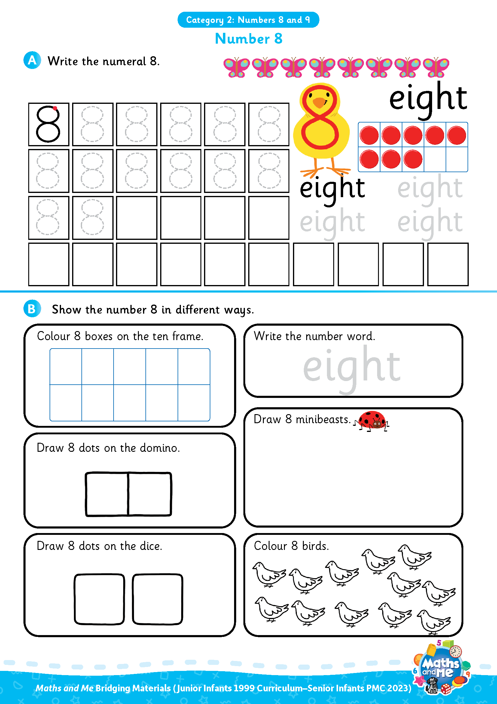
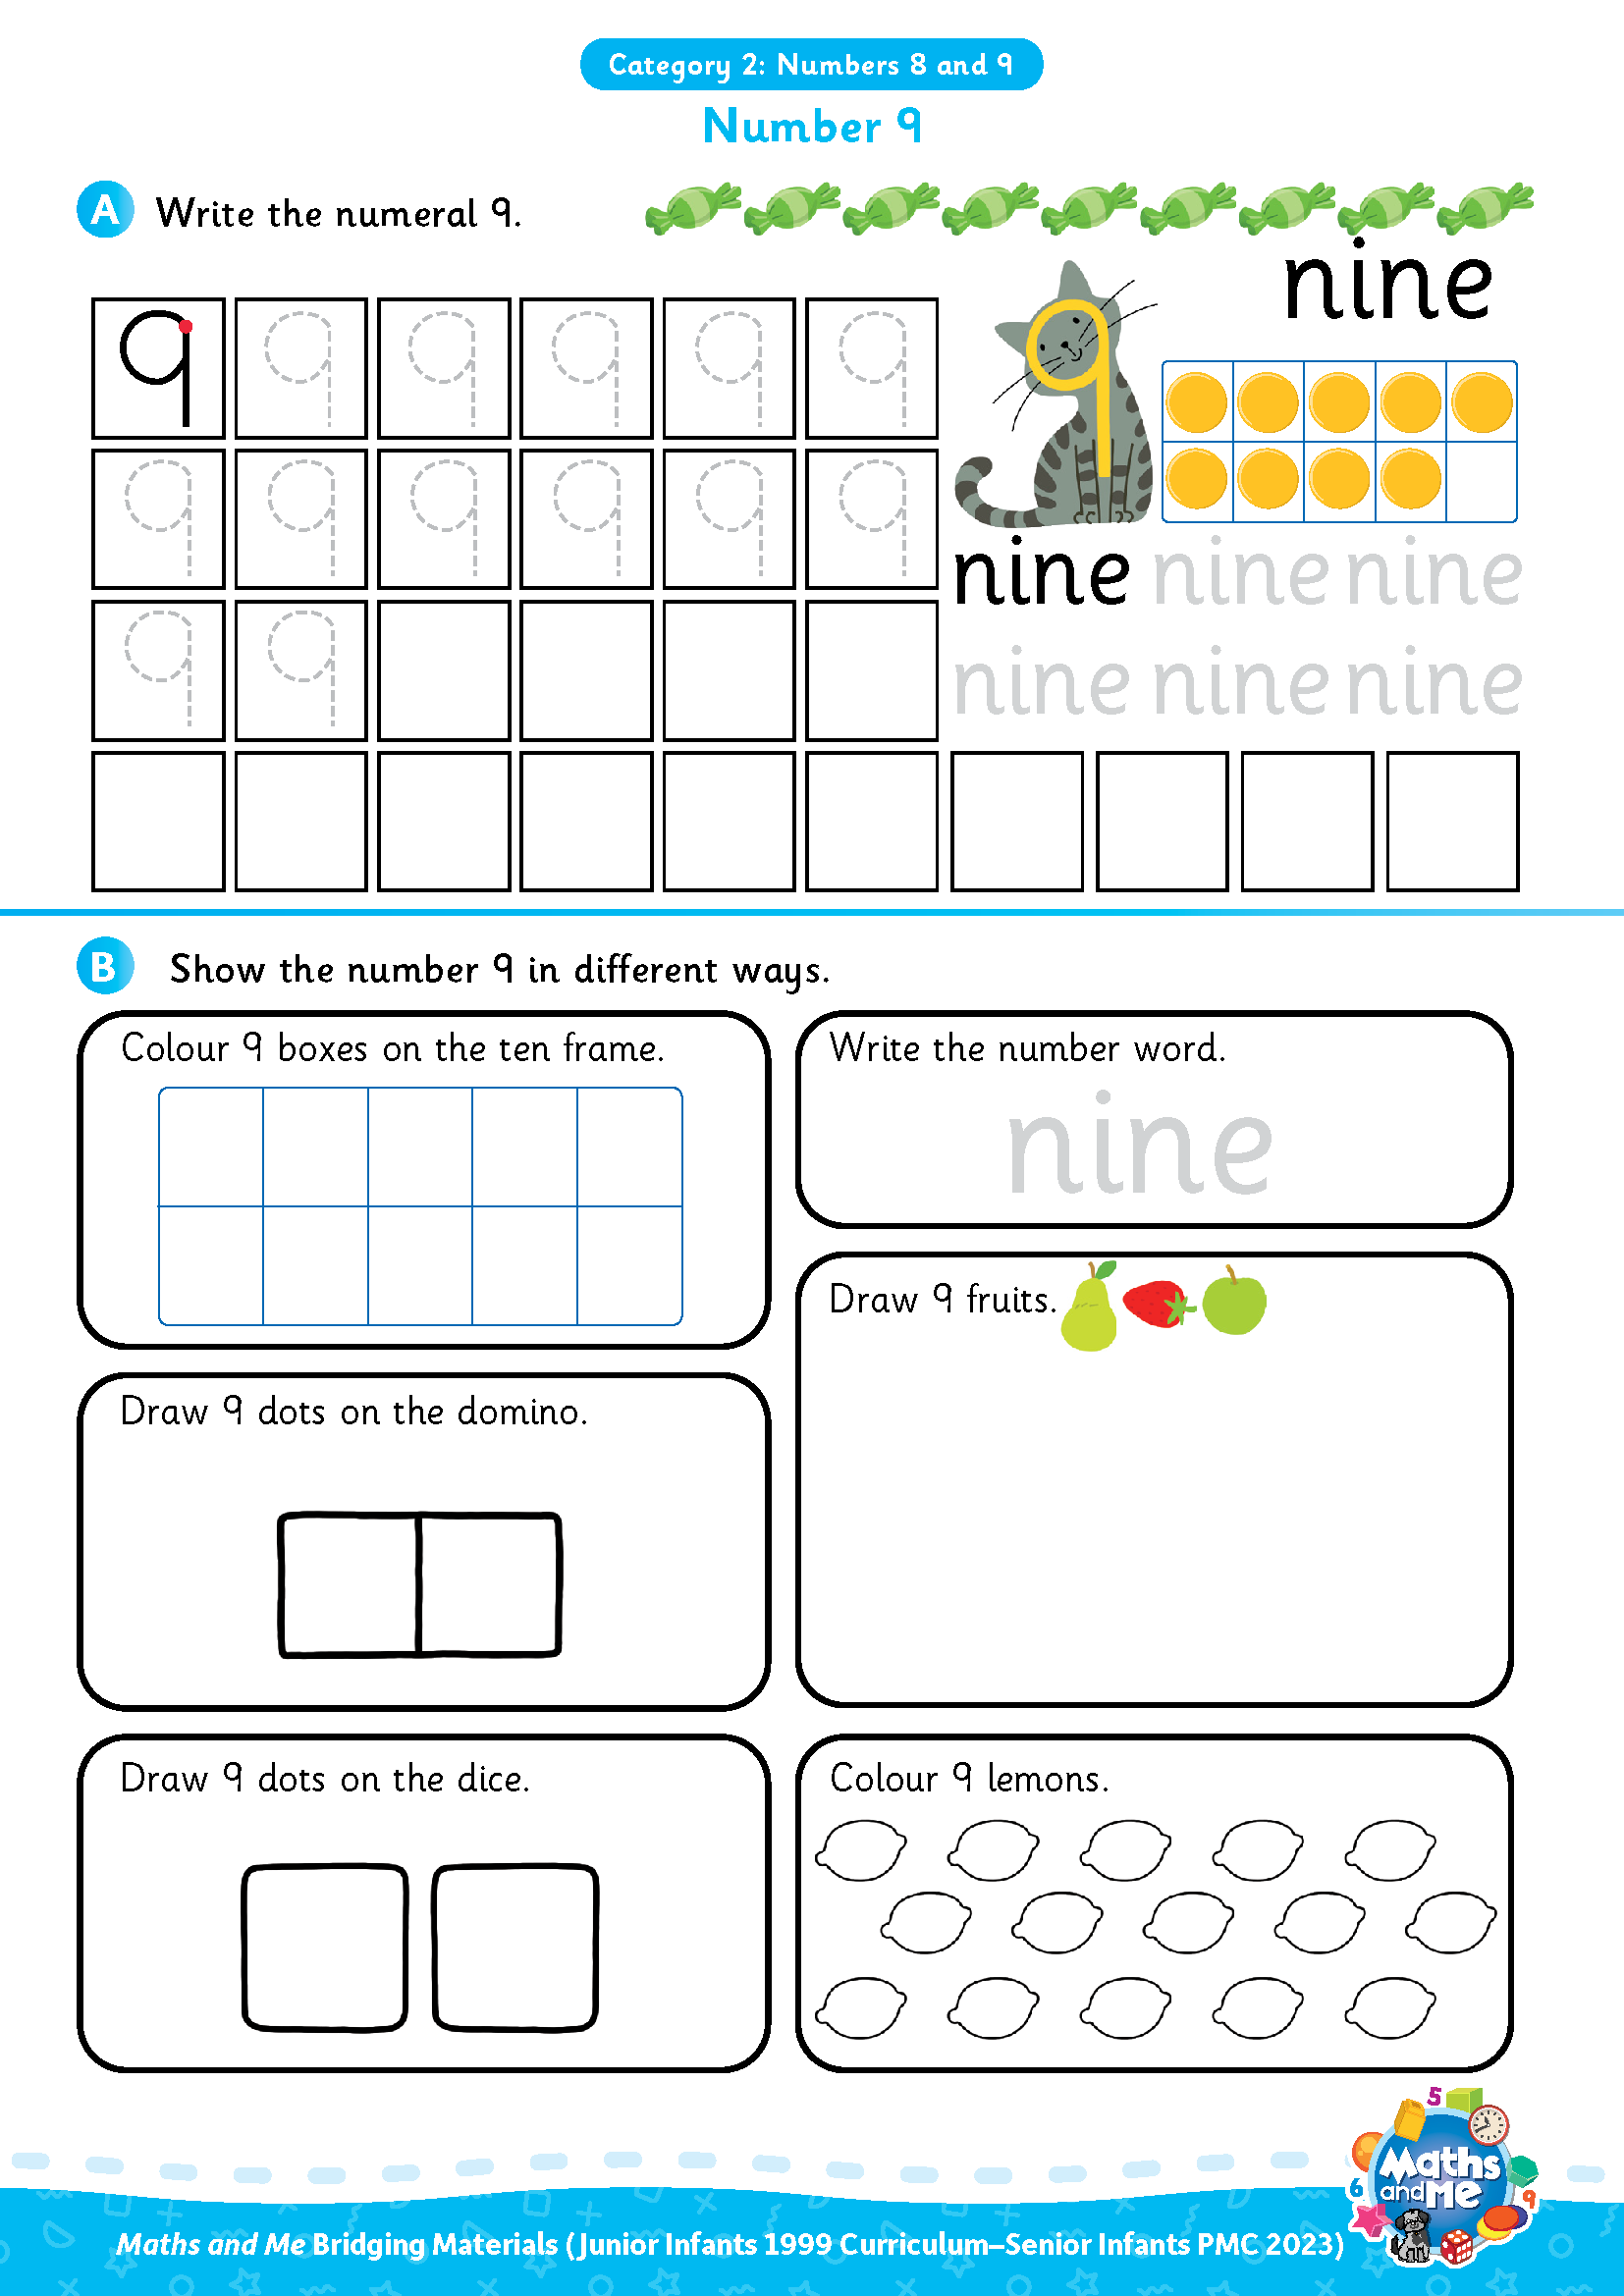
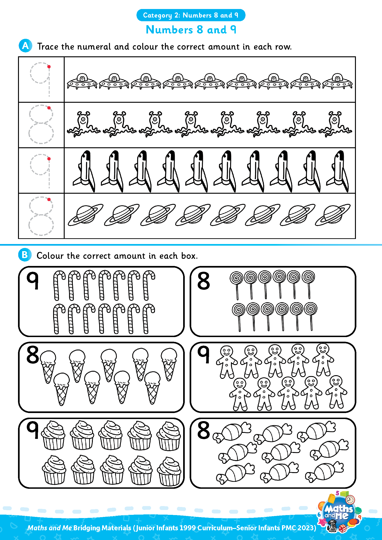
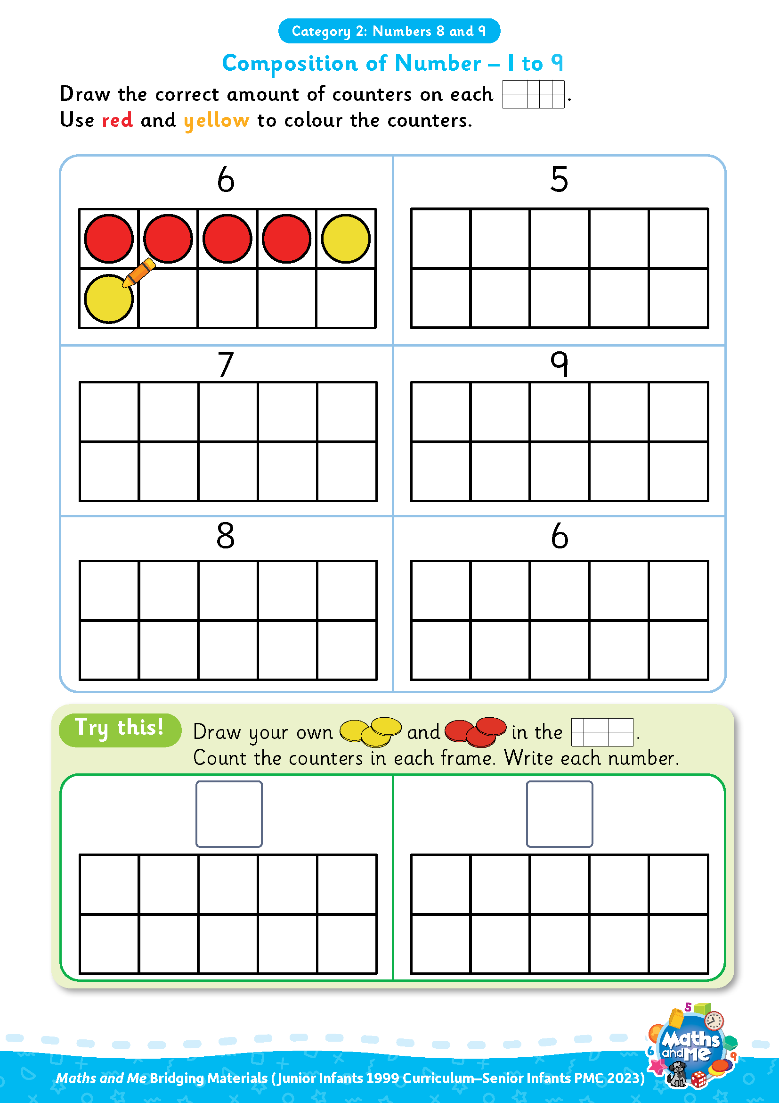
Introduction
This is the second of three presentations prepared to support teachers with the transition to the PMC. It covers Numbers 8 and 9.
Activity sheets are also available on Edco Learning to support this category.
Use these slides as they are or edit them to suit the needs of your class.

Slide 4
Rationale
These resources have been selected to offer children a gentle introduction to the numbers 8 and 9, which they may not have encountered formally in their current Junior Infants maths book. The resources will make them more prepared for the Maths and Me Senior Infants programme.
That said, it is not essential that teachers use these materials prior to starting the Maths and Me Senior Infant programme. The content of Maths and Me for Senior Infants has been carefully considered to provide cohesive and structured learning experiences for the children, that are also playful and engaging. When in Senior Infants, the numbers 8 and 9 will be constantly revised and consolidated alongside new learning.

Slide 5
Rationale
The low-threshold, high-ceiling approach that typifies Maths and Me is designed to support children and enable them to comfortably work with numbers outside the traditional number limits.
Ultimately, at the end of the Maths and Me Senior Infants programme, we are confident that the children will be much more capable and confident mathematicians!

Slide 6
Counting & Numeration

Slide 7
Counting & Numeration
0 | 1 | 2 | 3 | 4 | 5 | 6 | 7 | 8 | 9 | 10
Count forwards
Count backwards
Count forwards and clap hands
Count backwards and stamp feet

Slide 8
Counting & Numeration
0 | 1 | 2 | 3 | 4 | 5 | 6 | 7 | 8 | 9 | 10
Count forwards to 8
Count backwards from 8
Clap hands 8 times
Stamp feet 8 times
Slap knees 8 times

Slide 9
Counting & Numeration
0 | 1 | 2 | 3 | 4 | 5 | 6 | 7 | 8 | 9 | 10
Count forwards to 9
Count backwards from 9
Clap hands 9 times
Stamp feet 9 times
Slap knees 9 times

Slide 10
Counting & Numeration
0 | 1 | 2 |  | 4 | 5 | 6 | 7 | 8 | 9 | 10
What is missing?

Slide 11
Counting & Numeration
0 | 1 | 2 | 3 | 4 | 5 | 6 | 7 | 8 | 9 | 10
What is missing?

Slide 12
Counting & Numeration
0 | 1 | 2 | 3 | 4 | 5 |  | 7 | 8 | 9 | 10
What is missing?

Slide 13
Counting & Numeration
0 | 1 | 2 | 3 | 4 | 5 | 6 | 7 | 8 | 9 | 10
What is missing?

Slide 14
Counting & Numeration
0 |  | 2 | 3 | 4 | 5 | 6 | 7 | 8 | 9 | 10
What is missing?

Slide 15
Counting & Numeration
0 | 1 | 2 | 3 | 4 | 5 | 6 | 7 | 8 | 9 | 10
What is missing?

Slide 16
Counting & Numeration
0 | 1 | 2 | 3 | 4 | 5 | 6 | 7 |  | 9 | 10
What is missing?

Slide 17
Counting & Numeration
0 | 1 | 2 | 3 | 4 | 5 | 6 | 7 | 8 | 9 | 10
What is missing?

Slide 18
Counting & Numeration
0 | 1 | 2 | 3 | 4 | 5 | 6 | 7 | 8 |  | 10
What is missing?

Slide 19
Counting & Numeration
0 | 1 | 2 | 3 | 4 | 5 | 6 | 7 | 8 | 9 | 10
What is missing?

Slide 20
Counting & Numeration
0 | 1 | 2 | 3 | 4 | 5 | 6 | 7 | 8 | 9 | 10
Put something on the number after __
Put something on the number before __
Put something between __ and __
Needed: number path per child (0-10 or 0-20 number path)
Notes:
Needed: number path per child (0-10 or 0-20 number path)

Slide 21

Using Fingers to Grow, Show, Throw…
Grow 8: Put 8 fingers up, one at a time, counting as you go.
Show 8: Put up 8 fingers at once.
Throw 8: Throw 8 fingers forward quickly!
Bunny Ears Grow 8: Put 8 fingers up, behind your head, one at a time, counting as you go.
Bunny Ears Show 8: Put up 8 fingers, behind your head, at once.
Adapted from: https://www.ncetm.org.uk/features/cardinality-and-number-sense/
Notes:
Can be repeated with other numbers

Slide 22
Using Fingers to Grow, Show, Throw…
Grow 9: Put 9 fingers up, one at a time, counting as you go.
Show 9: Put up 9 fingers at once.
Throw 9: Throw 9 fingers forward quickly!
Bunny Ears Grow 9: Put 9 fingers up, behind your head, one at a time, counting as you go.
Bunny Ears Show 9: Put up 9 fingers, behind your head, at once.
Adapted from: https://www.ncetm.org.uk/features/cardinality-and-number-sense/
Notes:
Can be repeated with other numbers

Slide 23
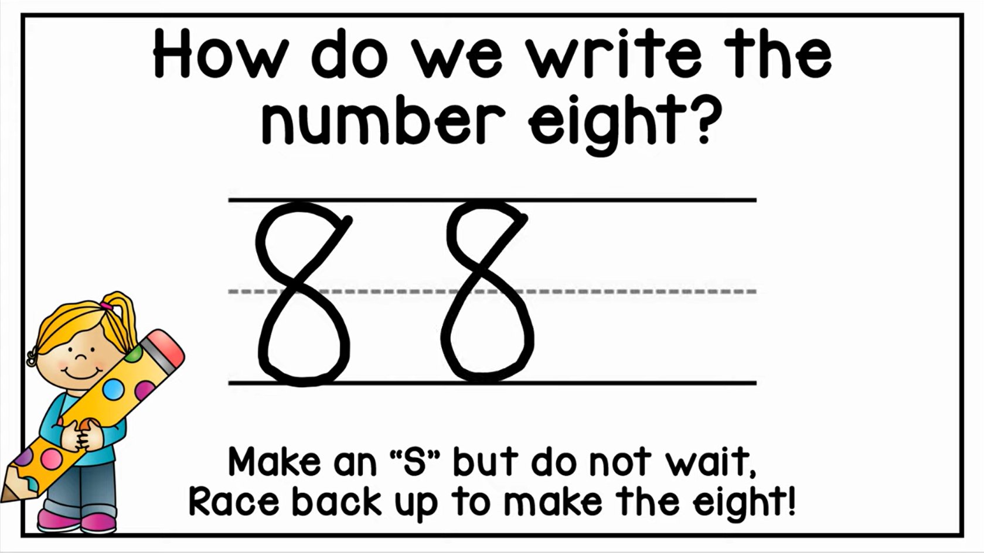
Video: How to Write the Number 8
edco.ie/wn84

Slide 24
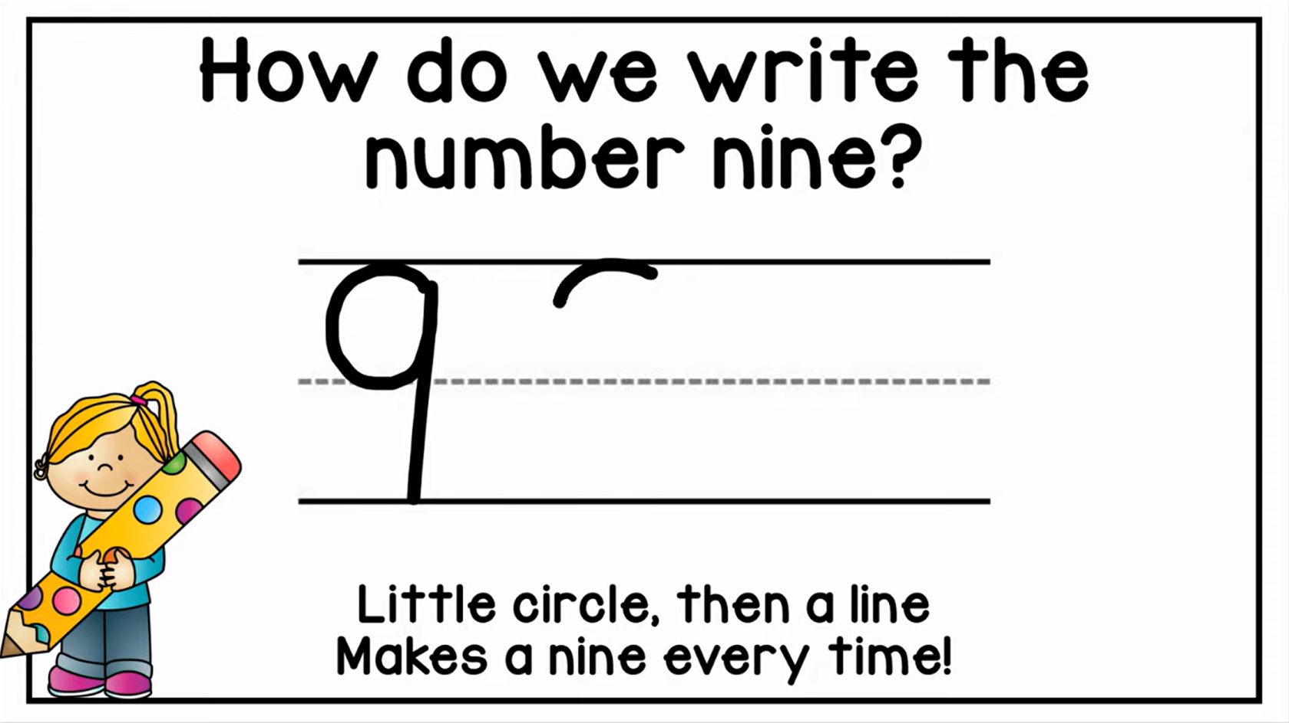
Video: How to Write the Number 9
edco.ie/7drb

Slide 25
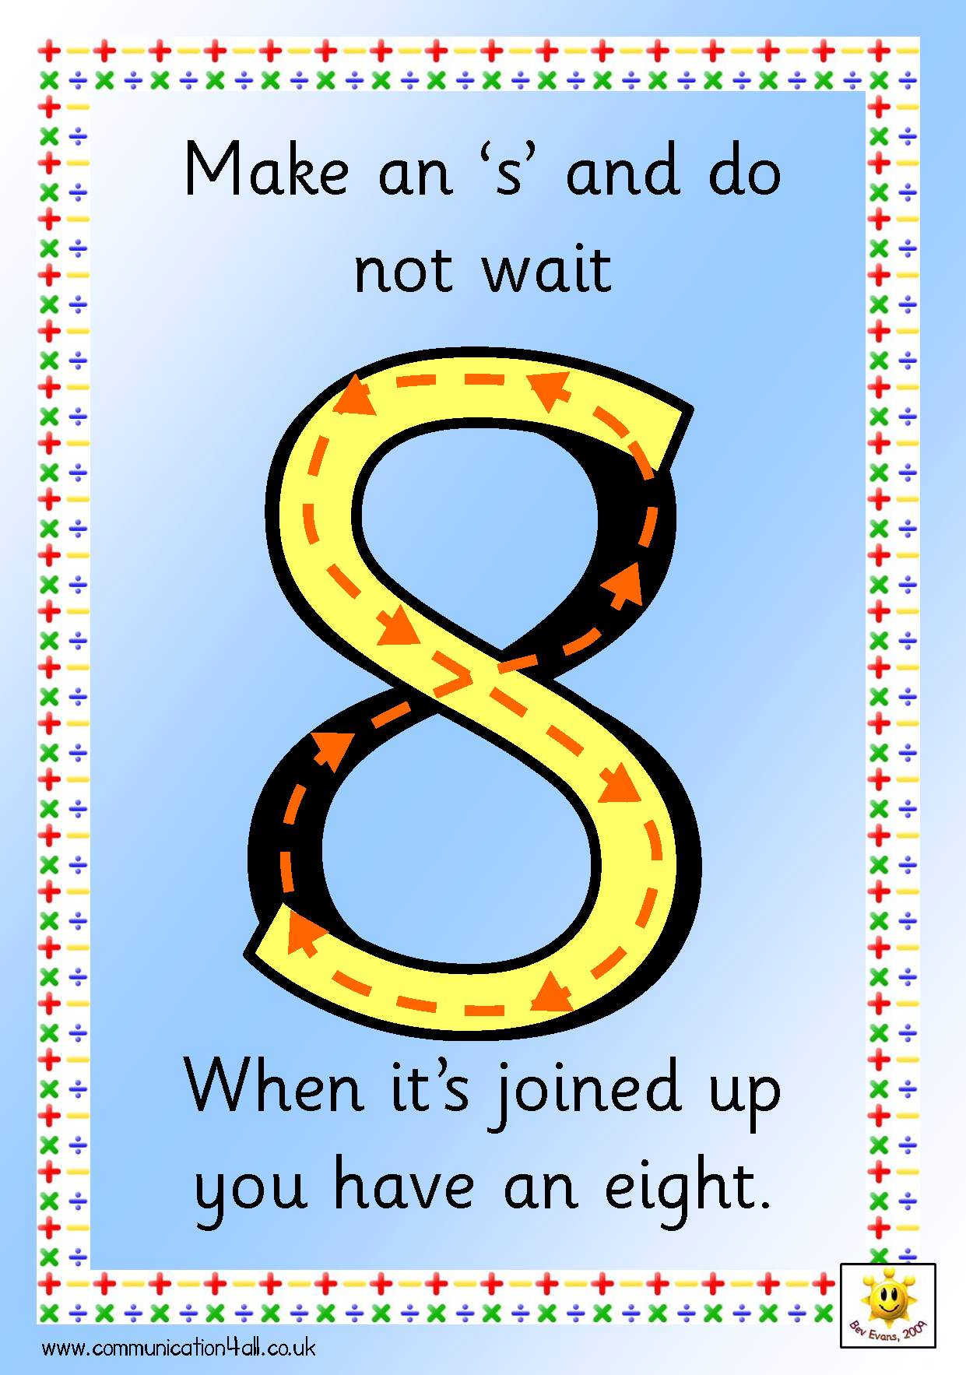
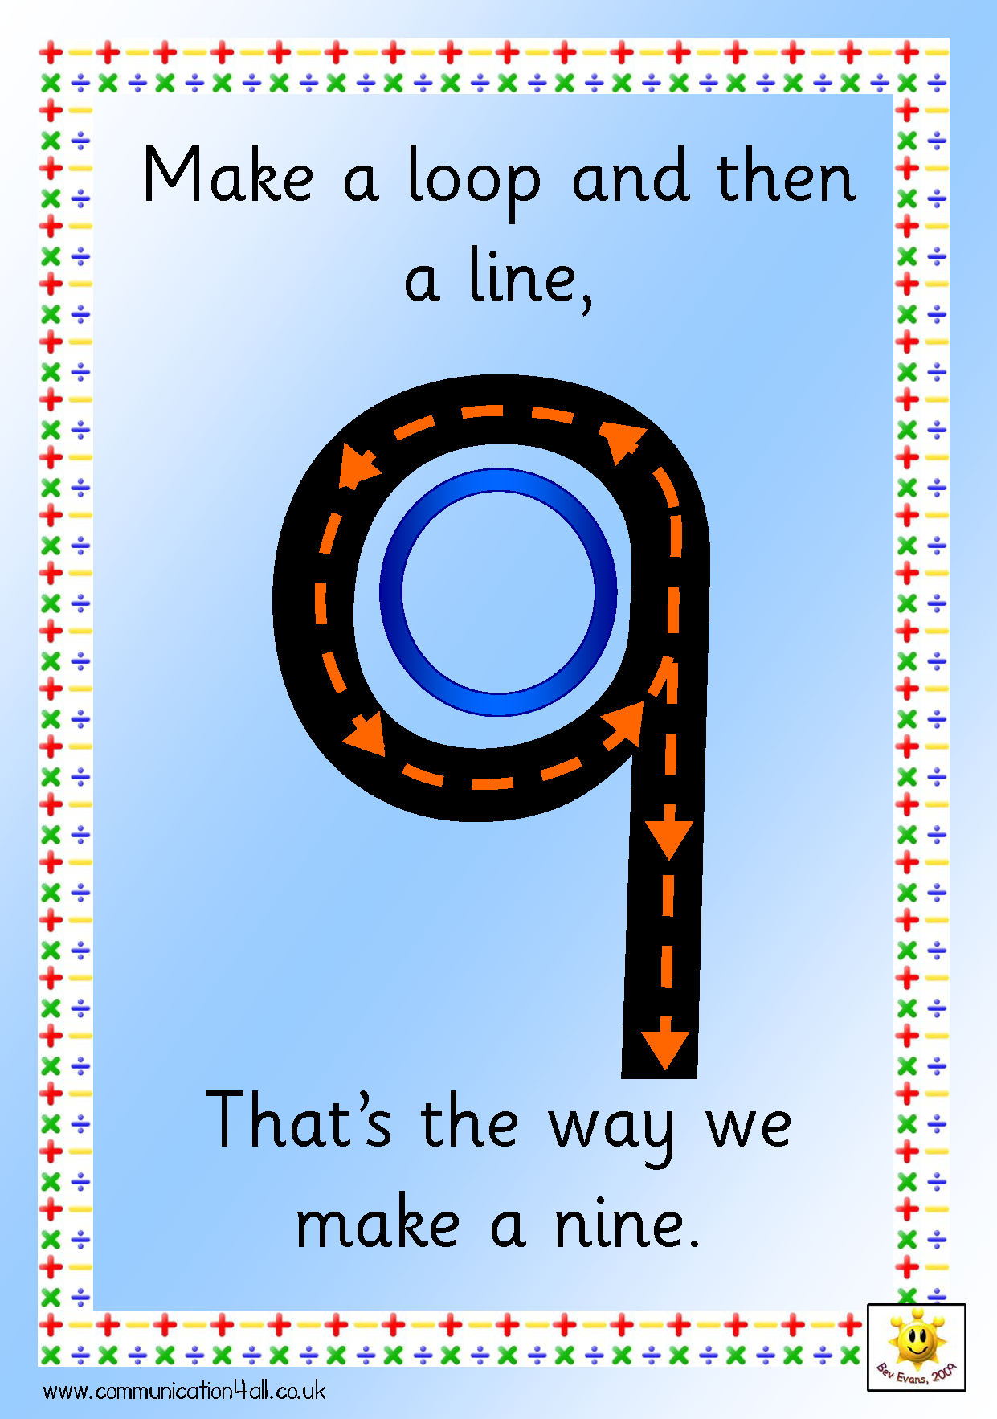
Make the Numeral in the Air
Source: http://www.communication4all.co.uk/http/numeracynew.htm
Notes:
Make the numeral in the air
Set of A4 poster of all numerals (like above) available to download from http://www.communication4all.co.uk/http/numeracynew.htm

Slide 26
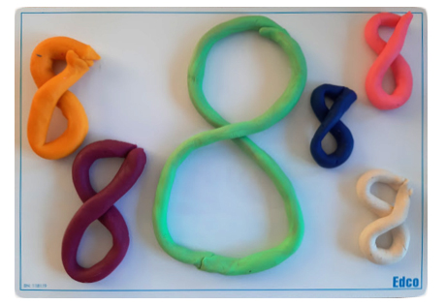
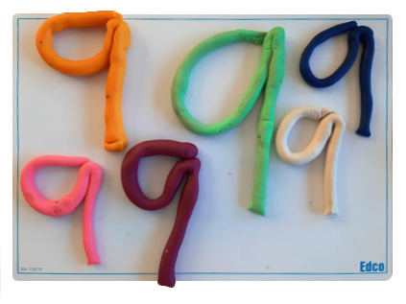
Play Dough: Make the Numeral

Slide 27
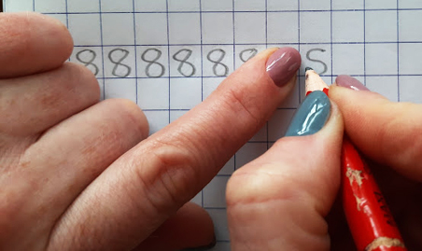
In Your Copy: Make the Numeral 8
Make an “s”… Join it up
Notes:
For right-handed writers only

Slide 28
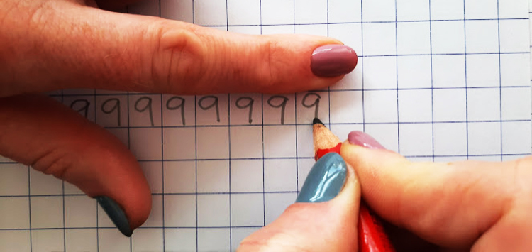
In Your Copy: Make the Numeral 9
Make a loop and then a line…
Notes:
For right-handed writers only

Slide 29

Interactive Web Activity
Today's Number Up to 20 | edco.ie/px4d

Slide 30
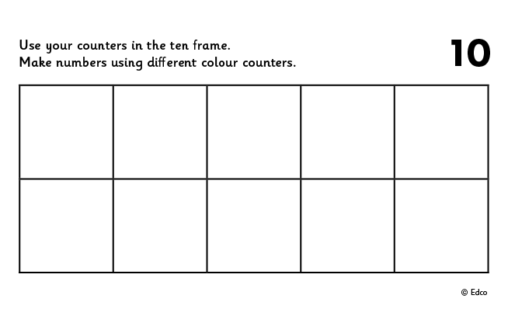
10 Frame
Put 8 in the frame.
How many on the top row?
How many on the bottom row?
Put 8 in the frame a different way.
If I take away ___ how many will be left?
Put __ in the frame. How many more to make 8?
Put 8 in the frame. How many do I need to take away to leave __?

Slide 31
10 Frame
Put 9 in the frame.
How many on the top row?
How many on the bottom row?
Put 9 in the frame a different way.
If I take away ___ how many will be left?
Put __ in the frame. How many more to make 9?
Put 9 in the frame. How many do I need to take away to leave __?

Slide 32
10 Frame
Now stand the frame up tall and put 8 in the frame. Fill from the bottom left.
How many on the left?
How many on the right?
Arrange 8 in the frame in a different way.
If I take away ___ how many will be left?
Put __ in the frame. How many more to make 8?
Put 8 in the frame. How many do I need to take away to leave __?

Slide 33
10 Frame
Now stand the frame up tall and put 9 in the frame. Fill from the bottom left.
How many on the left?
How many on the right?
Arrange 9 in the frame in a different way.
If I take away ___ how many will be left?
Put __ in the frame. How many more to make 9?
Put 9 in the frame. How many do I need to take away to leave __?

Slide 34

Clapping
Listen to me clap
How many times did I clap? Show me with your fingers.
How many times did I clap? Show me with your frame and counters.
How many times did I clap? Show me on your number fan.
How many times did I clap? Write the numeral on your MWB.

Slide 35
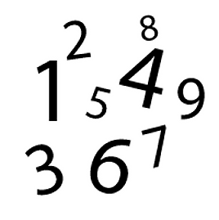
Sound of a Number
Listen to me drop coins into this tin.
How many coins did I drop in? Show me with your fingers
How many coins did I drop in? Show me with your frame and counters
How many coins did I drop in? Show me on your number fan
How many coins did I drop in? Write the numeral on your MWB

Slide 36
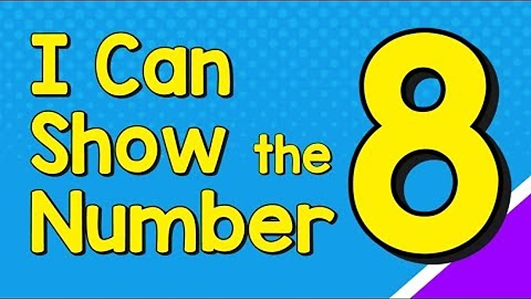
Video: I Can Show the Number 8
edco.ie/bf5r

Slide 37
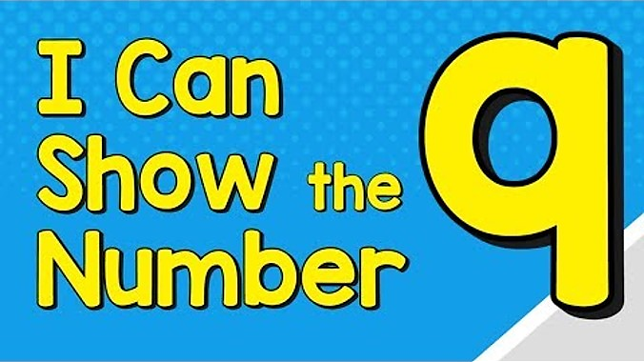
Video: I Can Show the Number 9
edco.ie/rqmk

Slide 38
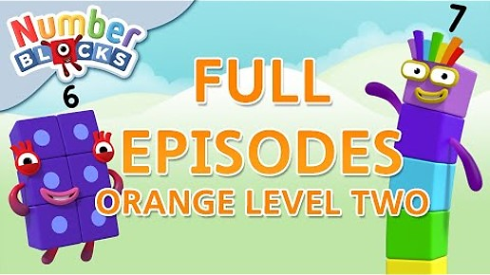
Video: Orange Level Two | Full Episodes 1-3
edco.ie/mspz
Notes:
Numberblocks Season 2:
Episode 1: Six
Episode 2: Seven
Episode 3: Eight
https://www.ncetm.org.uk/classroom-resources/ey-numberblocks-series-2/

Slide 39
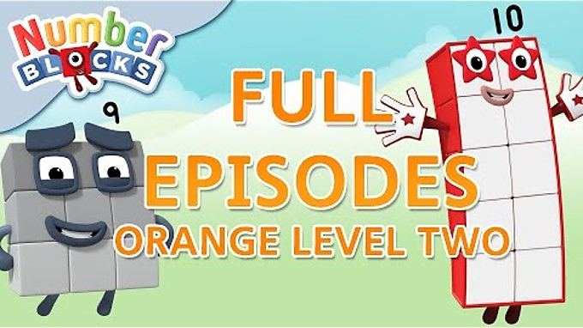
Video: Orange Level Two | Full Episodes 4-6
edco.ie/zbxu
Notes:
Numberblocks Season 2:
Episode 4: Nine
Episode 5: Ten
Episode 6: Just add 1
https://www.ncetm.org.uk/classroom-resources/ey-numberblocks-series-2/

Slide 40
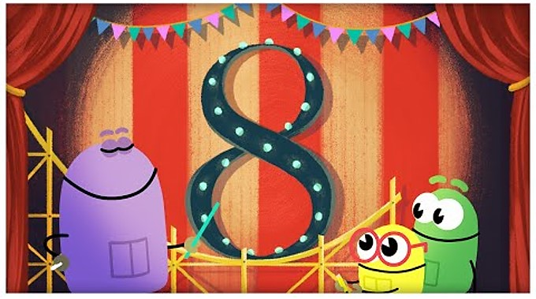
Video: The Number Eight
edco.ie/zqse

Slide 41
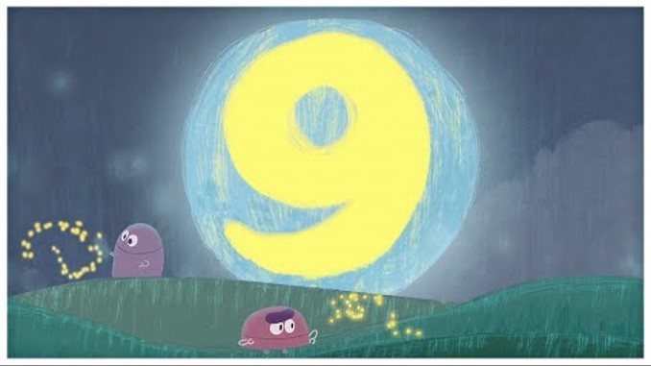
Video: The Number Nine
edco.ie/jucs

Slide 42
Picture Books & Read Alouds

Slide 43

Picture Books & Read Alouds via Internet Archive
There are many counting and number related books on https://archive.org
This is an online digital library/archive that is free to access. Just click on the link, register/log in for FREE, and then simply "borrow" the required book for an hour. After an hour you can choose to borrow it again if required.

Slide 44
Picture Books & Read Alouds
Anno’s Counting Book by Mitsumasa Anno
Downloadable at edco.ie/cfyz
Suitable for Junior Infants and Senior Infants
This book takes the reader on a journey through the four seasons of the year with numbers 1 to 12.
Numbers are represented by numerals, cubes and many sets of objects in the beautiful scenes depicted in this wordless counting book.
Notes:
https://earlymath.erikson.edu/numbers-and-fun-with-annos-counting-book-best-preschool-books-for-math/
https://earlymath.erikson.edu/different-uses-numbers-annos-counting-book/

Slide 45
Picture Books & Read Alouds
My Eight Book and My Nine Book by Jane Belk Moncure
Downloadable at edco.ie/bqyk and edco.ie/k92m
Suitable for Junior Infants and Senior Infants
A series of books where each one introduces the concept of the title number by interacting with that amount of a variety of things, some of which are grouped and regrouped to demonstrate adding and subtracting.

Slide 46
Picture Books & Read Alouds
Eight Silly Monkeys by Steve Haskamp
Downloadable at edco.ie/89ac
Suitable for Junior Infants and Senior Infants
A picture book version of the popular counting down song/rhyme ‘No more monkeys jumping on the bed!’

Slide 47
Picture Books & Read Alouds
Nine Town by Nadia Higgins
Downloadable at edco.ie/buds
Suitable for Junior Infants and Senior Infants
A series of books where each one tells the story of a town dedicated to the title number.

Slide 48
Picture Books & Read Alouds
Nine Ducks Nine by Sarah Hayes
Downloadable at edco.ie/82tz
Suitable for Junior Infants and Senior Infants
Intimidated by Fox, nine ducks leave, one-by-one, only to all return at the end when Fox gets his comeuppance.

Slide 49
Games

Slide 50
Pair Game: Tower Splits!
Needed: 8 cubes and tokens (could be counters, links, paperclips, etc.)
Player A makes a tower of 8 cubes.
Player B closes their eyes and calls SPLIT!
Player A splits the tower in 2 parts and hides one part behind their back.
Player B looks at the part of the tower they can see and says how many cubes are hidden. If correct, Player B takes a token.
Swap roles and keep playing until time is up.
The winner is the person with the most tokens when the time is up.

Slide 51
Pair Game: Tower Splits!
Needed: 9 cubes and tokens (could be counters, links, paperclips, etc.)
Player A makes a tower of 9 cubes.
Player B closes their eyes and calls SPLIT!
Player A splits the tower in 2 parts and hides one part behind their back.
Player B looks at the part of the tower they can see and says how many cubes are hidden. If correct, Player B takes a token.
Swap roles and keep playing until time is up.
The winner is the person with the most tokens when the time is up.

Slide 52
Pair Game: Chain Splits!
Needed: 8 links and tokens (could be counters, cubes, paperclips, etc.)
Player A makes a chain of 8 links.
Player B closes their eyes and calls SPLIT!
Player A splits the chain in 2 parts and hides one part behind their back.
Player B looks at the part of the chain they can see and says how many links are hidden. If correct, Player B takes a token.
Swap roles and keep playing until time is up.
The winner is the person with the most tokens when the time is up.

Slide 53
Pair Game: Chain Splits!
Needed: 9 links and tokens (could be counters, cubes, paperclips, etc.)
Player A makes a chain of 9 links.
Player B closes their eyes and calls SPLIT!
Player A splits the chain in 2 parts and hides one part behind their back.
Player B looks at the part of the chain they can see and says how many links are hidden. If correct, Player B takes a token.
Swap roles and keep playing until time is up.
The winner is the person with the most tokens when the time is up.

Slide 54
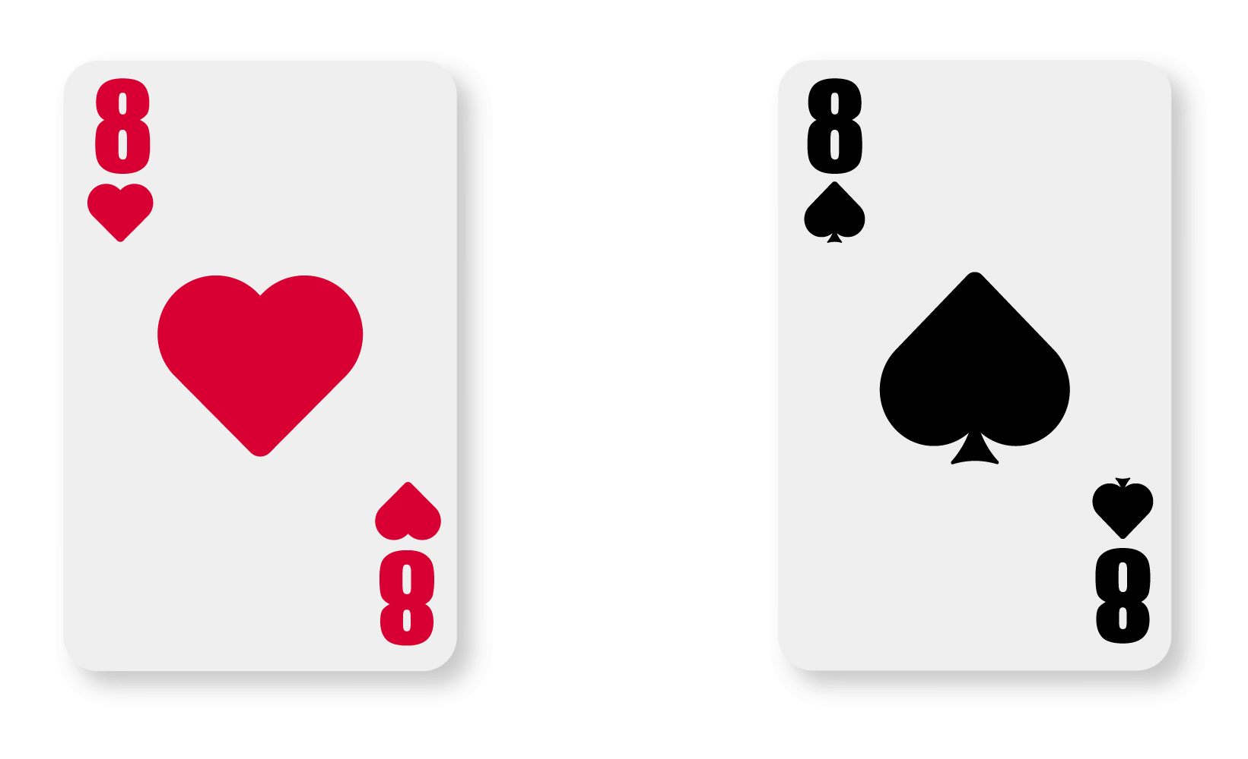

Play Memory
If you turn over two 8s or two 9s, you get a bonus go!

Slide 55
Image Credits
Shutterstock

