Slide 1
Let’s Investigate Drinks!

Slide 2
Let’s investigate – Fermi Question – What drinks to buy?
Please see section on Fermi Questions in TRB if you are not familiar with them.
There are 3 different levels of difficulty: Level 1 (recommended for most), 2 and 3 (if the total number of children in your school is smaller and/or within competence range of children in the class)
There are 2 different versions of each slide, depending on whether the principal is male or female.
 | Male principal | Female Principal
Level 1 | Slide 2 | Slide 3
Level 2 | Slide 4 | Slide 5
Level 3 | Slide 6 | Slide 7

Slide 3
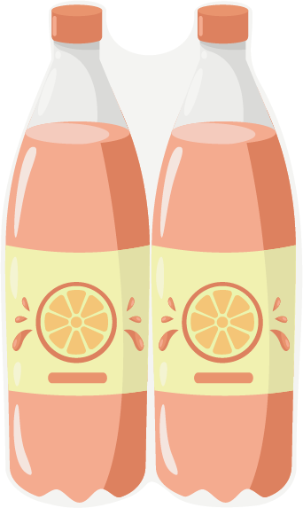
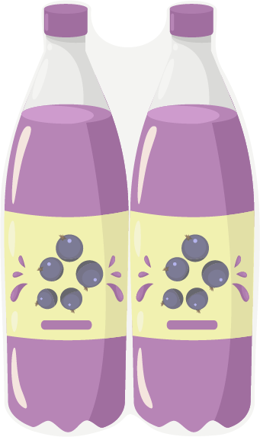
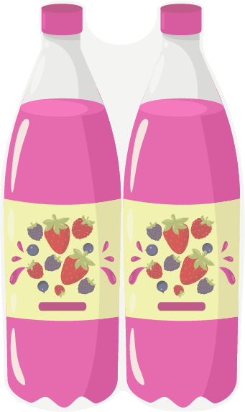
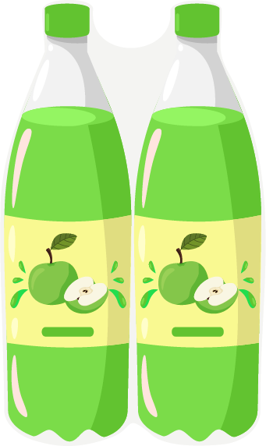
The principal wants our advice.
He wants to buy drinks for all the children in the school.
He only wants to buy 4 different types of drinks.
What 4 drinks do you think he should buy?
What drink should he buy the most of?
What drink should he buy the least of?
water | orange | blackcurrant | summer fruits | apple

Slide 4
The principal wants our advice.
She wants to buy drinks for all the children in the school.
She only wants to buy 4 different types of drinks.
What 4 drinks do you think she should buy?
What drink should she buy the most of?
What drink should she buy the least of?
water | orange | blackcurrant | summer fruits | apple

Slide 5
The principal wants our advice.
He wants to buy drinks for all the children in the school.
He only wants to buy 4 different types of drinks.
What 4 drinks do you think he should buy?
How many of each type should he buy?
water | orange | blackcurrant | summer fruits | apple

Slide 6
The principal wants our advice.
She wants to buy drinks for all the children in the school.
She only wants to buy 4 different types of drinks.
What 4 drinks do you think she should buy?
How many of each type should she buy?
water | orange | blackcurrant | summer fruits | apple

Slide 7
The principal wants our advice.
He wants to buy drinks for all the children in the school.
He only wants to buy 4 different types of drinks.
What and how many do you think he should buy?
water | orange | blackcurrant | summer fruits | apple

Slide 8
The principal wants our advice.
She wants to buy drinks for all the children in the school.
She only wants to buy 4 different types of drinks.
What and how many do you think she should buy?
water | orange | blackcurrant | summer fruits | apple

