Slide 2
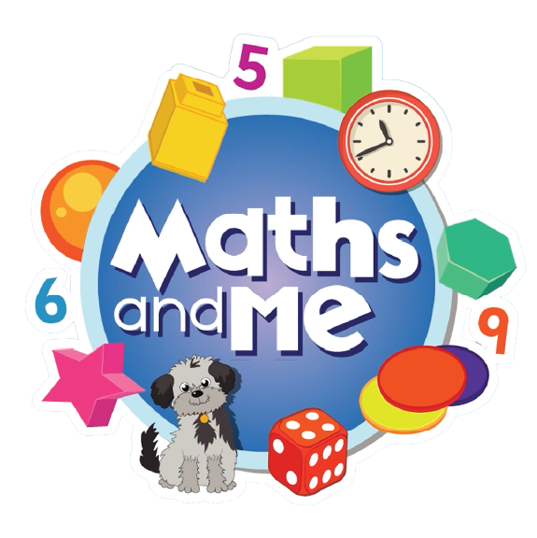
Contents
How to Use These Slides
Rationale
Counting & Numeration
Picture Books & Read Alouds
Games

Slide 3
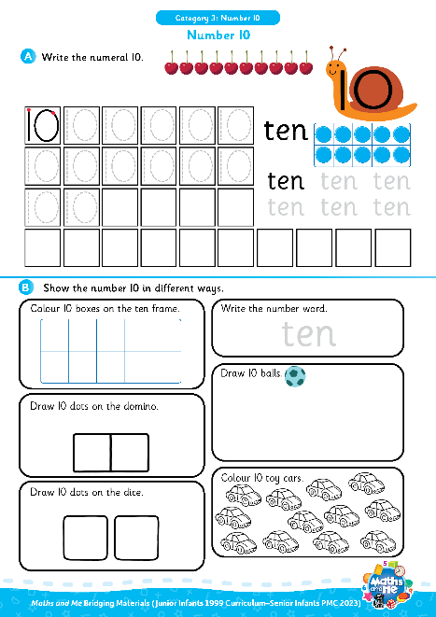
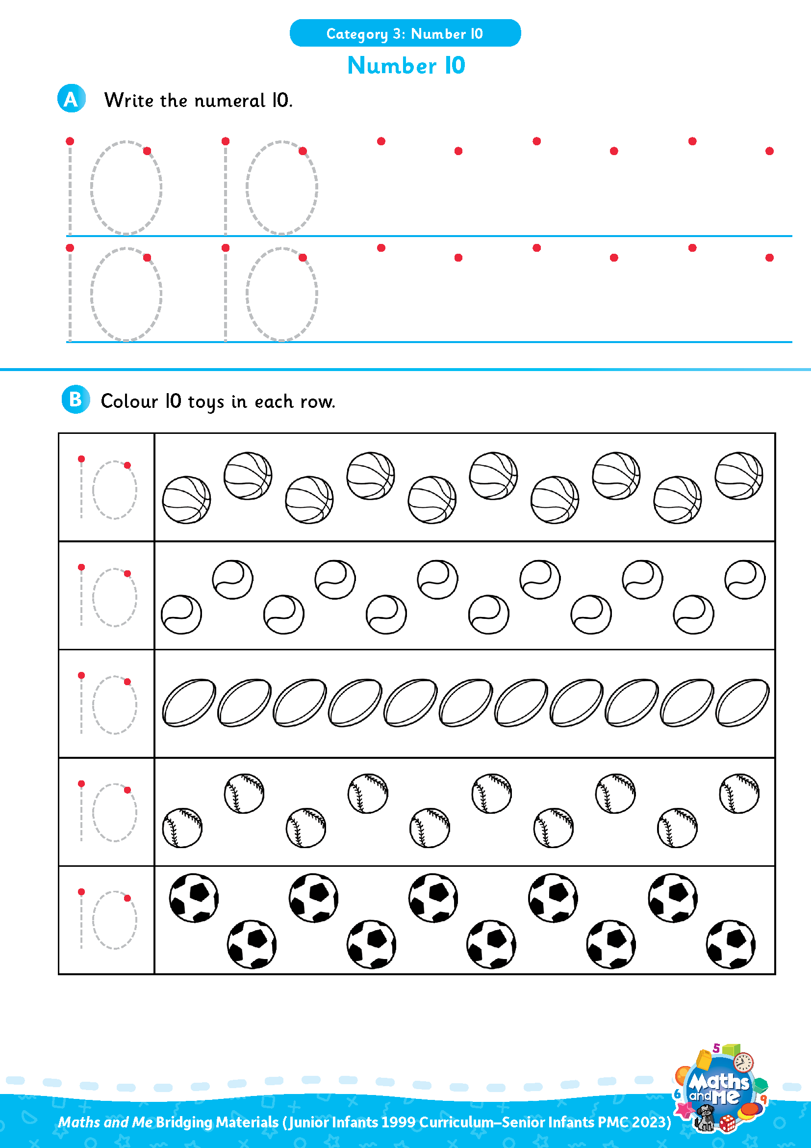
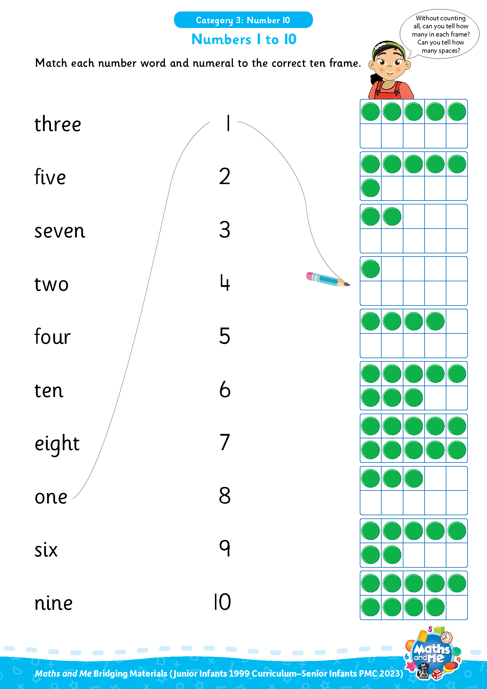
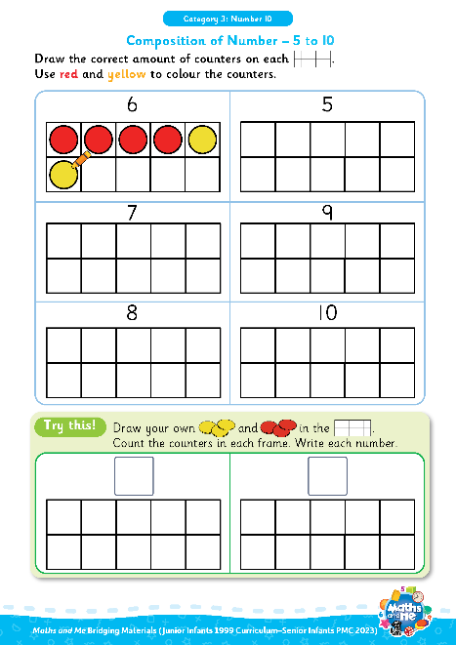
Introduction
This is the first of three presentations prepared to support teachers with the transition to the PMC. It covers Number 10.
Activity sheets are also available on Edco Learning to support this category.
Use these slides as they are or edit them to suit the needs of your class.

Slide 4
Rationale
These resources have been selected to offer children a gentle introduction to the number 10, which they may not have encountered formally in their current Junior Infants maths book. The resources will make them more prepared for the Maths and Me Senior Infants programme.
That said, it is not essential that teachers use these materials prior to starting the Maths and Me Senior Infant programme. The content of Maths and Me for Senior Infants has been carefully considered to provide cohesive and structured learning experiences for the children, that are also playful and engaging. When in Senior Infants, the number 10 will be constantly revised and consolidated alongside new learning.

Slide 5

Rationale
The low-threshold, high-ceiling approach that typifies Maths and Me is designed to support children and enable them to comfortably work with numbers outside the traditional number limits.
Ultimately, at the end of the Maths and Me Senior Infants programme, we are confident that the children will be much more capable and confident mathematicians!

Slide 6
Counting & Numeration

Slide 7

Digital Activity: Forwards and Backwards
edco.ie/9h7a

Slide 8
Counting & Numeration
0 | 1 | 2 | 3 | 4 | 5 | 6 | 7 | 8 | 9 | 10
Count forwards
Count backwards
Count forwards and clap hands
Count backwards and stamp feet

Slide 9
Counting & Numeration
0 | 1 | 2 | 3 | 4 | 5 | 6 | 7 | 8 | 9 | 10
Count forwards to 10
Count backwards from 10
Clap hands 10 times
Stamp feet 10 times
Slap knees 10 times

Slide 10
Counting & Numeration
0 | 1 | 2 | 3 | 4 | 5 |  | 7 | 8 | 9 | 10
What is missing?

Slide 11
Counting & Numeration
0 | 1 | 2 | 3 | 4 | 5 | 6 | 7 | 8 | 9 | 10
What is missing?

Slide 12
Counting & Numeration
0 | 1 | 2 | 3 | 4 | 5 | 6 | 7 |  | 9 | 10
What is missing?

Slide 13
Counting & Numeration
0 | 1 | 2 | 3 | 4 | 5 | 6 | 7 | 8 | 9 | 10
What is missing?

Slide 14
Counting & Numeration
0 | 1 | 2 | 3 | 4 | 5 | 6 | 7 | 8 | 9
What is missing?

Slide 15
Counting & Numeration
0 | 1 | 2 | 3 | 4 | 5 | 6 | 7 | 8 | 9 | 10
What is missing?

Slide 16
Counting & Numeration
0 | 1 | 2 | 3 | 4 | 5 | 6 | 7 | 8 | 9 | 10
Put something on the number after __
Put something on the number before __
Put something between __ and __
Needed: number path per child (0-10 or 0-20 number path)
Notes:
Needed: number path per child (0-10 or 0-20 number path)

Slide 17

Video: Caught a Fish Alive

Slide 18

Video: Ten Green Bottles

Slide 19

Using Fingers to Grow, Show, Throw…
Grow 10: Put 10 fingers up, one at a time, counting as you go.
Show 10: Put up 10 fingers at once.
Throw 10: Throw 10 fingers forward quickly!
Bunny Ears Grow 10: Put 10 fingers up, behind your head, one at a time, counting as you go.
Bunny Ears Show 10: Put up 10 fingers, behind your head, at once.
Adapted from: https://www.ncetm.org.uk/features/cardinality-and-number-sense/
Notes:
Can be repeated with other numbers

Slide 20



Number Patterns
4
5
6
What number comes next?
Notes:
Needed: number path per child (0-10 or 0-20 number path)

Slide 21
Number Patterns
4
5
6
7
What number comes next?
Notes:
Needed: number path per child (0-10 or 0-20 number path)

Slide 22
Number Patterns
5
6
7
What number comes next?
Notes:
Needed: number path per child (0-10 or 0-20 number path)

Slide 23
Number Patterns
5
6
7
8
What number comes next?
Notes:
Needed: number path per child (0-10 or 0-20 number path)

Slide 24
Number Patterns
6
7
8
What number comes next?
Notes:
Needed: number path per child (0-10 or 0-20 number path)

Slide 25
Number Patterns
6
7
8
9
What number comes next?
Notes:
Needed: number path per child (0-10 or 0-20 number path)

Slide 26
Number Patterns
7
8
9
What number comes next?
Notes:
Needed: number path per child (0-10 or 0-20 number path)

Slide 27
Number Patterns
7
8
9
10
What number comes next?
Notes:
Needed: number path per child (0-10 or 0-20 number path)

Slide 28
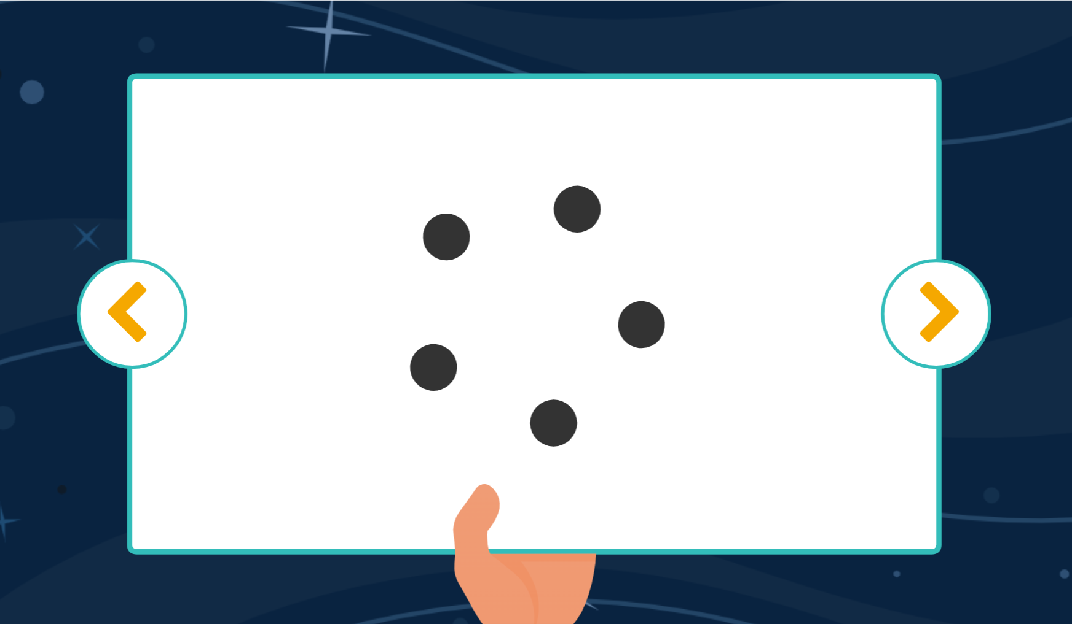
Digital Activity: Dot Patterns
edco.ie/986e

Slide 29
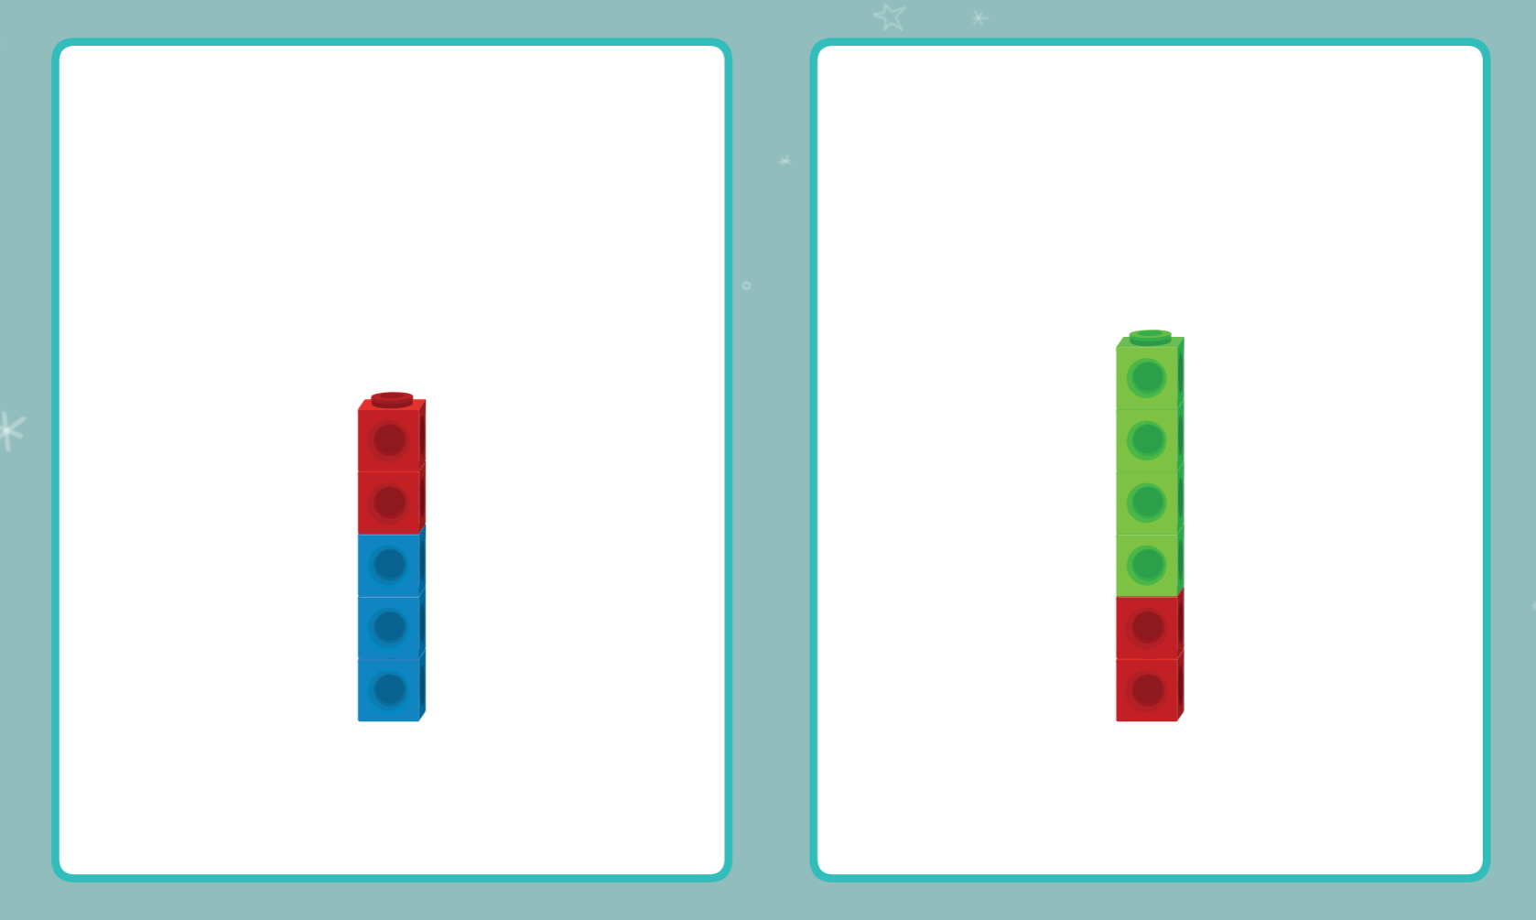
Digital Activity: Comparing Cubes
edco.ie/t8hp

Slide 30
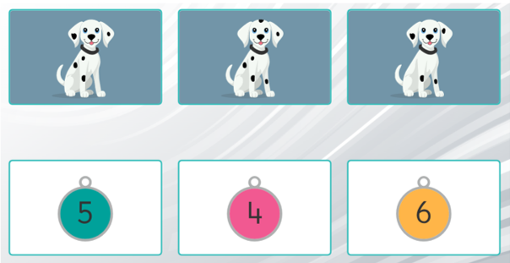
Digital Activity: Matching Numbers to Dots
edco.ie/z5c7

Slide 31
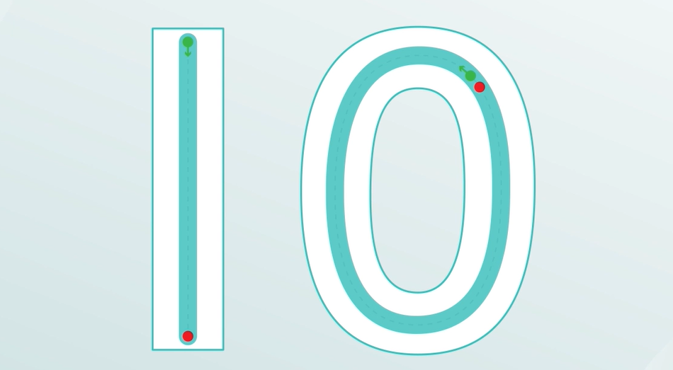
Video: Number Formation – 10
edco.ie/n4xz

Slide 32
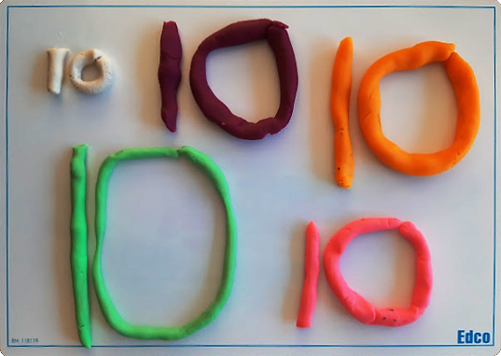
Play Dough: Make the Numeral

Slide 33
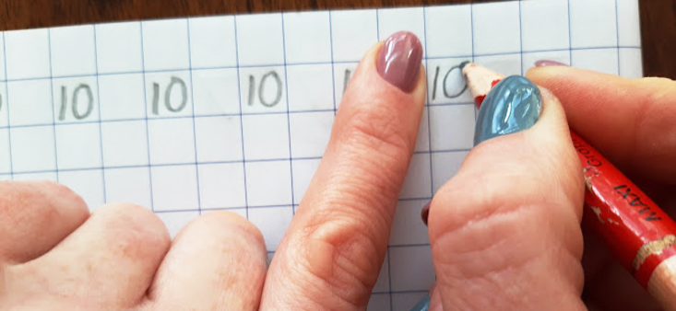
In Your Copy: Make the Numeral 10
First a 1, then a 0
Notes:
For right-handed writers only

Slide 34

Interactive Web Activity
Today's Number Up to 20 | edco.ie/px4d

Slide 35
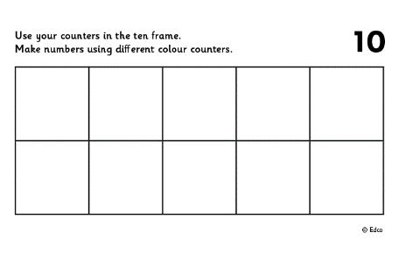
Ten Frame
Put 10 in the frame.
How many on the top row?
How many on the bottom row?
Put 10 in the frame a different way.
If I take away ___ how many will be left?
Put __ in the frame. How many more to make 10?
Put 10 in the frame. How many do I need to take away to leave __?

Slide 36
Ten Frame
Now stand the frame up tall and put 10 in the frame. Fill from the bottom left.
How many on the left?
How many on the right?
Arrange 10 in the frame in a different way.
If I take away ___ how many will be left?
Put __ in the frame. How many more to make 10?
Put 10 in the frame. How many do I need to take away to leave __?

Slide 37

Clapping
Listen to me clap.
How many times did I clap? Show me with your fingers.
How many times did I clap? Show me with your frame and counters.
How many times did I clap? Show me on your number fan.
How many times did I clap? Write the numeral on your MWB.

Slide 38
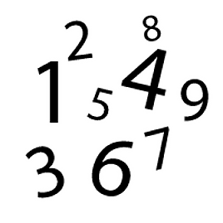
Sound of a Number
Listen to me drop coins into this tin.
How many coins did I drop in? Show me with your fingers.
How many coins did I drop in? Show me with your frame and counters.
How many coins did I drop in? Show me on your number fan.
How many coins did I drop in? Write the numeral on your MWB.

Slide 39
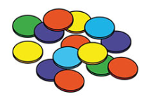
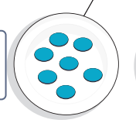
Making Sets of 10
Choose some objects to make
a set.
How many objects are there in your set? How do you know?
Can you make a set of 10? How did you make a set of 10? How do you know that there are 10 objects in your set?
Count the objects in your set. Put your objects in a line.
How many are there?
Needed: manipulatives (bears, counters, beads, links and interlocking cubes)

Slide 40
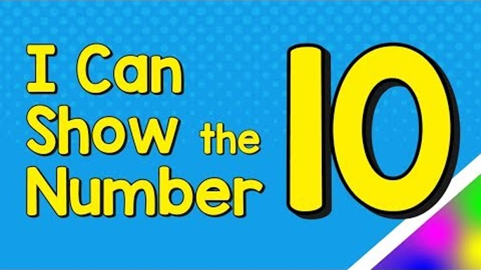
Video: I Can Show the Number 10
edco.ie/pn57

Slide 41
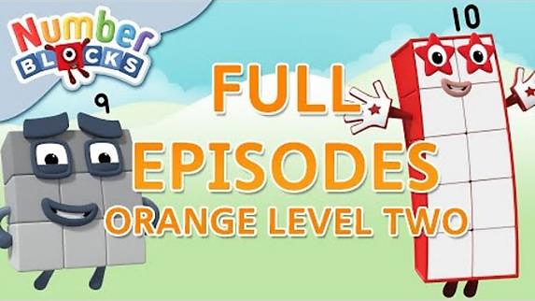
Video: Orange Level Two | Full Episodes 4-6
edco.ie/zbxu
Notes:
Numberblocks Series 2:
Episode 4: Nine
Episode 5: Ten
Episode 6: Just add 1
https://www.ncetm.org.uk/classroom-resources/ey-numberblocks-series-2/

Slide 42
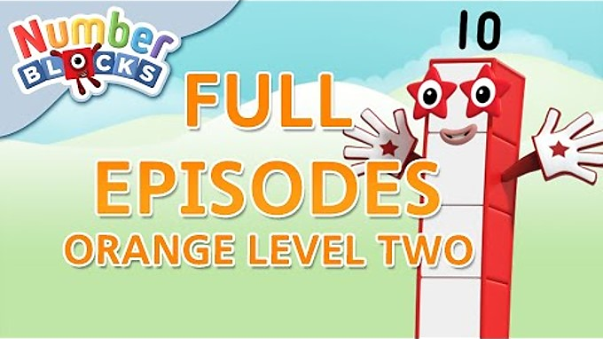
Video: Orange Level Two | Full Episodes 7, 9, 10
edco.ie/s6ys
Notes:
Numberblocks Series 2:
Episode 7: Ten Green Bottles
Episode 9: Double Trouble
Episode 10: Three Threes
https://www.ncetm.org.uk/classroom-resources/ey-numberblocks-series-2/

Slide 43
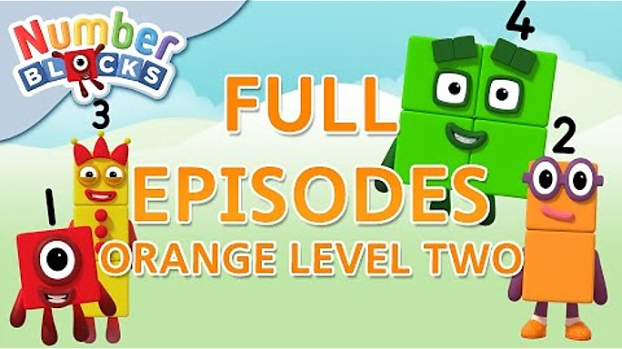
Video: Orange Level Two | Full Episodes 10-13
edco.ie/jdrj
Notes:
Numberblocks Series 2:
Episode 11: Odds and Evens
Episode 12: Fluffies
Episode 13: Blast Off!
https://www.ncetm.org.uk/classroom-resources/ey-numberblocks-series-2/

Slide 44
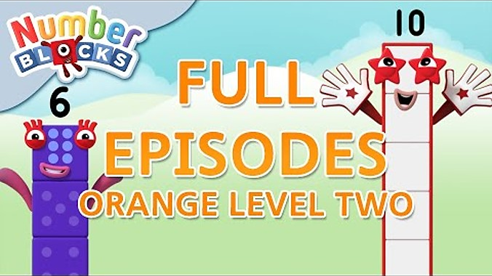
Video: Orange Level Two | Full Episodes 14-16
edco.ie/waev
Notes:
Numberblocks:
Series 2, Episode 14: The Two Tree
Series 2, Episode 15: Numberblock Castle
Series 3, Episode 6: Now we are Six to Ten
https://www.ncetm.org.uk/classroom-resources/ey-numberblocks-series-2/
https://www.ncetm.org.uk/classroom-resources/ey-numberblocks-series-3/

Slide 45

Video: Orange Level Two | Full Episodes 17-19
edco.ie/cvtf
Notes:
Numberblocks Series 3:
Episode 7: Numberblobs
Episode 8: Building Blocks
Episode 9: Peekaboo
https://www.ncetm.org.uk/classroom-resources/ey-numberblocks-series-3/

Slide 46
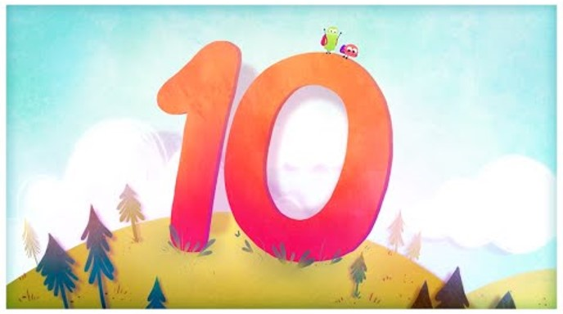
Video: The Number 10
edco.ie/x9nu

Slide 47
Picture Books & Read Alouds

Slide 48

Picture Books & Read Alouds via Internet Archive
There are many counting and number related books on https://archive.org
This is an online digital library/archive that is free to access. Just click on the link, register/log in for FREE, and then simply "borrow" the required book for an hour. After an hour you can choose to borrow it again if required.

Slide 49
Picture Books & Read Alouds
Anno’s Counting Book by Mitsumasa Anno
Downloadable at edco.ie/cfyz
Suitable for Junior Infants and Senior Infants
This book takes the reader on a journey through the four seasons of the year with numbers 1 to 12.
Numbers are represented by numerals, cubes and many sets of objects in the beautiful scenes depicted in this wordless counting book.
Notes:
https://earlymath.erikson.edu/numbers-and-fun-with-annos-counting-book-best-preschool-books-for-math/
https://earlymath.erikson.edu/different-uses-numbers-annos-counting-book/

Slide 50
Picture Books & Read Alouds
My Ten Book by Jane Belk Moncure
Downloadable at edco.ie/frmr
Suitable for Junior Infants and Senior Infants
A series of books where each one introduces the concept of the title number by interacting with that amount of a variety of things, some of which are grouped and regrouped to demonstrate adding and subtracting.

Slide 51
Picture Books & Read Alouds
Ten Town by Nadia Higgins
Downloadable at edco.ie/qv98
Suitable for Junior Infants and Senior Infants
A series of books where each one tells the story of a town dedicated to the title number.

Slide 52
Picture Books & Read Alouds
Ten by Dana Meachen Rau
Downloadable at edco.ie/3k6v
Suitable for Junior Infants and Senior Infants
A series of books where each represents the title number via real life photographs.

Slide 53
Picture Books & Read Alouds
Mouse Count by Ellen Stoll Walsh
Downloadable at edco.ie/rnh4
Suitable for Junior Infants and Senior Infants
The story of a very hungry snake. He is on the hunt. He finds ten mice to eat but something surprising happens.
Notes:
https://earlymath.erikson.edu/mouse-collections-preschool-storytime-game/

Slide 54
Picture Books & Read Alouds
Ten Racing Rats by Jack Booth
Downloadable at edco.ie/w262
Suitable for Junior Infants and Senior Infants
This simple story explores the number bonds of ten as it describes the colours of the various sets of ten animals that run through the town.

Slide 55
Picture Books & Read Alouds
Ten Black Dots by Donald Crews
Downloadable at edco.ie/pywr
Suitable for Junior Infants and Senior Infants
This book has simple pictures and text.
On each page the artist adds one more dot and thinks of new designs to make with the growing number.
Notes:
https://www.theteacherbag.com/ten-black-dot-activities-for-the-classroom/
https://www.pinterest.ie/pin/3448137184635501/
https://www.teacherspayteachers.com/Browse/Search:10%20black%20dots%20activities/Order:Price-Asc

Slide 56
Picture Books & Read Alouds
Fish Eyes by Lois Ehlert
Downloadable at edco.ie/we6c
Suitable for Junior Infants and Senior Infants
This book follows one fish on a journey as it meets new groups of fish (up to 10).
It builds the number relationship of one more as our fish narrator finds the total of each new group of fish and then adds itself to the count..”
For example, ‘2 jumping fish plus me makes 3’.

Slide 57
Picture Books & Read Alouds
1, 2, 3 to the Zoo by Eric Carle
Downloadable at edco.ie/srbf
Suitable for Junior Infants and Senior Infants
This book follows one tiny mouse’s train ride to the zoo.
As the journey continues, a new car is added (up to 10) with one more animal on each car, than the one before it.

Slide 58
Games

Slide 59
Pair Game: Throw and Build!
Needed: 10 cubes (unifix or multilink), one or two dice, per player.
Each player, in turn, chooses to throw one or two dice and then builds a stack of that number
of cubes.
The players add to their stack of number of cubes.
The first player to build a stack of 10 cubes wins
the game.

Slide 60
Pair Game: Tower Splits!
Needed: 10 cubes and tokens (could be counters, links, paperclips, etc.)
Player A makes a tower of 10 cubes.
Player B closes their eyes and calls SPLIT!
Player A splits the tower in 2 parts and hides one part behind their back.
Player B looks at the part of the tower they can see and says how many cubes are hidden. If correct, Player B takes a token.
Swap roles and keep playing until time is up.
The winner is the person with the most tokens when the time is up.

Slide 61
Pair Game: Chain Splits!
Needed: 10 links and tokens (could be counters, cubes, paperclips, etc.)
Player A makes a chain of 10 links.
Player B closes their eyes and calls SPLIT!
Player A splits the chain in 2 parts and hides one part behind their back.
Player B looks at the part of the chain they can see and says how many links are hidden. If correct, Player B takes a token.
Swap roles and keep playing until time is up.
The winner is the person with the most tokens when the time is up.

Slide 62
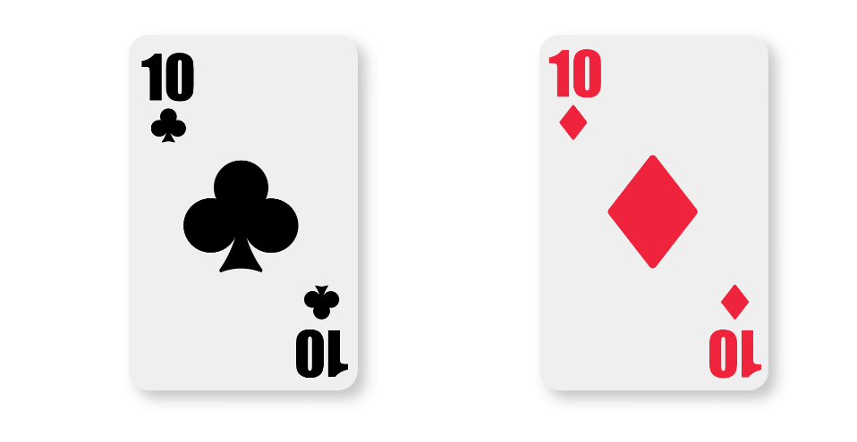
Play Memory
If you turn over two tens, you get a bonus go!

Slide 63
Image Credits
Shutterstock

