Slide 2
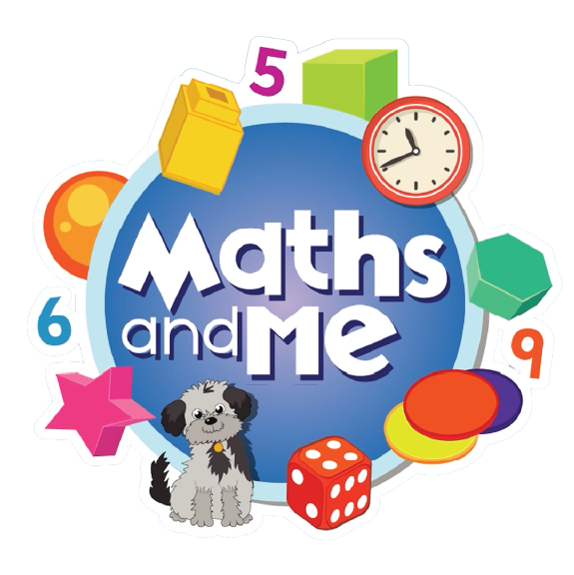
Contents
How to Use These Slides
Rationale
Counting & Numeration
Picture Books & Read Alouds
Games

Slide 3
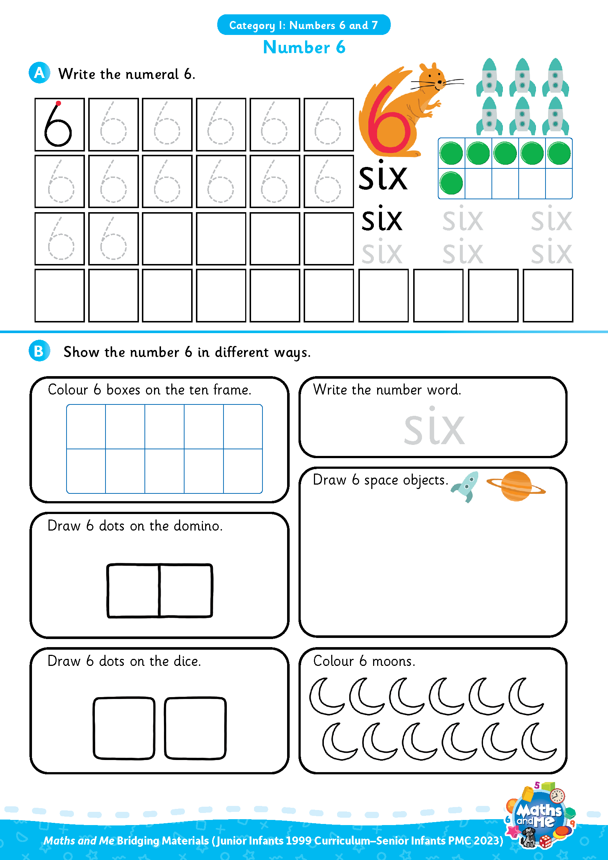
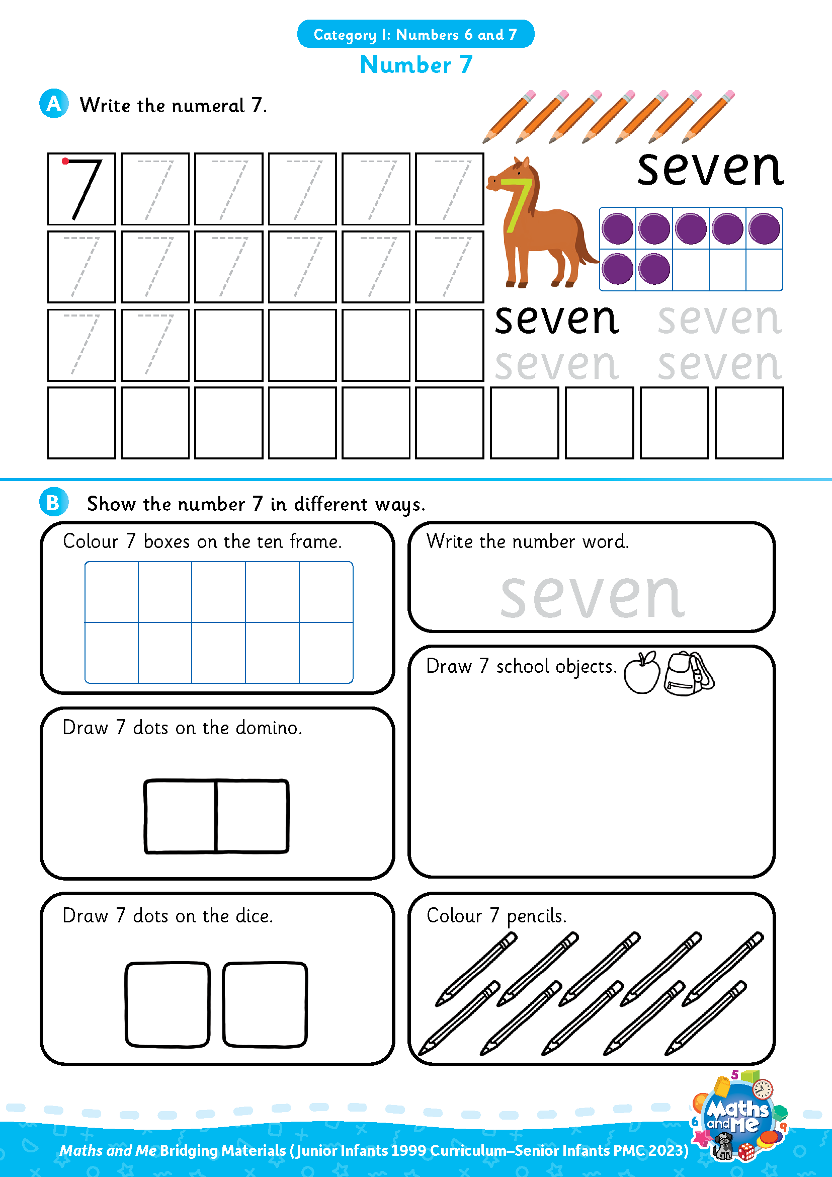
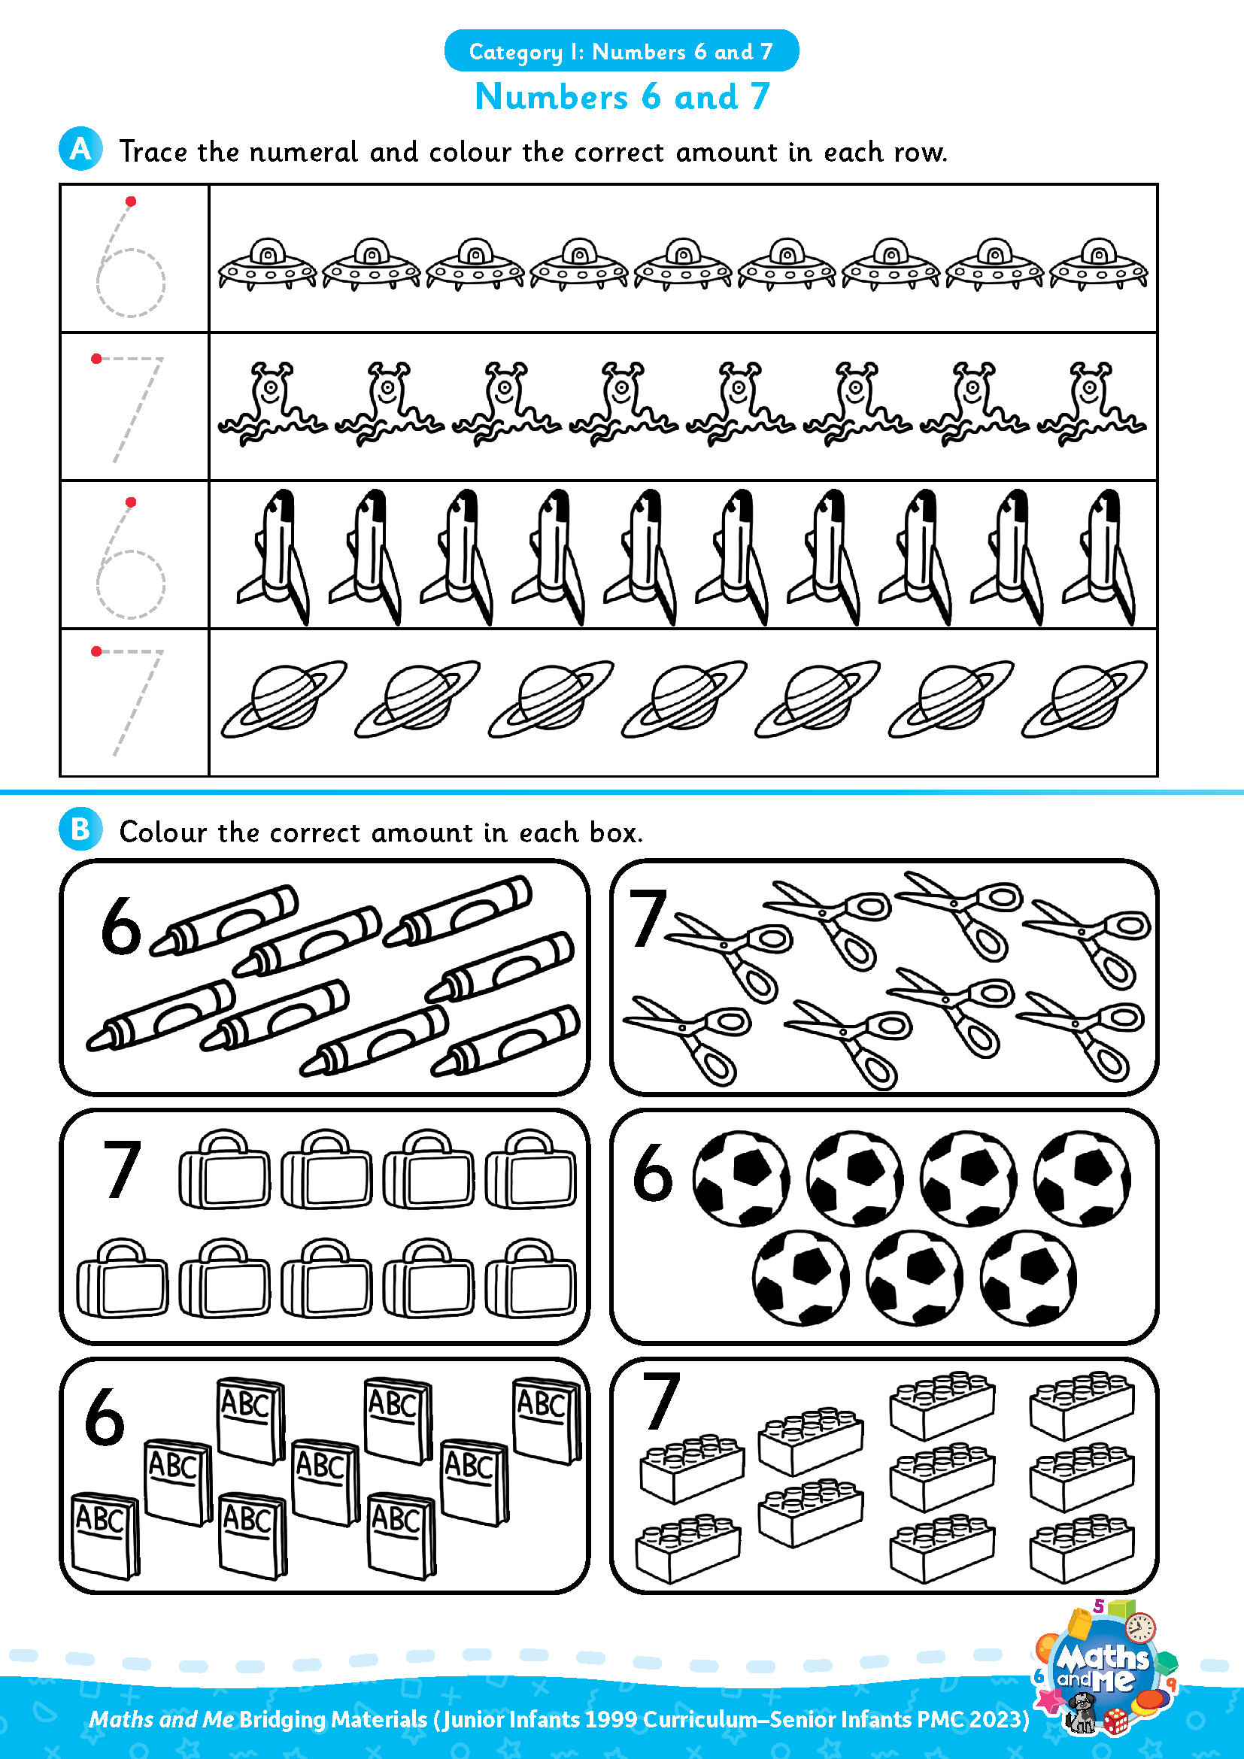
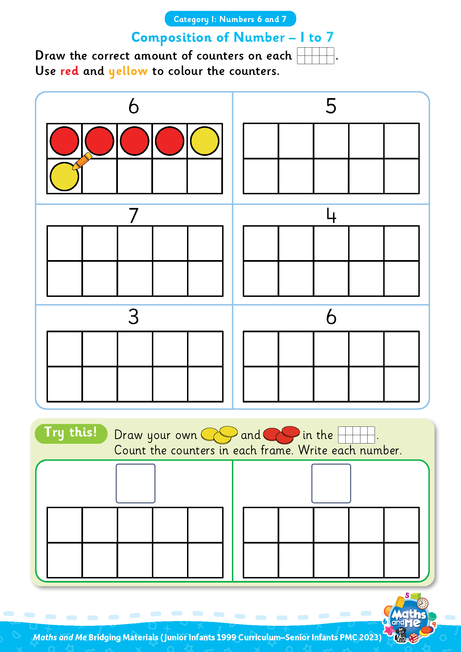
Introduction
This is the first of three presentations prepared to support teachers with the transition to the PMC. It covers Numbers 6 and 7.
Activity sheets are also available on Edco Learning to support this category.
Use these slides as they are or edit them to suit the needs of your class.

Slide 4
Rationale
These resources have been selected to offer children a gentle introduction to the numbers 6 and 7, which they may not have encountered formally in their current Junior Infants maths book. The resources will make them more prepared for the Maths and Me Senior Infants programme.
That said, it is not essential that teachers use these materials prior to starting the Maths and Me Senior Infant programme. The content of Maths and Me for Senior Infants has been carefully considered to provide cohesive and structured learning experiences for the children, that are also playful and engaging. When in Senior Infants, the numbers 6 and 7 will be constantly revised and consolidated alongside new learning.

Slide 5
Rationale
The low-threshold, high-ceiling approach that typifies Maths and Me is designed to support children and enable them to comfortably work with numbers outside the traditional number limits.
Ultimately, at the end of the Maths and Me Senior Infants programme, we are confident that the children will be much more capable and confident mathematicians!

Slide 6
Counting & Numeration

Slide 7
Counting & Numeration
0 | 1 | 2 | 3 | 4 | 5 | 6 | 7 | 8 | 9 | 10
Count forwards
Count backwards
Count forwards and clap hands
Count backwards and stamp feet

Slide 8
Counting & Numeration
0 | 1 | 2 | 3 | 4 | 5 | 6 | 7 | 8 | 9 | 10
Count forwards to 6
Count backwards from 6
Clap hands 6 times
Stamp feet 6 times
Slap knees 6 times

Slide 9
Counting & Numeration
0 | 1 | 2 | 3 | 4 | 5 | 6 | 7 | 8 | 9 | 10
Count forwards to 7
Count backwards from 7
Clap hands 7 times
Stamp feet 7 times
Slap knees 7 times

Slide 10
Counting & Numeration
0 | 1 | 2 | 3 | 4 |  | 6 | 7 | 8 | 9 | 10
What is missing?

Slide 11
Counting & Numeration
0 | 1 | 2 | 3 | 4 | 5 | 6 | 7 | 8 | 9 | 10
What is missing?

Slide 12
Counting & Numeration
0 |  | 2 | 3 | 4 | 5 | 6 | 7 | 8 | 9 | 10
What is missing?

Slide 13
Counting & Numeration
0 | 1 | 2 | 3 | 4 | 5 | 6 | 7 | 8 | 9 | 10
What is missing?

Slide 14
Counting & Numeration
0 | 1 | 2 | 3 | 4 | 5 |  | 7 | 8 | 9 | 10
What is missing?

Slide 15
Counting & Numeration
0 | 1 | 2 | 3 | 4 | 5 | 6 | 7 | 8 | 9 | 10
What is missing?

Slide 16
Counting & Numeration
0 | 1 | 2 | 3 |  | 5 | 6 | 7 | 8 | 9 | 10
What is missing?

Slide 17
Counting & Numeration
0 | 1 | 2 | 3 | 4 | 5 | 6 | 7 | 8 | 9 | 10
What is missing?

Slide 18
Counting & Numeration
0 | 1 | 2 | 3 | 4 | 5 | 6 |  | 8 | 9 | 10
What is missing?

Slide 19
Counting & Numeration
0 | 1 | 2 | 3 | 4 | 5 | 6 | 7 | 8 | 9 | 10
What is missing?

Slide 20
Counting & Numeration
0 | 1 | 2 | 3 | 4 | 5 | 6 | 7 | 8 | 9 | 10
Put something on the number after __
Put something on the number before __
Put something between __ and __
Needed: number path per child (0-10 or 0-20 number path)
Notes:
Needed: number path per child (0-10 or 0-20 number path)

Slide 21

Using Fingers to Grow, Show, Throw…
Grow 6: Put 6 fingers up, one at a time, counting as you go.
Show 6: Put up 6 fingers at once.
Throw 6: Throw 6 fingers forward quickly!
Bunny Ears Grow 6: Put 6 fingers up, behind your head, one at a time, counting as you go.
Bunny Ears Show 6: Put up 6 fingers, behind your head, at once.
Adapted from: https://www.ncetm.org.uk/features/cardinality-and-number-sense/
Notes:
Can be repeated with other numbers

Slide 22
Using Fingers to Grow, Show, Throw…
Grow 7: Put 7 fingers up, one at a time, counting as you go.
Show 7: Put up 7 fingers at once.
Throw 7: Throw 7 fingers forward quickly!
Bunny Ears Grow 7: Put 7 fingers up, behind your head, one at a time, counting as you go.
Bunny Ears Show 7: Put up 7 fingers, behind your head, at once.
Adapted from: https://www.ncetm.org.uk/features/cardinality-and-number-sense/
Notes:
Can be repeated with other numbers

Slide 23
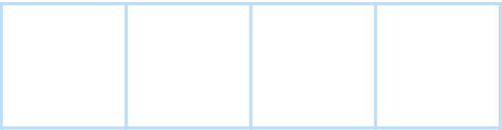


Number Patterns
1
2
3
What number comes next?
Notes:
Needed: number path per child (0-10 or 0-20 number path)

Slide 24
Number Patterns
1
2
3
4
What number comes next?
Notes:
Needed: number path per child (0-10 or 0-20 number path)

Slide 25
Number Patterns
2
3
4
What number comes next?
Notes:
Needed: number path per child (0-10 or 0-20 number path)

Slide 26
Number Patterns
2
3
4
5
What number comes next?
Notes:
Needed: number path per child (0-10 or 0-20 number path)

Slide 27
Number Patterns
3
4
5
What number comes next?
Notes:
Needed: number path per child (0-10 or 0-20 number path)

Slide 28
Number Patterns
3
4
5
6
What number comes next?
Notes:
Needed: number path per child (0-10 or 0-20 number path)

Slide 29
Number Patterns
4
5
6
What number comes next?
Notes:
Needed: number path per child (0-10 or 0-20 number path)

Slide 30
Number Patterns
4
5
6
7
What number comes next?
Notes:
Needed: number path per child (0-10 or 0-20 number path)

Slide 31

Video: Number Formation – 6
edco.ie/vt7v

Slide 32

Video: Number Formation – 7
edco.ie/czmf

Slide 33
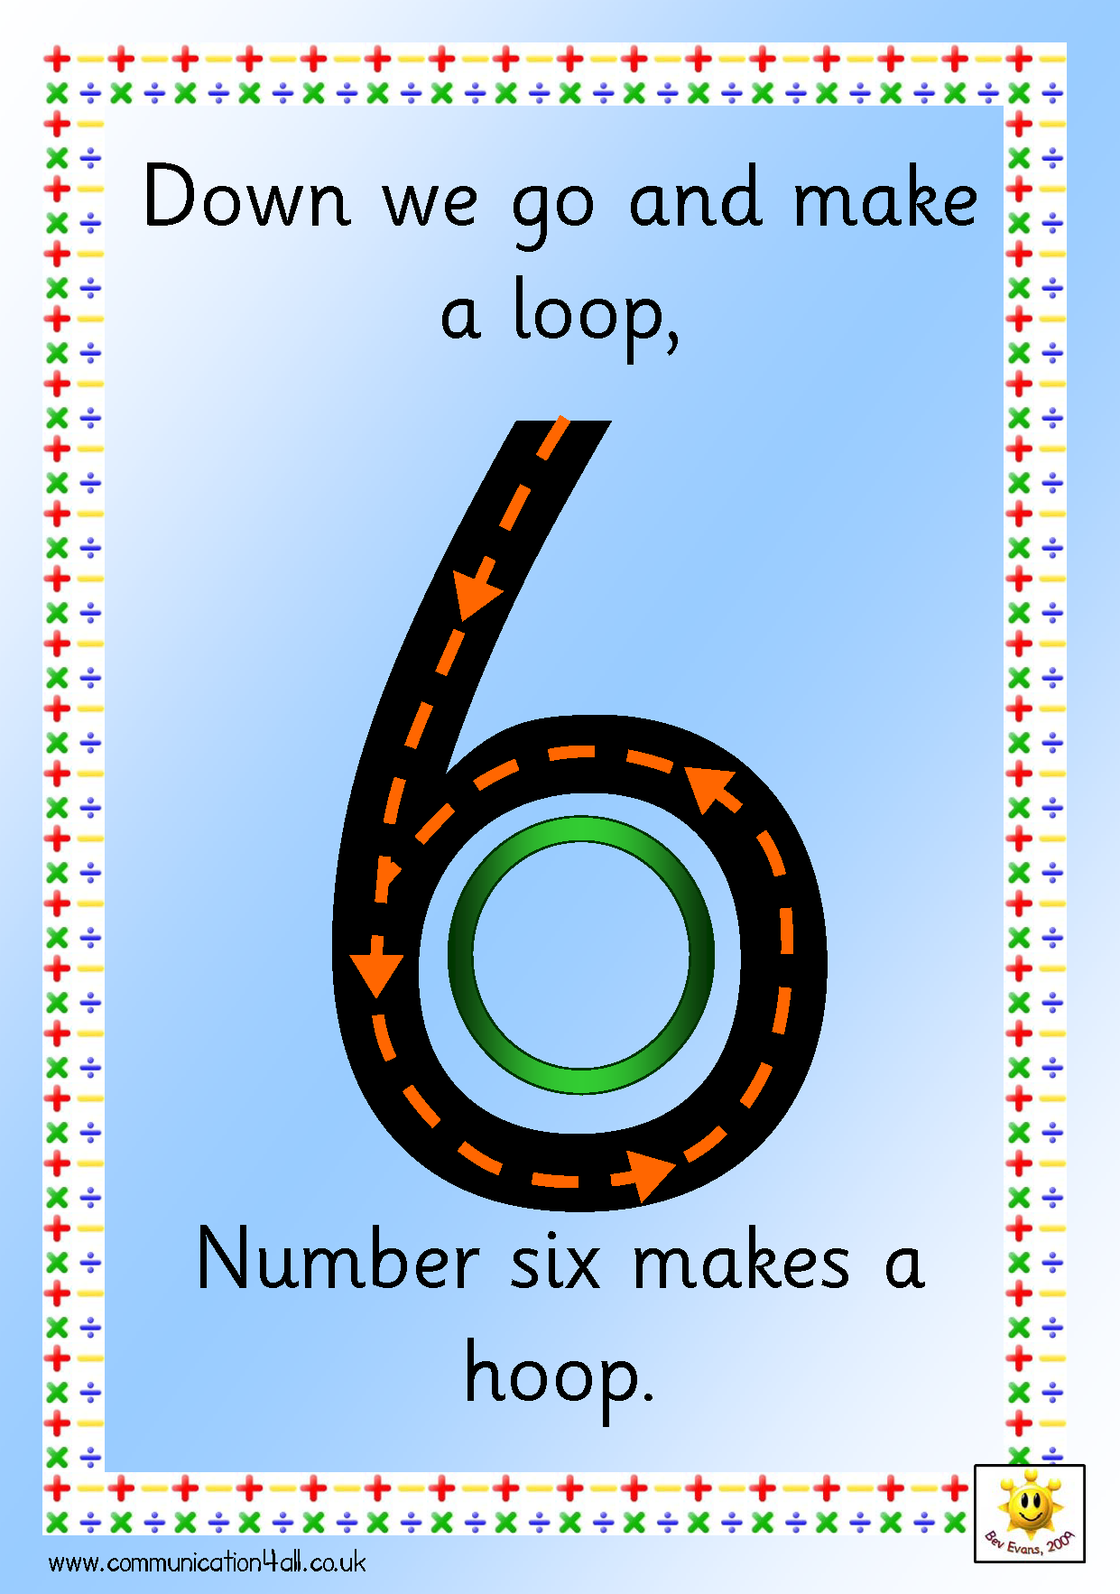
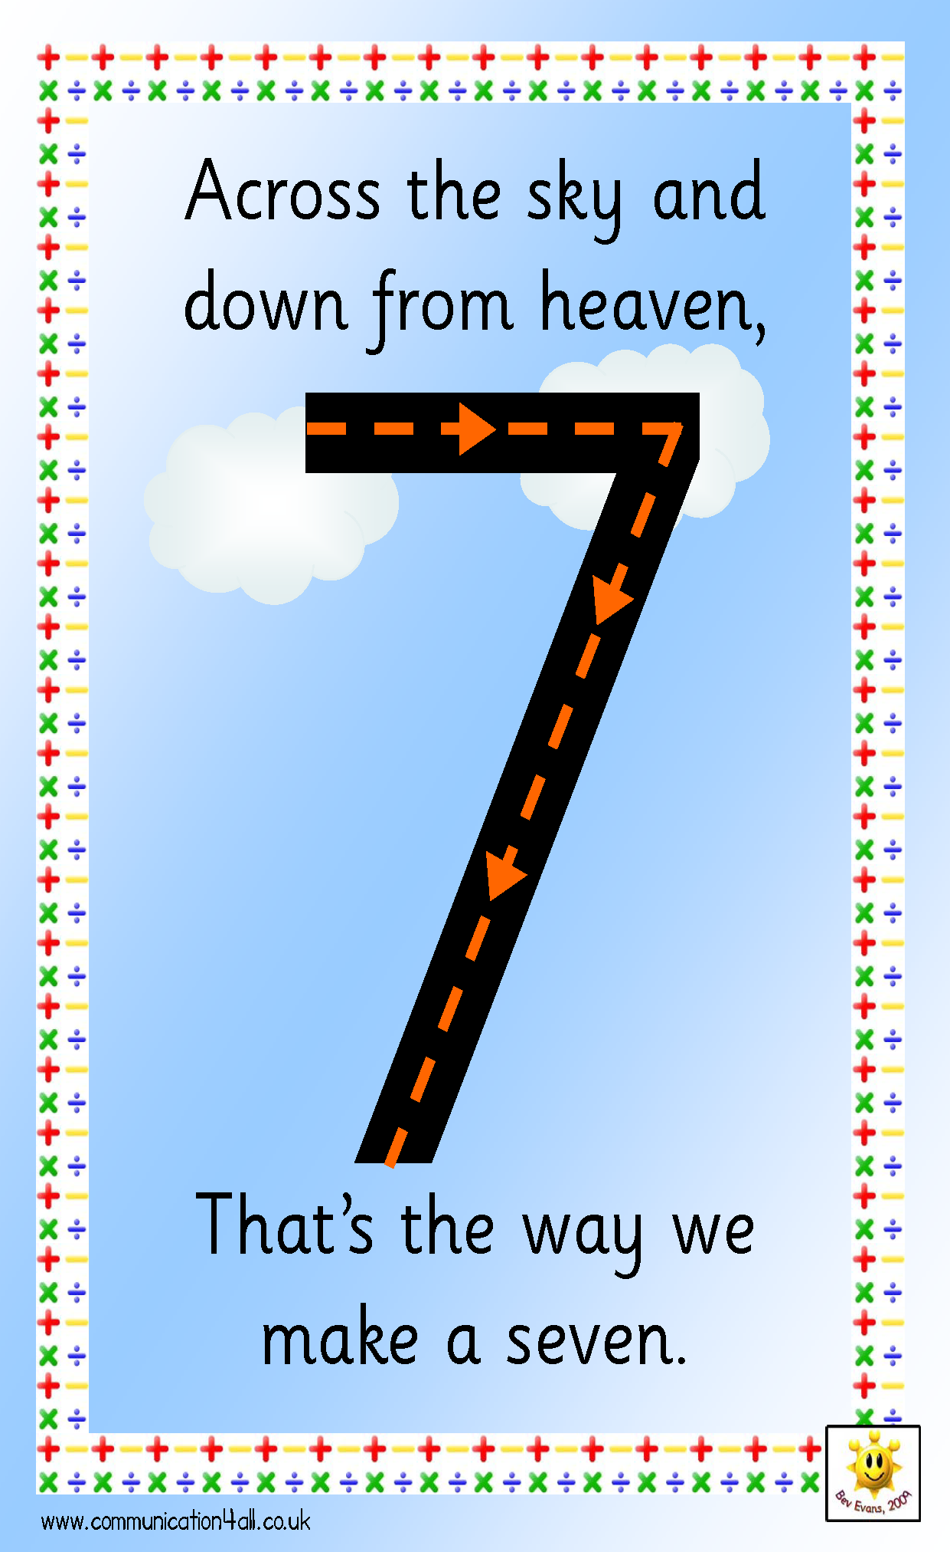
Make the Numeral in the Air
Source: http://www.communication4all.co.uk/http/numeracynew.htm
Notes:
Make the numeral in the air
Set of A4 poster of all numerals (like above) available to download from http://www.communication4all.co.uk/http/numeracynew.htm

Slide 34
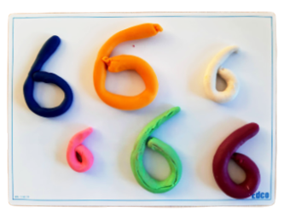
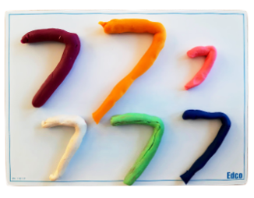
Play Dough: Make the Numeral

Slide 35
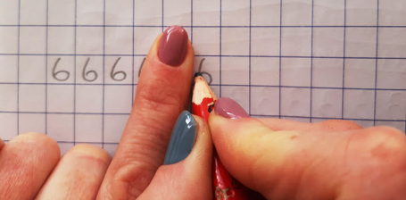
In Your Copy: Make the Numeral 6
Down we go… along your finger
Make a loop… back in, finish in the centre
Notes:
For right-handed writers only

Slide 36
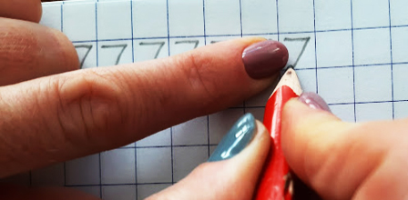
In Your Copy: Make the Numeral 7
Across… away from your pointy finger
Back down… back in, finish at the bottom
Notes:
For right-handed writers only

Slide 37

Interactive Web Activity
Today's Number Up to 20 | edco.ie/px4d

Slide 38
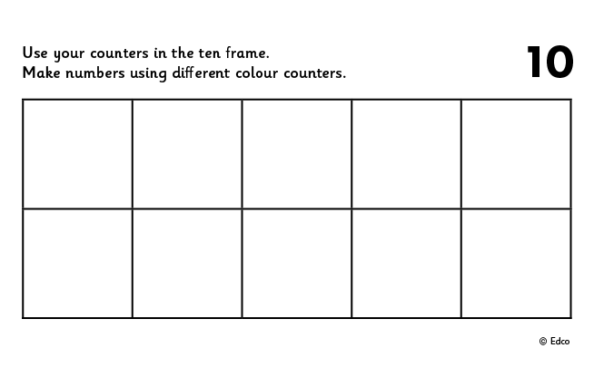
Ten Frame
Put 6 in the frame.
How many on the top row?
How many on the bottom row?
Put 6 in the frame a different way.
If I take away ___ how many will be left?
Put __ in the frame. How many more to make 6?
Put 6 in the frame. How many do I need to take away to leave __?

Slide 39
Ten Frame
Put 7 in the frame.
How many on the top row?
How many on the bottom row?
Put 7 in the frame a different way.
If I take away ___ how many will be left?
Put __ in the frame. How many more to make 7?
Put 7 in the frame. How many do I need to take away to leave __?

Slide 40
Ten Frame
Now stand the frame up tall and put 6 in the frame. Fill from the bottom left.
How many on the left?
How many on the right?
Arrange 6 in the frame in a different way.
If I take away ___ how many will be left?
Put __ in the frame. How many more to make 6?
Put 6 in the frame. How many do I need to take away to leave __?

Slide 41
Ten Frame
Now stand the frame up tall and put 7 in the frame. Fill from the bottom left.
How many on the left?
How many on the right?
Arrange 7 in the frame in a different way.
If I take away ___ how many will be left?
Put __ in the frame. How many more to make 7?
Put 7 in the frame. How many do I need to take away to leave __?

Slide 42

Video: Birthday Cake

Slide 43

Clapping
Listen to me clap.
How many times did I clap? Show me with your fingers.
How many times did I clap? Show me with your frame and counters.
How many times did I clap? Show me on your number fan.
How many times did I clap? Write the numeral on your MWB.

Slide 44
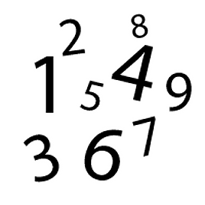
Sound of a Number
Listen to me drop coins into this tin.
How many coins did I drop in? Show me with your fingers.
How many coins did I drop in? Show me with your frame and counters.
How many coins did I drop in? Show me on your number fan.
How many coins did I drop in? Write the numeral on your MWB.

Slide 45
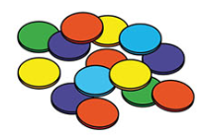
Making Sets of 6
Choose some objects to make a set.
How many objects are there in your set? How do you know?
Can you make a set of 6? How did you make a set of 6? How do you know that there are 6 objects in your set?
Count the objects in your set. Put your objects in a line. How many are there?
Needed: manipulatives (bears, counters, beads, links and interlocking cubes)

Slide 46
Making Sets of 7
Choose some objects to make a set.
How many objects are there in your set? How do you know?
Can you make a set of 7? How did you make a set of 7? How do you know that there are 7 objects in your set?
Count the objects in your set. Put your objects in a line. How many are there?
Needed: manipulatives (bears, counters, beads, links and interlocking cubes)

Slide 47
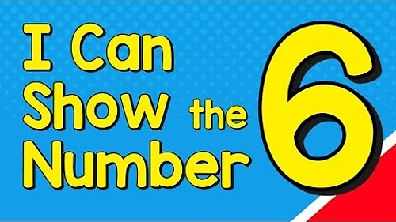
Video: I Can Show the Number 6
edco.ie/x4cy
Notes:
Option: Stop video at intervals to ask “how could we show 6 in a picture, on a frame, on dice, as a numeral/word?” etc.
Ask children to show you on their MWBs

Slide 48
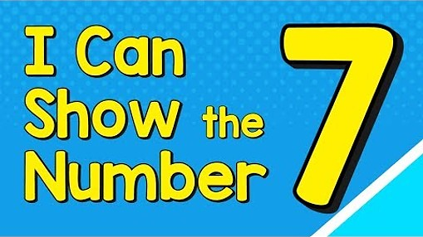
Video: I Can Show the Number 7
edco.ie/gtkj

Slide 49
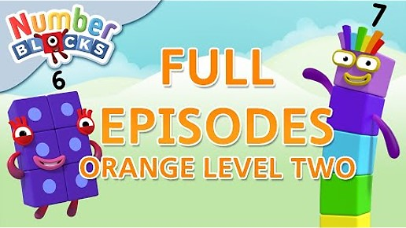
Video: Orange Level Two
edco.ie/mspz
Notes:
Numberblocks Season 2:
Episode 1: Six
Episode 2: Seven
Episode 3: Eight
https://www.ncetm.org.uk/classroom-resources/ey-numberblocks-series-2/

Slide 50

Video: Six Little Ducks
edco.ie/z6vy

Slide 51

Video: Number 6 Song
edco.ie/3tg9

Slide 52
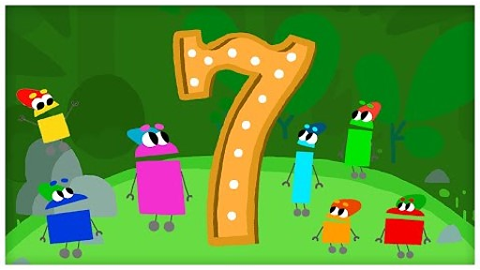
Video: The Number Seven
edco.ie/npy6

Slide 53
Picture Books & Read Alouds

Slide 54

Picture Books & Read Alouds via Internet Archive
There are many counting and number related books on https://archive.org
This is an online digital library/archive that is free to access. Just click on the link, register/log in for FREE, and then simply "borrow" the required book for an hour. After an hour you can choose to borrow it again if required.
Notes:
Title: Anno’s Counting Book
Author: Mitsumasa Anno
Suits: Junior Infants, Senior Infants
This book takes the reader on a journey through the four seasons of the year with numbers 1 to 12. Numbers are represented by numerals, cubes and many sets of objects in the beautiful scenes depicted in this wordless counting book.
https://earlymath.erikson.edu/numbers-and-fun-with-annos-counting-book-best-preschool-books-for-math/
https://earlymath.erikson.edu/different-uses-numbers-annos-counting-book/

Slide 55
Picture Books & Read Alouds
Anno’s Counting Book by Mitsumasa Anno
Downloadable at edco.ie/cfyz
Suitable for Junior Infants and Senior Infants
This book takes the reader on a journey through the four seasons of the year with numbers 1 to 12.
Numbers are represented by numerals, cubes and many sets of objects in the beautiful scenes depicted in this wordless counting book.
Notes:
https://earlymath.erikson.edu/numbers-and-fun-with-annos-counting-book-best-preschool-books-for-math/
https://earlymath.erikson.edu/different-uses-numbers-annos-counting-book/

Slide 56
Picture Books & Read Alouds
Six-Dinner Sid by Inga Moore
Downloadable at edco.ie/acph
Suitable for Junior Infants and Senior Infants
A cat named Sid fools six neighbours on one street into thinking that he is their cat, in order to get six dinners.
An entertaining story that can be used to explore the components of 6 and one-to-one correspondence.

Slide 57
Picture Books & Read Alouds
6 Sticks by Molly Coxe
Downloadable at edco.ie/gdkq
Suitable for Junior Infants and Senior Infants
A simple book that illustrates the things that can be made out of six sticks.
Demonstrates linkage with shape and space

Slide 58
Picture Books & Read Alouds
My Six Book and My Seven Book by Jane Belk Moncure
Downloadable at edco.ie/544d and edco.ie/qzb8
Suitable for Junior Infants and Senior Infants
A series of books where each one introduces the concept of the title number by interacting with that amount of a variety of things, some of which are grouped and regrouped to demonstrate adding and subtracting.

Slide 59
Picture Books & Read Alouds
Six Town by Nadia Higgins
Downloadable at edco.ie/7bts
Suitable for Junior Infants and Senior Infants
A series of books where each one tells the story of a town dedicated to the title number.

Slide 60
Picture Books & Read Alouds
Quack and Count by Keith Baker
Downloadable at edco.ie/pjq6
Suitable for Junior Infants and Senior Infants
Ducklings illustrate the various number bonds of 7 by grouping themselves in various combinations.

Slide 61
Games

Slide 62
Pair Game: Throw and Build!
Needed: 6 cubes (unifix or multilink), one or two dice, per player.
Each player, in turn, chooses to throw one or two dice and then builds a stack of that number of cubes.
The players add to their stack of number of cubes.
The first player to build a stack of 6 cubes wins the game.

Slide 63
Pair Game: Throw and Build!
Needed: 7 cubes (unifix or multilink), one or two dice, per player.
Each player, in turn, chooses to throw one or two dice and then builds a stack of that number of cubes.
The players add to their stack of number of cubes.
The first player to build a stack of 7 cubes wins the game.

Slide 64
Pair Game: Tower Splits!
Needed: 6 cubes and tokens (could be counters, links, paperclips, etc.)
Player A makes a tower of 6 cubes.
Player B closes their eyes and calls SPLIT!
Player A splits the tower in 2 parts and hides one part behind their back.
Player B looks at the part of the tower they can see and says how many cubes are hidden. If correct, Player B takes a token.
Swap roles and keep playing until time is up.
The winner is the person with the most tokens when the time is up.

Slide 65
Pair Game: Tower Splits!
Needed: 7 cubes and tokens (could be counters, links, paperclips, etc.)
Player A makes a tower of 7 cubes.
Player B closes their eyes and calls SPLIT!
Player A splits the tower in 2 parts and hides one part behind their back.
Player B looks at the part of the tower they can see and says how many cubes are hidden. If correct, Player B takes a token.
Swap roles and keep playing until time is up.
The winner is the person with the most tokens when the time is up.

Slide 66
Pair Game: Chain Splits!
Needed: 6 links and tokens (could be counters, cubes, paperclips, etc.)
Player A makes a chain of 6 links.
Player B closes their eyes and calls SPLIT!
Player A splits the chain in 2 parts and hides one part behind their back.
Player B looks at the part of the chain they can see and says how many links are hidden. If correct, Player B takes a token.
Swap roles and keep playing until time is up.
The winner is the person with the most tokens when the time is up.

Slide 67
Pair Game: Chain Splits!
Needed: 7 links and tokens (could be counters, cubes, paperclips, etc.)
Player A makes a chain of 7 links.
Player B closes their eyes and calls SPLIT!
Player A splits the chain in 2 parts and hides one part behind their back.
Player B looks at the part of the chain they can see and says how many links are hidden. If correct, Player B takes a token.
Swap roles and keep playing until time is up.
The winner is the person with the most tokens when the time is up.

Slide 68
Game: Steps and Stairs
Needed: Cubes (unifix or multilink), a dice, a number path (with at least 1-7) per player.
In turn, each player throws the dice, collects and connects that number of cubes and stands them on that numeral on the number path. For example, if you throw a 3, you collect and connect 3 cubes and place them standing up on the numeral 3 on your number path.
If you throw a number, you already have collected you miss a turn.
The winner is the first person to cover all the numerals from 1-7 on their number path.

Slide 69
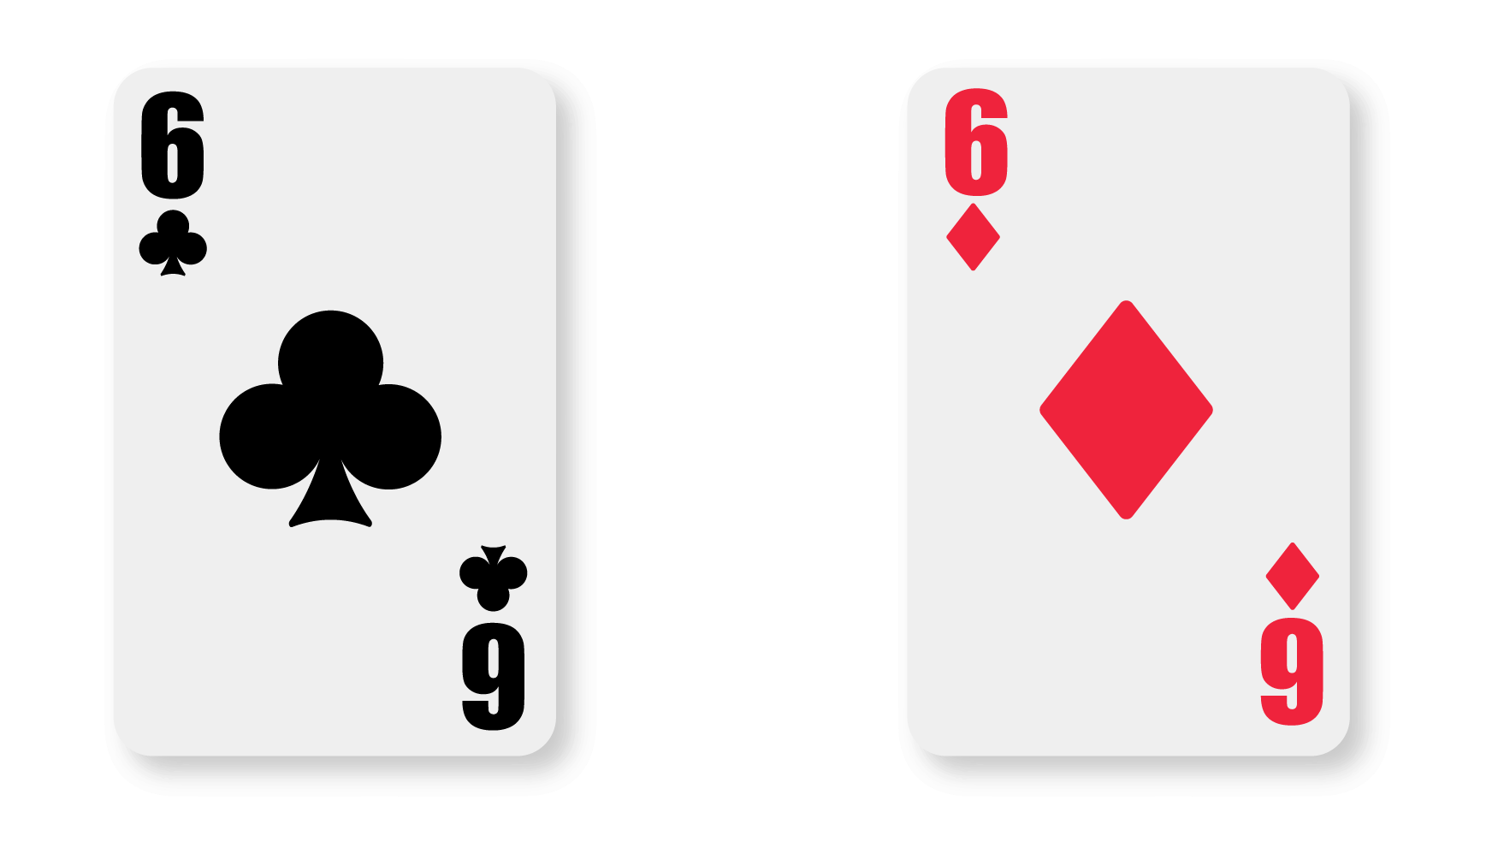
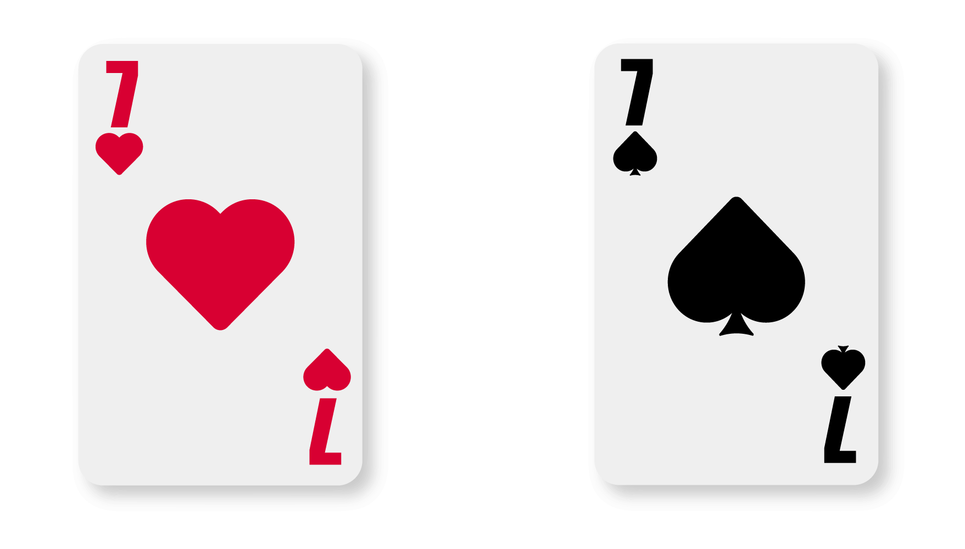
Play Memory
If you turn over two 6s or two 7s, you get a bonus go!

Slide 70
Image Credits
Shutterstock

