Slide 2
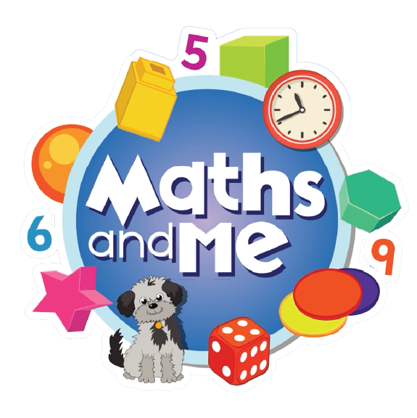
Contents
How to Use These Slides
Rationale
Counting & Numeration
Picture Books & Read Alouds
Games

Slide 3
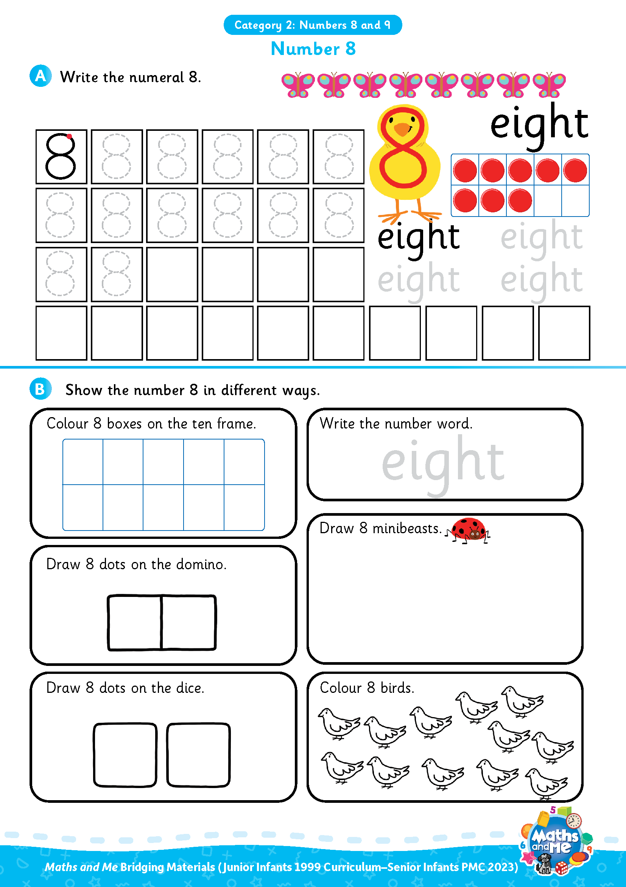
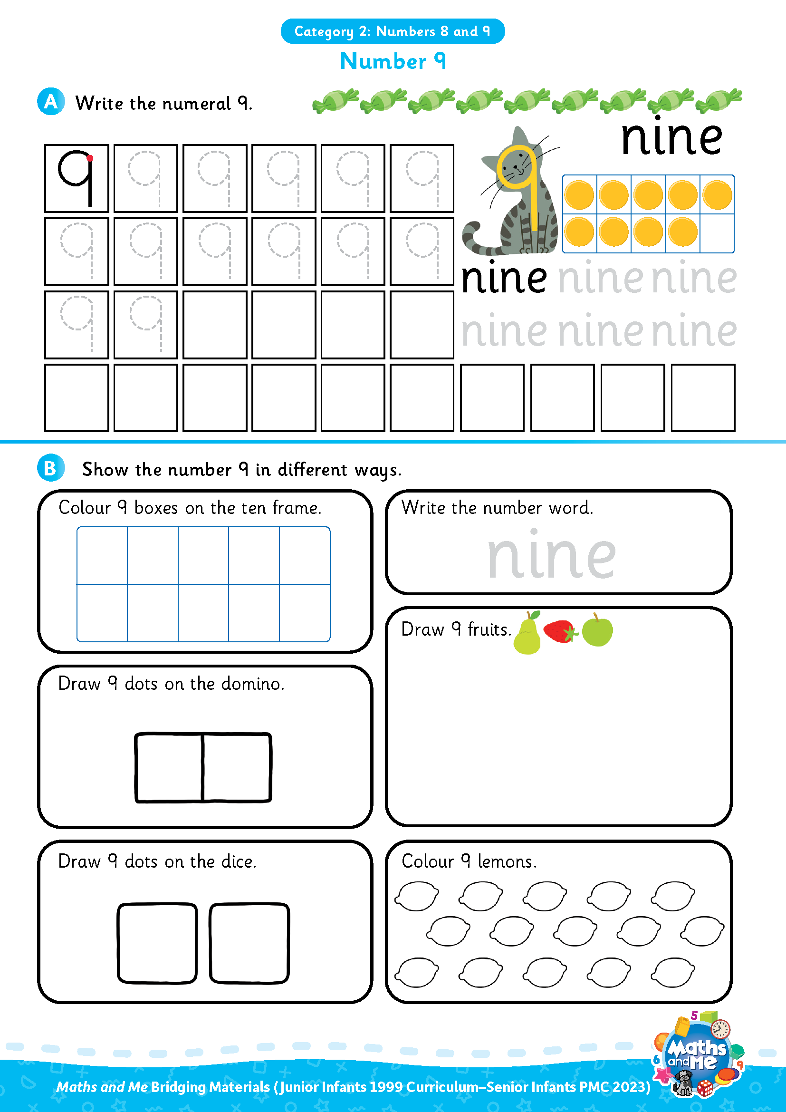
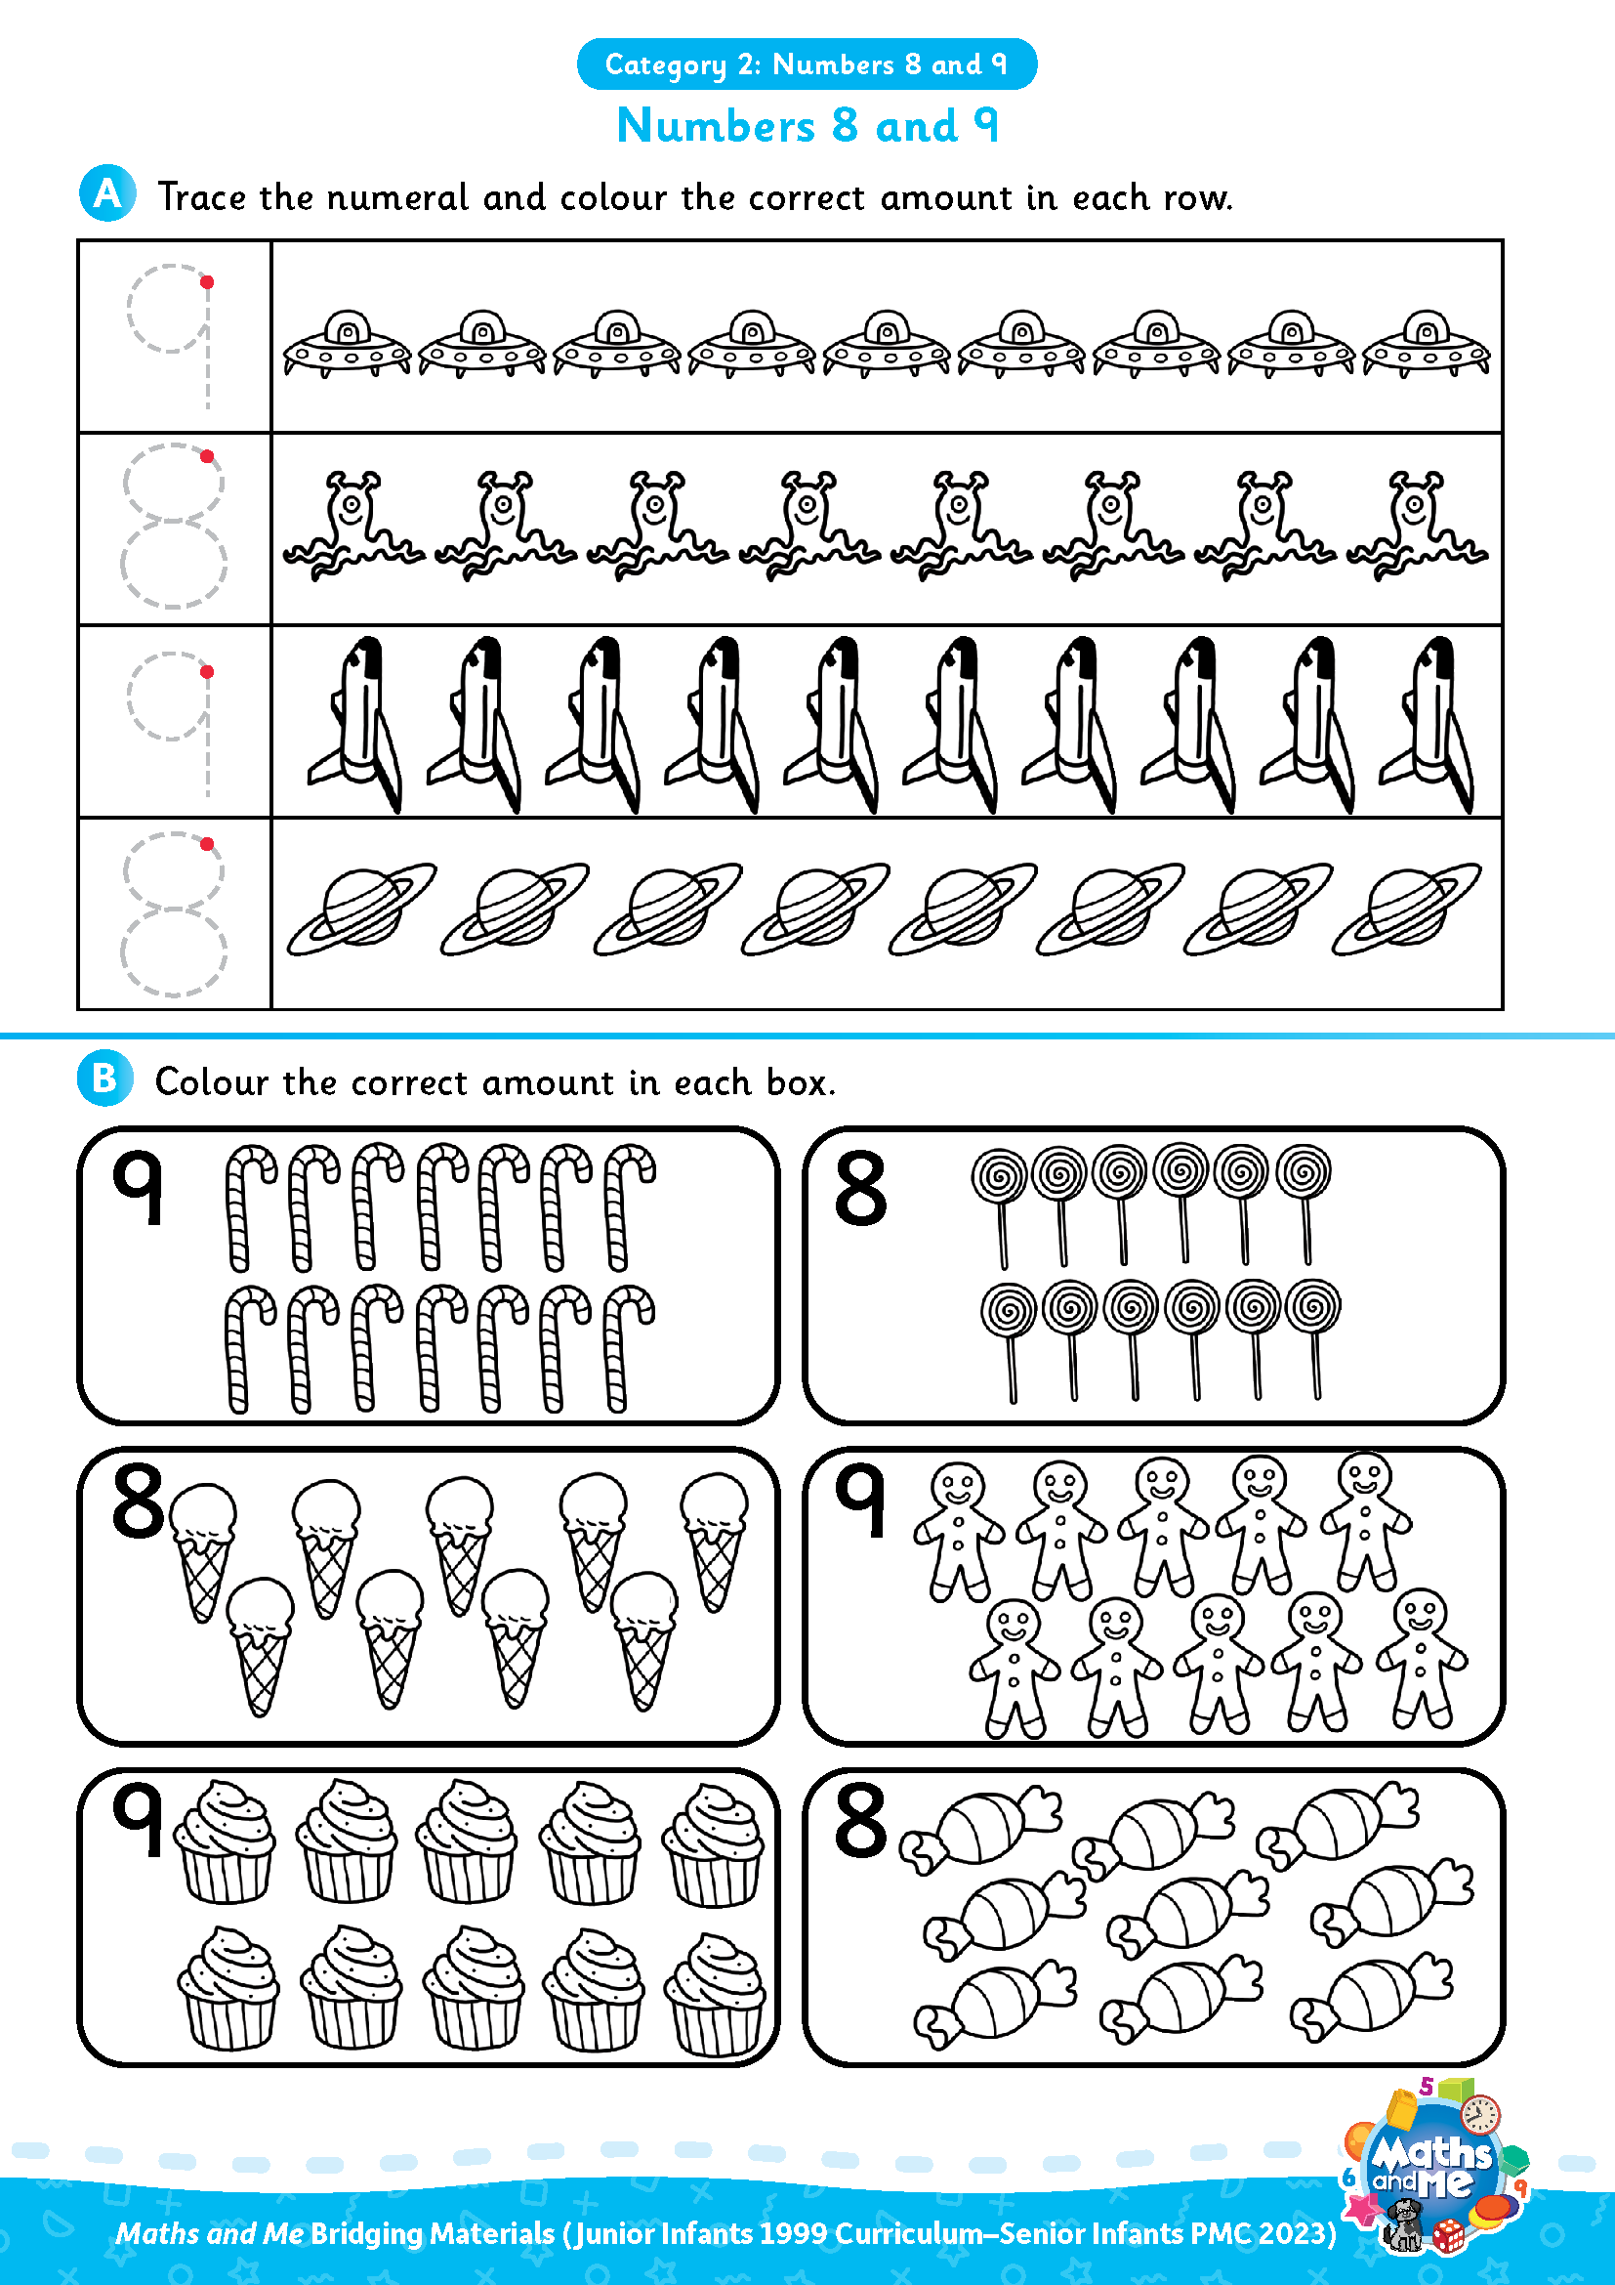
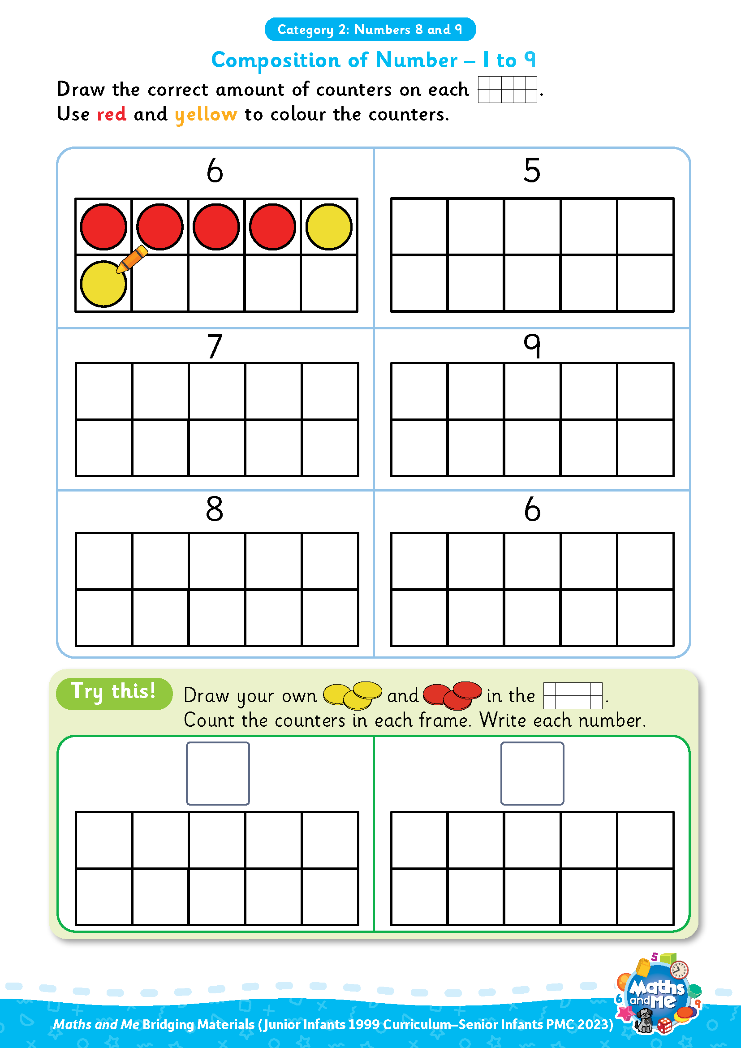
Introduction
This is the second of three presentations prepared to support teachers with the transition to the PMC. It covers Numbers 8 and 9.
Activity sheets are also available on Edco Learning to support this category.
Use these slides as they are or edit them to suit the needs of your class.

Slide 4
Rationale
These resources have been selected to offer children a gentle introduction to the numbers 8 and 9, which they may not have encountered formally in their current Junior Infants maths book. The resources will make them more prepared for the Maths and Me Senior Infants programme.
That said, it is not essential that teachers use these materials prior to starting the Maths and Me Senior Infant programme. The content of Maths and Me for Senior Infants has been carefully considered to provide cohesive and structured learning experiences for the children, that are also playful and engaging. When in Senior Infants, the numbers 8 and 9 will be constantly revised and consolidated alongside new learning.

Slide 5
Rationale
The low-threshold, high-ceiling approach that typifies Maths and Me is designed to support children and enable them to comfortably work with numbers outside the traditional number limits.
Ultimately, at the end of the Maths and Me Senior Infants programme, we are confident that the children will be much more capable and confident mathematicians!

Slide 6
Counting & Numeration

Slide 7
Counting & Numeration
0 | 1 | 2 | 3 | 4 | 5 | 6 | 7 | 8 | 9 | 10
Count forwards
Count backwards
Count forwards and clap hands
Count backwards and stamp feet

Slide 8
Counting & Numeration
0 | 1 | 2 | 3 | 4 | 5 | 6 | 7 | 8 | 9 | 10
Count forwards to 8
Count backwards from 8
Clap hands 8 times
Stamp feet 8 times
Slap knees 8 times

Slide 9
Counting & Numeration
0 | 1 | 2 | 3 | 4 | 5 | 6 | 7 | 8 | 9 | 10
Count forwards to 9
Count backwards from 9
Clap hands 9 times
Stamp feet 9 times
Slap knees 9 times

Slide 10
Counting & Numeration
0 | 1 | 2 |  | 4 | 5 | 6 | 7 | 8 | 9 | 10
What is missing?

Slide 11
Counting & Numeration
0 | 1 | 2 | 3 | 4 | 5 | 6 | 7 | 8 | 9 | 10
What is missing?

Slide 12
Counting & Numeration
0 | 1 | 2 | 3 | 4 | 5 |  | 7 | 8 | 9 | 10
What is missing?

Slide 13
Counting & Numeration
0 | 1 | 2 | 3 | 4 | 5 | 6 | 7 | 8 | 9 | 10
What is missing?

Slide 14
Counting & Numeration
0 |  | 2 | 3 | 4 | 5 | 6 | 7 | 8 | 9 | 10
What is missing?

Slide 15
Counting & Numeration
0 | 1 | 2 | 3 | 4 | 5 | 6 | 7 | 8 | 9 | 10
What is missing?

Slide 16
Counting & Numeration
0 | 1 | 2 | 3 | 4 | 5 | 6 | 7 |  | 9 | 10
What is missing?

Slide 17
Counting & Numeration
0 | 1 | 2 | 3 | 4 | 5 | 6 | 7 | 8 | 9 | 10
What is missing?

Slide 18
Counting & Numeration
0 | 1 | 2 | 3 | 4 | 5 | 6 | 7 | 8 |  | 10
What is missing?

Slide 19
Counting & Numeration
0 | 1 | 2 | 3 | 4 | 5 | 6 | 7 | 8 | 9 | 10
What is missing?

Slide 20
Counting & Numeration
0 | 1 | 2 | 3 | 4 | 5 | 6 | 7 | 8 | 9 | 10
Put something on the number after __
Put something on the number before __
Put something between __ and __
Needed: number path per child (0-10 or 0-20 number path)
Notes:
Needed: number path per child (0-10 or 0-20 number path)

Slide 21

Using Fingers to Grow, Show, Throw…
Grow 8: Put 8 fingers up, one at a time, counting as you go.
Show 8: Put up 8 fingers at once.
Throw 8: Throw 8 fingers forward quickly!
Bunny Ears Grow 8: Put 8 fingers up, behind your head, one at a time, counting as you go.
Bunny Ears Show 8: Put up 8 fingers, behind your head, at once.
Adapted from: https://www.ncetm.org.uk/features/cardinality-and-number-sense/
Notes:
Can be repeated with other numbers

Slide 22
Using Fingers to Grow, Show, Throw…
Grow 9: Put 9 fingers up, one at a time, counting as you go.
Show 9: Put up 9 fingers at once.
Throw 9: Throw 9 fingers forward quickly!
Bunny Ears Grow 9: Put 9 fingers up, behind your head, one at a time, counting as you go.
Bunny Ears Show 9: Put up 9 fingers, behind your head, at once.
Adapted from: https://www.ncetm.org.uk/features/cardinality-and-number-sense/
Notes:
Can be repeated with other numbers

Slide 23
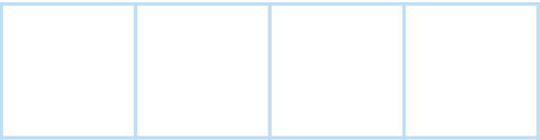


Number Patterns
3
4
5
What number comes next?
Notes:
Needed: number path per child (0-10 or 0-20 number path)

Slide 24
Number Patterns
3
4
5
6
What number comes next?
Notes:
Needed: number path per child (0-10 or 0-20 number path)

Slide 25
Number Patterns
4
5
6
What number comes next?
Notes:
Needed: number path per child (0-10 or 0-20 number path)

Slide 26
Number Patterns
4
5
6
7
What number comes next?
Notes:
Needed: number path per child (0-10 or 0-20 number path)

Slide 27
Number Patterns
5
6
7
What number comes next?
Notes:
Needed: number path per child (0-10 or 0-20 number path)

Slide 28
Number Patterns
What number comes next?
5
6
7
8
Notes:
Needed: number path per child (0-10 or 0-20 number path)

Slide 29
Number Patterns
6
7
8
What number comes next?
Notes:
Needed: number path per child (0-10 or 0-20 number path)

Slide 30
Number Patterns
6
7
8
9
What number comes next?
Notes:
Needed: number path per child (0-10 or 0-20 number path)

Slide 31
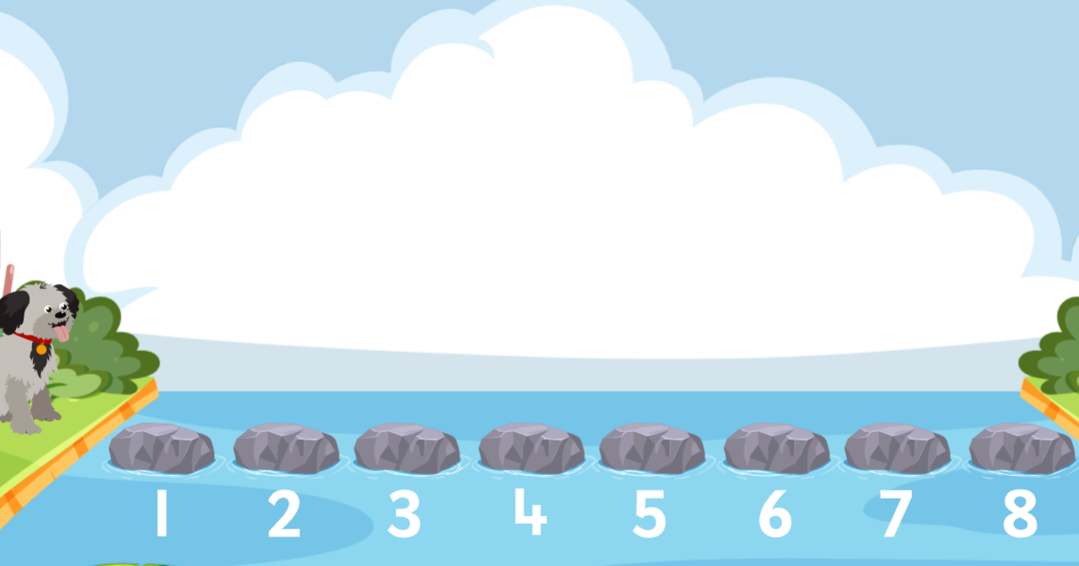
Digital Activity: Count with Monty
edco.ie/f6b2

Slide 32
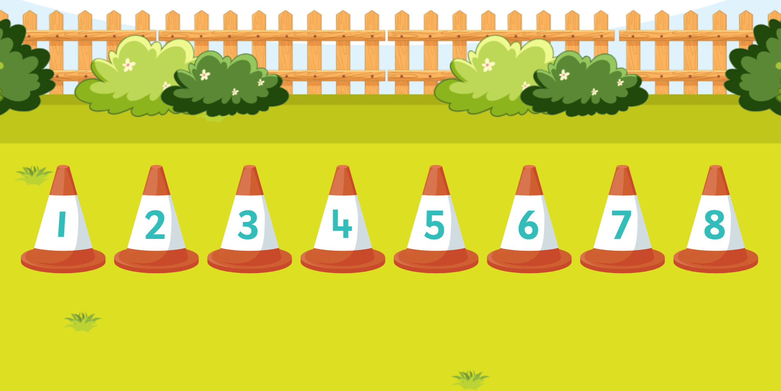
Digital Activity: Order the Cones
edco.ie/cxyn

Slide 33
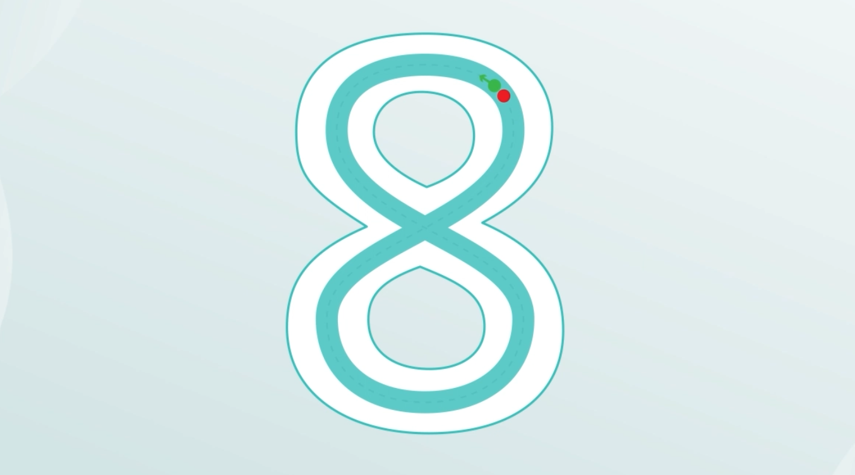
Video: Number Formation – 8
edco.ie/2hmp

Slide 34

Video: Number Formation – 9
edco.ie/9tgg

Slide 35
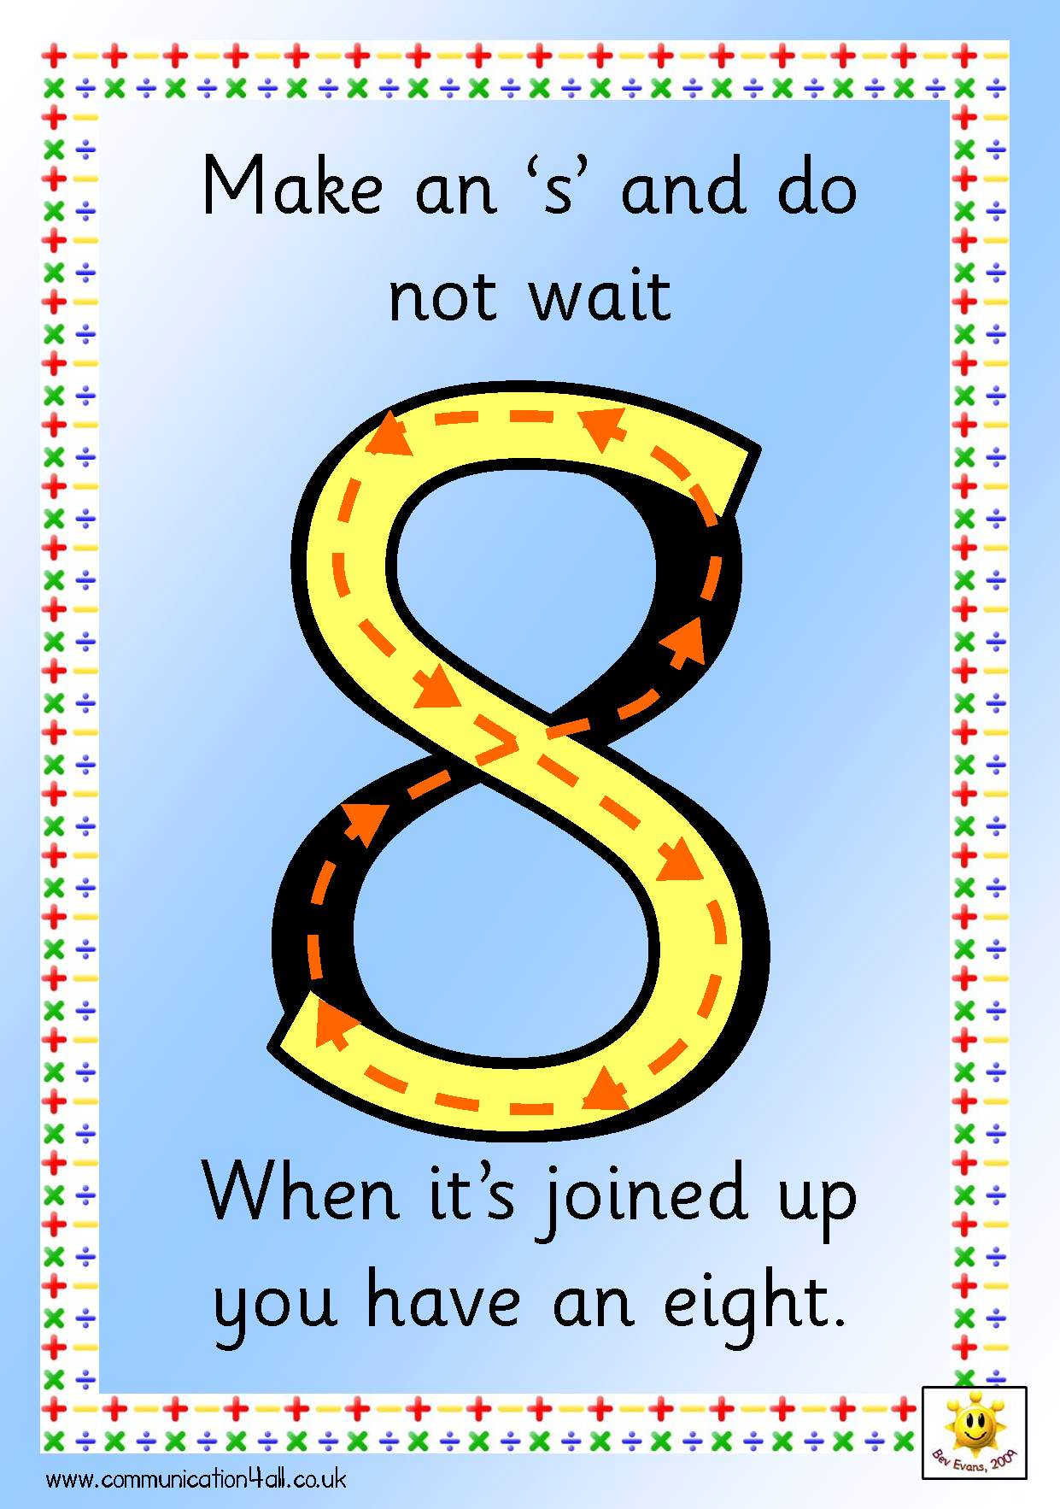
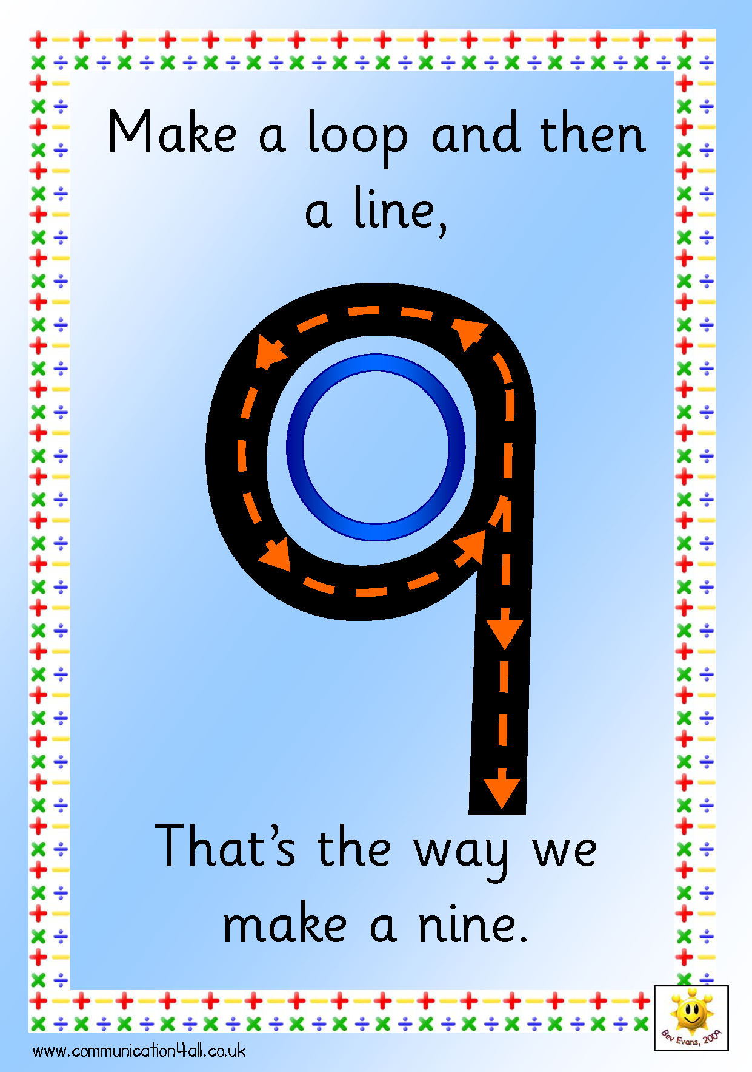
Make the Numeral in the Air
Source: http://www.communication4all.co.uk/http/numeracynew.htm
Notes:
Make the numeral in the air
Set of A4 poster of all numerals (like above) available to download from http://www.communication4all.co.uk/http/numeracynew.htm

Slide 36
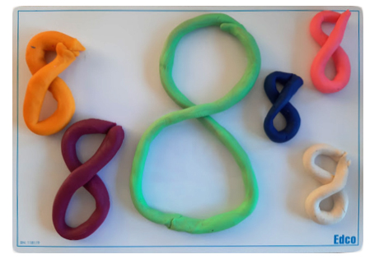
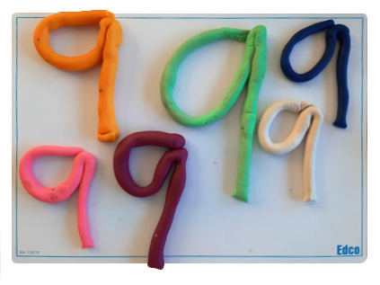
Play Dough: Make the Numeral

Slide 37
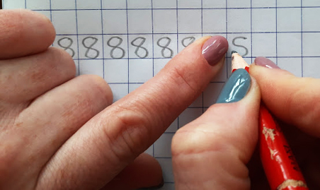
In Your Copy: Make the Numeral 8
Make an “s”… Join it up
Notes:
For right-handed writers only

Slide 38
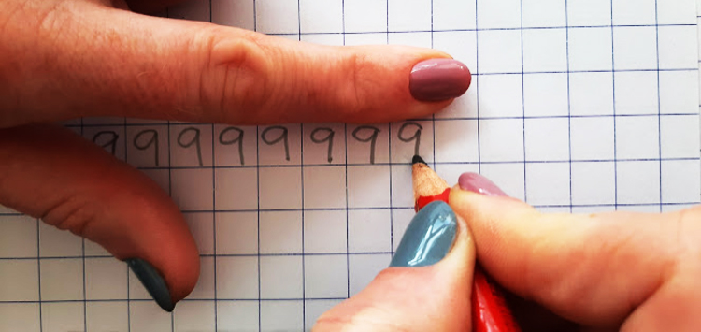
In Your Copy: Make the Numeral 9
Make a loop and then a line…
Notes:
For right-handed writers only

Slide 39

Interactive Web Activity
Today's Number Up to 20 | edco.ie/px4d

Slide 40
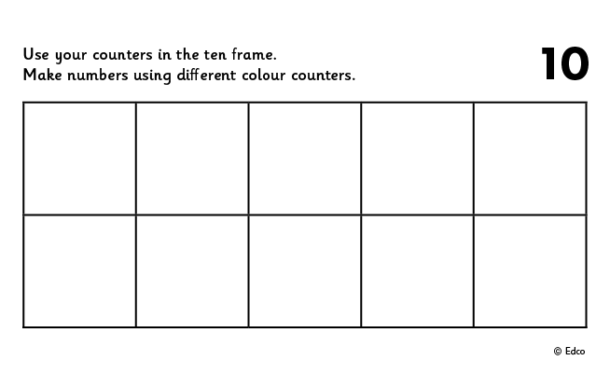
Ten Frame
Put 8 in the frame.
How many on the top row?
How many on the bottom row?
Put 8 in the frame a different way.
If I take away ___ how many will be left?
Put __ in the frame. How many more to make 8?
Put 8 in the frame. How many do I need to take away to leave __?

Slide 41
Ten Frame
Put 9 in the frame.
How many on the top row?
How many on the bottom row?
Put 9 in the frame a different way.
If I take away ___ how many will be left?
Put __ in the frame. How many more to make 9?
Put 9 in the frame. How many do I need to take away to leave __?

Slide 42
Ten Frame
Now stand the frame up tall and put 8 in the frame. Fill from the bottom left.
How many on the left?
How many on the right?
Arrange 8 in the frame in a different way.
If I take away ___ how many will be left?
Put __ in the frame. How many more to make 8?
Put 8 in the frame. How many do I need to take away to leave __?

Slide 43
Ten Frame
Now stand the frame up tall and put 9 in the frame. Fill from the bottom left.
How many on the left?
How many on the right?
Arrange 9 in the frame in a different way.
If I take away ___ how many will be left?
Put __ in the frame. How many more to make 9?
Put 9 in the frame. How many do I need to take away to leave __?

Slide 44
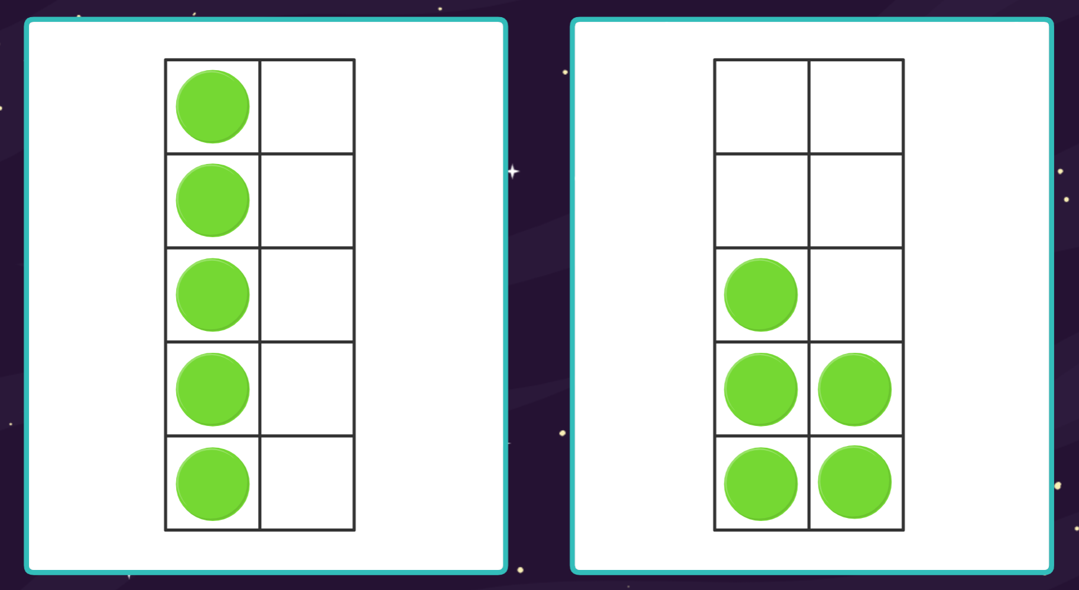
Digital Activity: Same But Different –
Ten Frames
edco.ie/34pt

Slide 45

Clapping
Listen to me clap.
How many times did I clap? Show me with your fingers.
How many times did I clap? Show me with your frame and counters.
How many times did I clap? Show me on your number fan.
How many times did I clap? Write the numeral on your MWB.

Slide 46
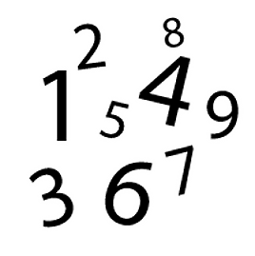
Sound of a Number
Listen to me drop coins into this tin.
How many coins did I drop in? Show me with your fingers.
How many coins did I drop in? Show me with your frame and counters.
How many coins did I drop in? Show me on your number fan.
How many coins did I drop in? Write the numeral on your MWB.

Slide 47
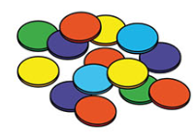
Making Sets of 8
Choose some objects to make
a set.
How many objects are there in your set? How do you know?
Can you make a set of 8? How did you make a set of 8? How
do you know that there are 8 objects in your set?
Count the objects in your set. Put your objects in a line.
How many are there?
Needed: manipulatives (bears, counters, beads, links and interlocking cubes)

Slide 48
Making Sets of 9
Choose some objects to make
a set.
How many objects are there in your set? How do you know?
Can you make a set of 9? How did you make a set of 9? How
do you know that there are 9 objects in your set?
Count the objects in your set. Put your objects in a line.
How many are there?
Needed: manipulatives (bears, counters, beads, links and interlocking cubes)

Slide 49
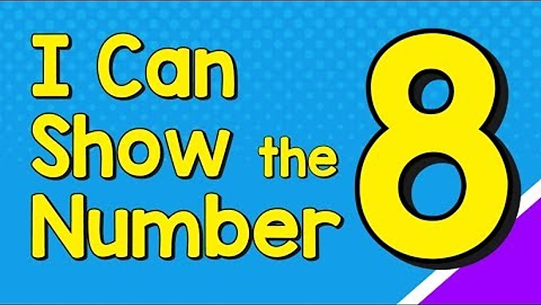
Video: I Can Show the Number 8
edco.ie/bf5r

Slide 50
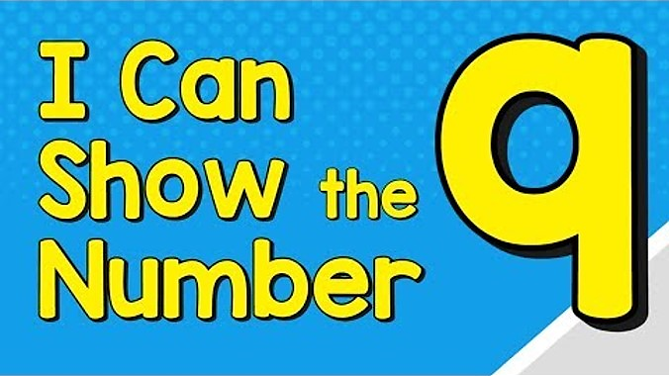
Video: I Can Show the Number 9
edco.ie/rqmk

Slide 51
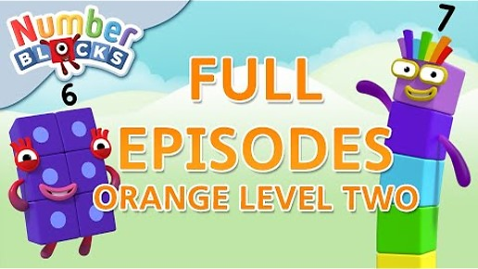
Video: Orange Level Two | Full Episodes 1-3
edco.ie/mspz
Notes:
Numberblocks Season 2:
Episode 1: Six
Episode 2: Seven
Episode 3: Eight
https://www.ncetm.org.uk/classroom-resources/ey-numberblocks-series-2/

Slide 52
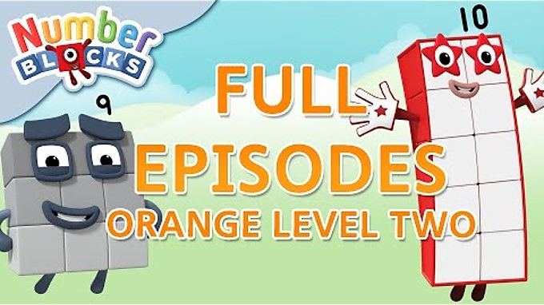
Video: Orange Level Two | Full Episodes 4-6
edco.ie/zbxu
Notes:
Numberblocks Season 2:
Episode 4: Nine
Episode 5: Ten
Episode 6: Just add 1
https://www.ncetm.org.uk/classroom-resources/ey-numberblocks-series-2/

Slide 53
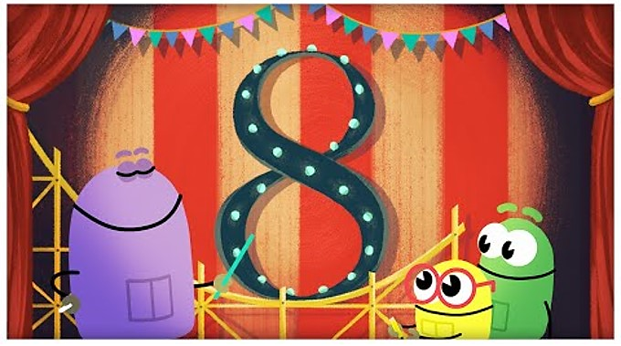
Video: The Number Eight
edco.ie/zqse

Slide 54
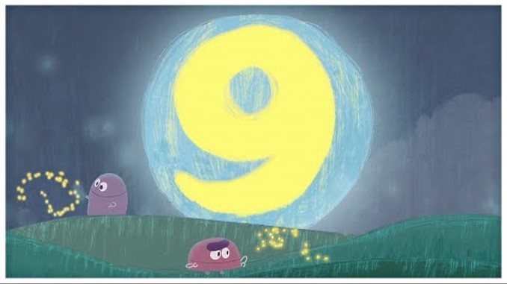
Video: The Number Nine
edco.ie/jucs

Slide 55
Picture Books & Read Alouds

Slide 56

Picture Books & Read Alouds via Internet Archive
There are many counting and number related books on https://archive.org
This is an online digital library/archive that is free to access. Just click on the link, register/log in for FREE, and then simply "borrow" the required book for an hour. After an hour you can choose to borrow it again if required.

Slide 57
Picture Books & Read Alouds
Anno’s Counting Book by Mitsumasa Anno
Downloadable at edco.ie/cfyz
Suitable for Junior Infants and Senior Infants
This book takes the reader on a journey through the four seasons of the year with numbers 1 to 12.
Numbers are represented by numerals, cubes and many sets of objects in the beautiful scenes depicted in this wordless counting book.
Notes:
https://earlymath.erikson.edu/numbers-and-fun-with-annos-counting-book-best-preschool-books-for-math/
https://earlymath.erikson.edu/different-uses-numbers-annos-counting-book/

Slide 58
Picture Books & Read Alouds
My Eight Book and My Nine Book by Jane Belk Moncure
Downloadable at edco.ie/bqyk and edco.ie/k92m
Suitable for Junior Infants and Senior Infants
A series of books where each one introduces the concept of the title number by interacting with that amount of a variety of things, some of which are grouped and regrouped to demonstrate adding and subtracting.

Slide 59
Picture Books & Read Alouds
Eight Silly Monkeys by Steve Haskamp
Downloadable at edco.ie/89ac
Suitable for Junior Infants and Senior Infants
A picture book version of the popular counting down song/rhyme ‘No more monkeys jumping on the bed!’

Slide 60
Picture Books & Read Alouds
Nine Town by Nadia Higgins
Downloadable at edco.ie/buds
Suitable for Junior Infants and Senior Infants
A series of books where each one tells the story of a town dedicated to the title number.

Slide 61
Picture Books & Read Alouds
Nine Ducks Nine by Sarah Hayes
Downloadable at edco.ie/82tz
Suitable for Junior Infants and Senior Infants
Intimidated by Fox, nine ducks leave, one-by-one, only to all return at the end when Fox gets his comeuppance.

Slide 62
Games

Slide 63
Pair Game: Throw and Build!
Needed: 8 cubes (unifix or multilink), one or two dice, per player.
Each player, in turn, chooses to throw one or two dice and then builds a stack of that number
of cubes.
The players add to their stack of number of cubes.
The first player to build a stack of 8 cubes wins
the game.

Slide 64
Pair Game: Throw and Build!
Needed: 9 cubes (unifix or multilink), one or two dice, per player.
Each player, in turn, chooses to throw one or two dice and then builds a stack of that number
of cubes.
The players add to their stack of number of cubes.
The first player to build a stack of 9 cubes wins
the game.

Slide 65
Pair Game: Tower Splits!
Needed: 8 cubes and tokens (could be counters, links, paperclips, etc.)
Player A makes a tower of 8 cubes.
Player B closes their eyes and calls SPLIT!
Player A splits the tower in 2 parts and hides one part behind their back.
Player B looks at the part of the tower they can see and says how many cubes are hidden. If correct, Player B takes a token.
Swap roles and keep playing until time is up.
The winner is the person with the most tokens when the time is up.

Slide 66
Pair Game: Tower Splits!
Needed: 9 cubes and tokens (could be counters, links, paperclips, etc.)
Player A makes a tower of 9 cubes.
Player B closes their eyes and calls SPLIT!
Player A splits the tower in 2 parts and hides one part behind their back.
Player B looks at the part of the tower they can see and says how many cubes are hidden. If correct, Player B takes a token.
Swap roles and keep playing until time is up.
The winner is the person with the most tokens when the time is up.

Slide 67
Pair Game: Chain Splits!
Needed: 8 links and tokens (could be counters, cubes, paperclips, etc.)
Player A makes a chain of 8 links.
Player B closes their eyes and calls SPLIT!
Player A splits the chain in 2 parts and hides one part behind their back.
Player B looks at the part of the chain they can see and says how many links are hidden. If correct, Player B takes a token.
Swap roles and keep playing until time is up.
The winner is the person with the most tokens when the time is up.

Slide 68
Pair Game: Chain Splits!
Needed: 9 links and tokens (could be counters, cubes, paperclips, etc.)
Player A makes a chain of 9 links.
Player B closes their eyes and calls SPLIT!
Player A splits the chain in 2 parts and hides one part behind their back.
Player B looks at the part of the chain they can see and says how many links are hidden. If correct, Player B takes a token.
Swap roles and keep playing until time is up.
The winner is the person with the most tokens when the time is up.

Slide 69
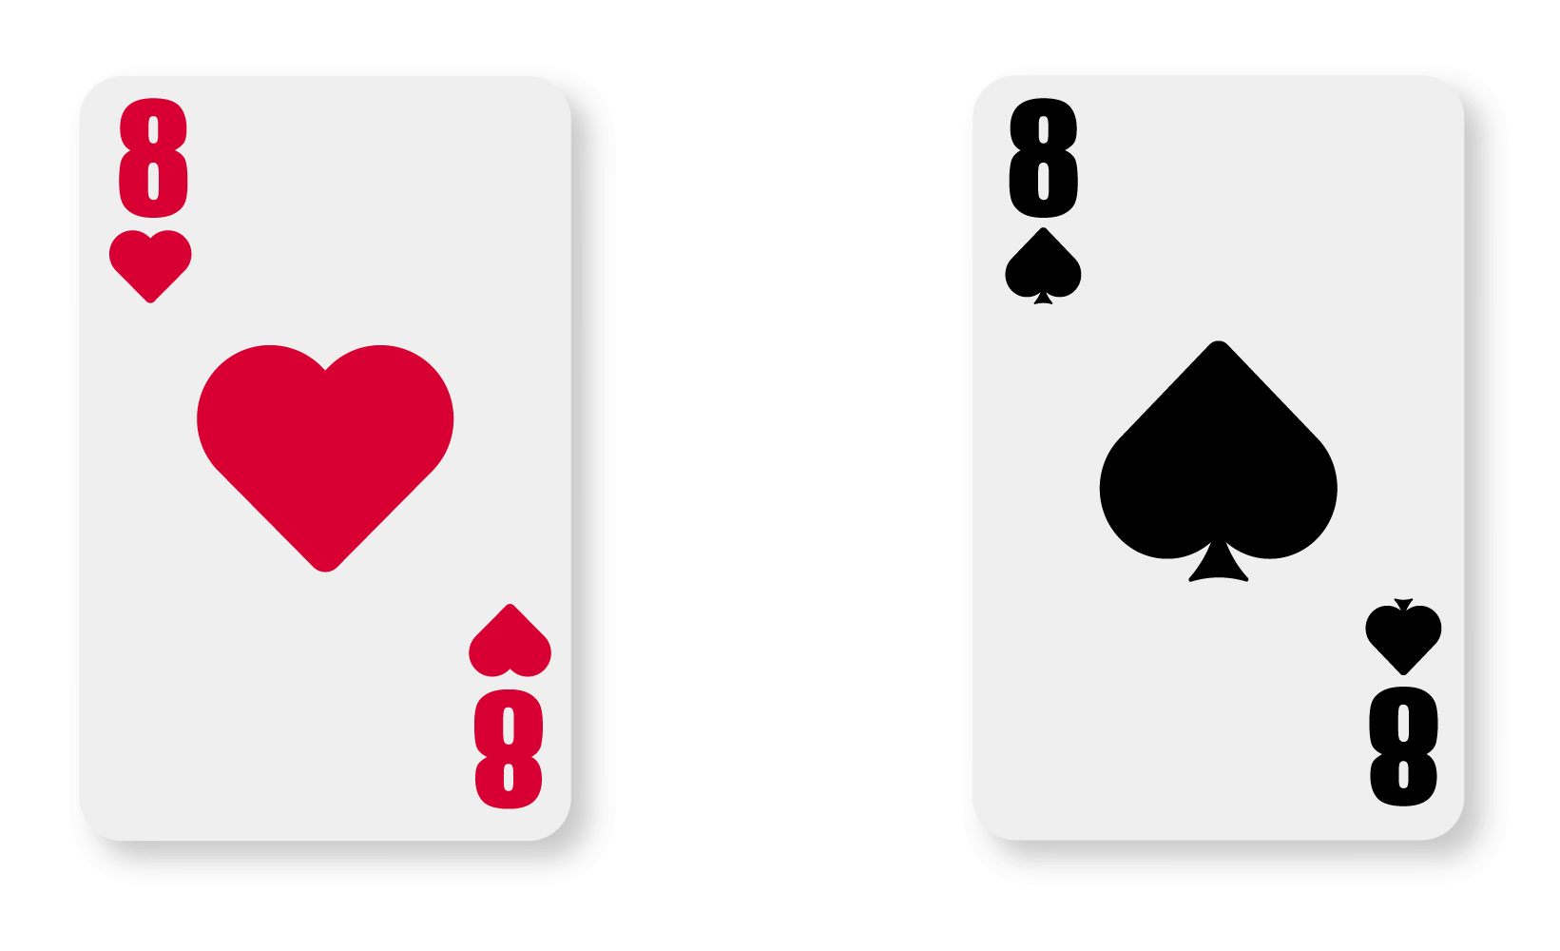

Play Memory
If you turn over two 8s or two 9s, you get a bonus go!

Slide 70
Image Credits
Shutterstock

