Slide 2
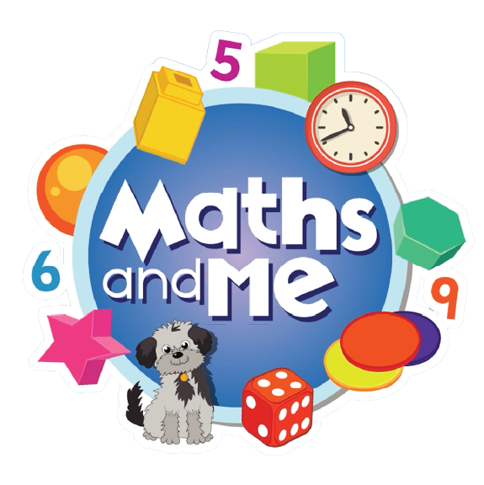
Contents
How to Use These Slides
Rationale
Counting & Numeration
Picture Books & Read Alouds
Games

Slide 3
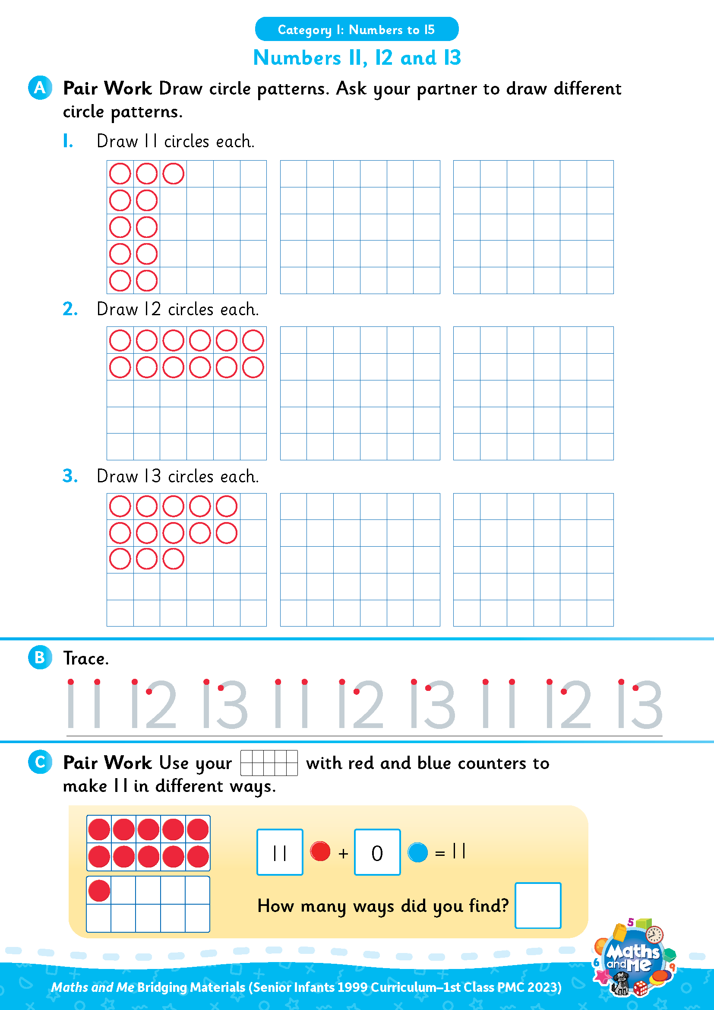
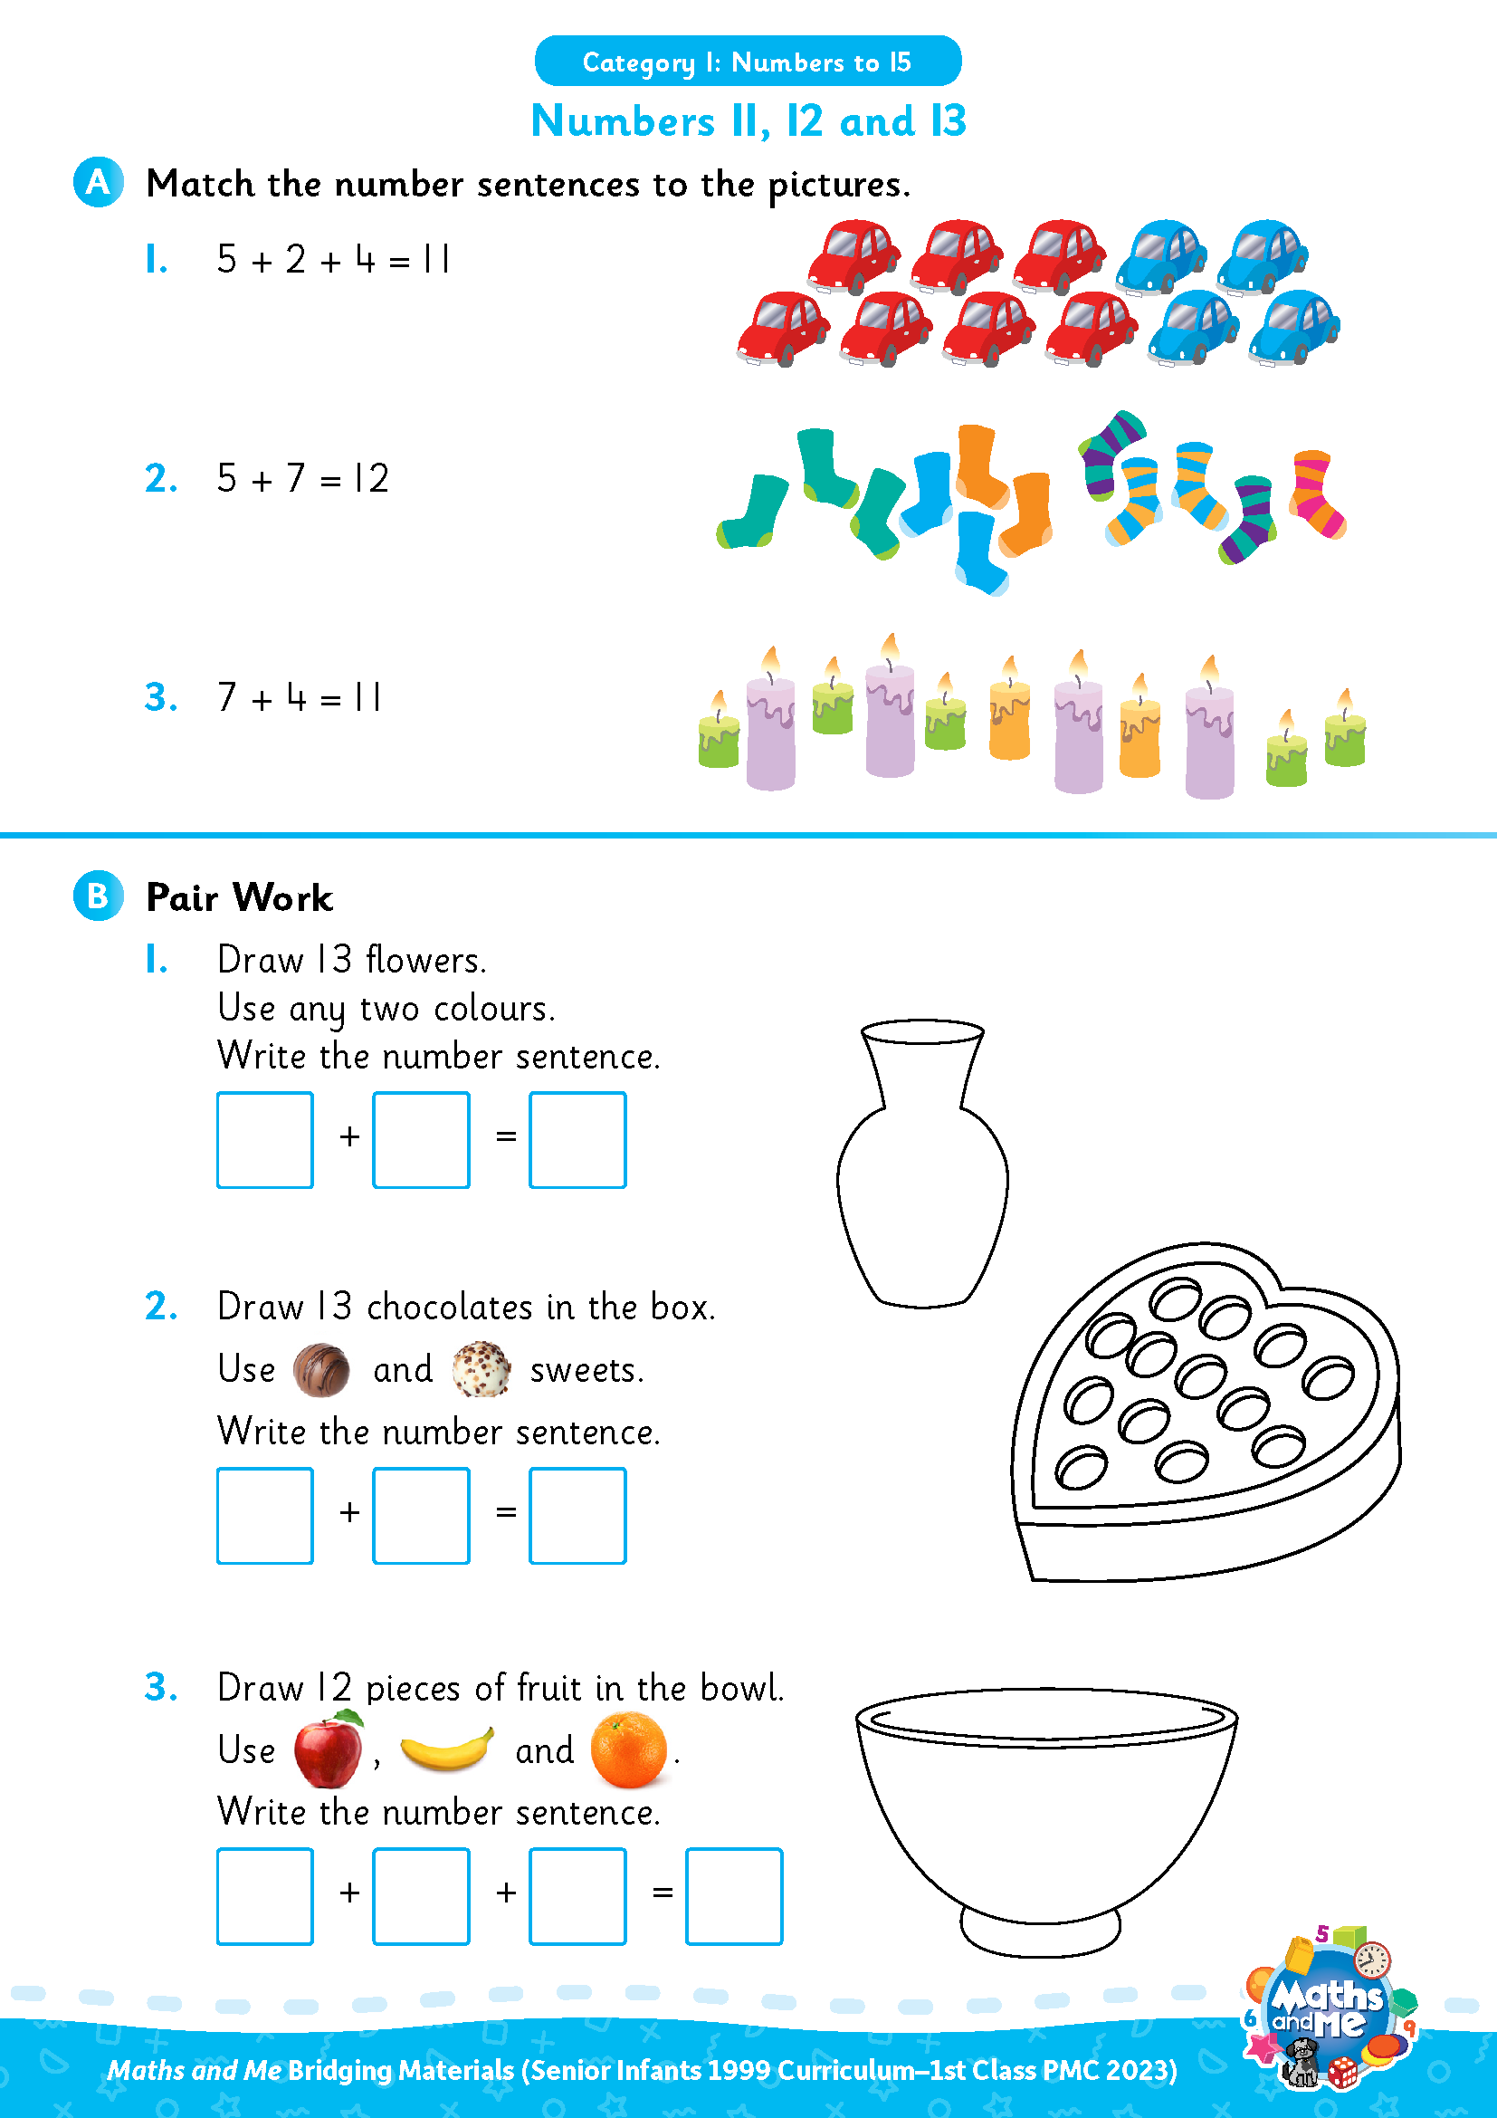
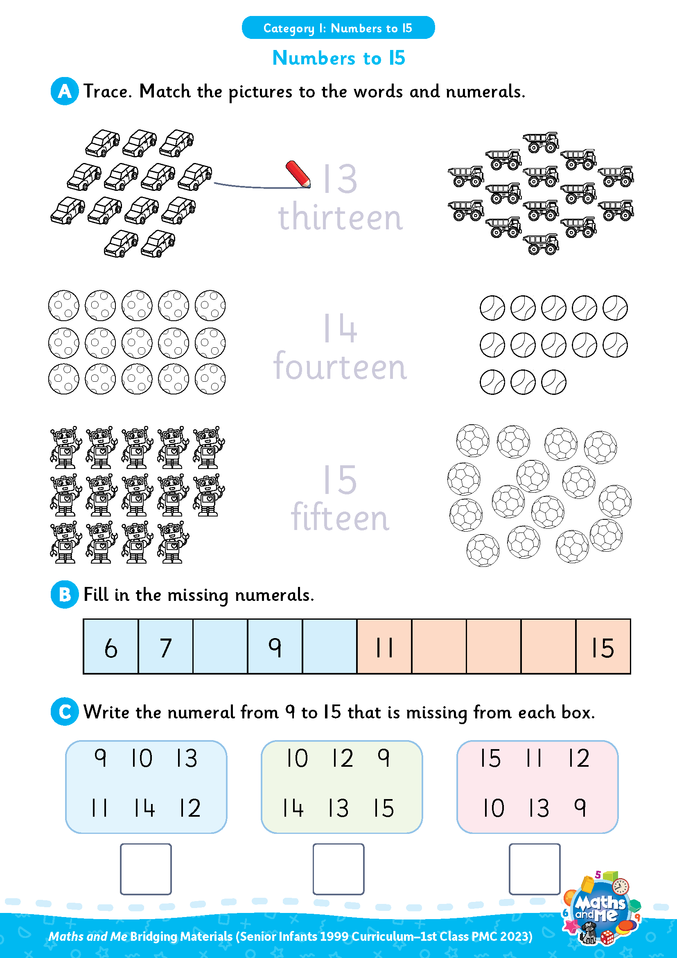
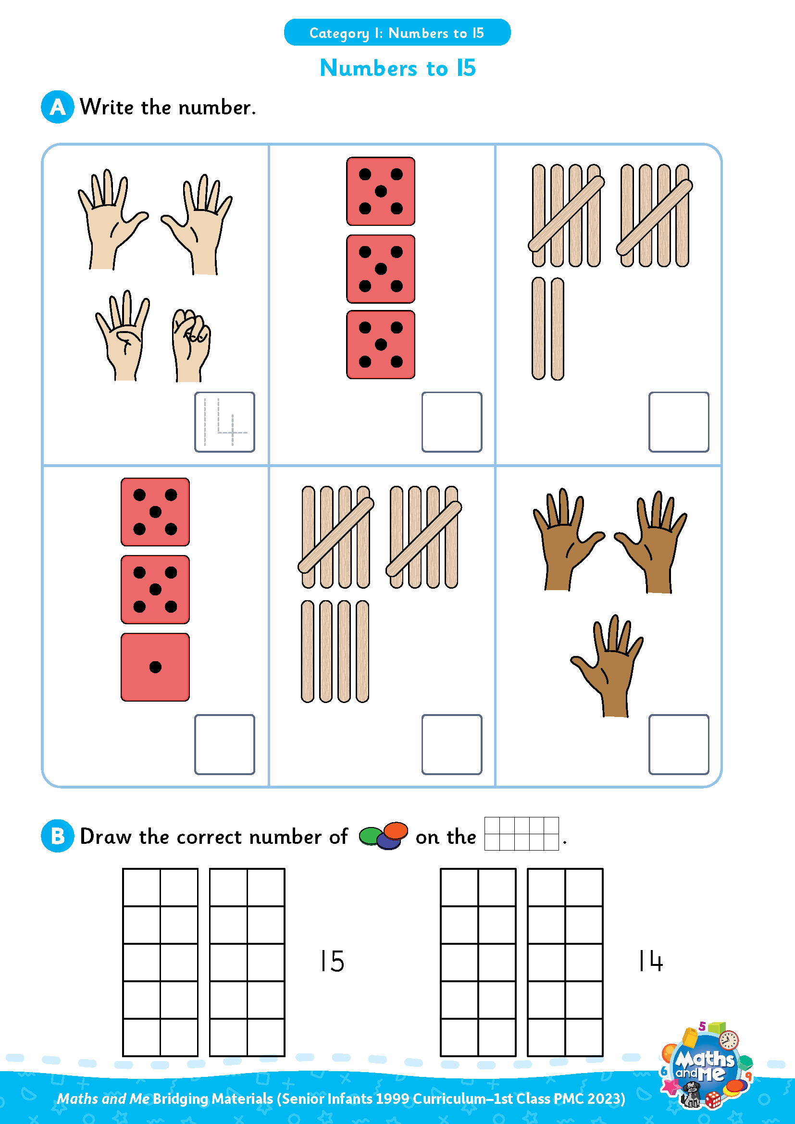
Introduction
This is the first of two presentations prepared to support teachers with the transition to the PMC. It covers Numbers to 15.
Activity sheets are also available on Edco Learning to support this category.
Use these slides as they are or edit them to suit the needs of your class.

Slide 4
Rationale
These resources have been selected to offer children a gentle introduction to numbers up to 15, which they may not have encountered formally in their current Senior Infants maths book. The resources will make them more prepared for the Maths and Me First Class programme.
That said, it is not essential that teachers use these materials prior to starting the Maths and Me First Class programme. The content of Maths and Me for First Class has been carefully considered to provide cohesive and structured learning experiences for the children, that are also playful and engaging. When in First Class, the numbers up to 15 will be constantly revised and consolidated alongside new learning.

Slide 5
Rationale
The low-threshold, high-ceiling approach that typifies Maths and Me is designed to support children and enable them to comfortably work with numbers outside the traditional number limits.
Ultimately, at the end of the Maths and Me Senior Infants programme, we are confident that the children will be much more capable and confident mathematicians!

Slide 6
Counting & Numeration

Slide 7
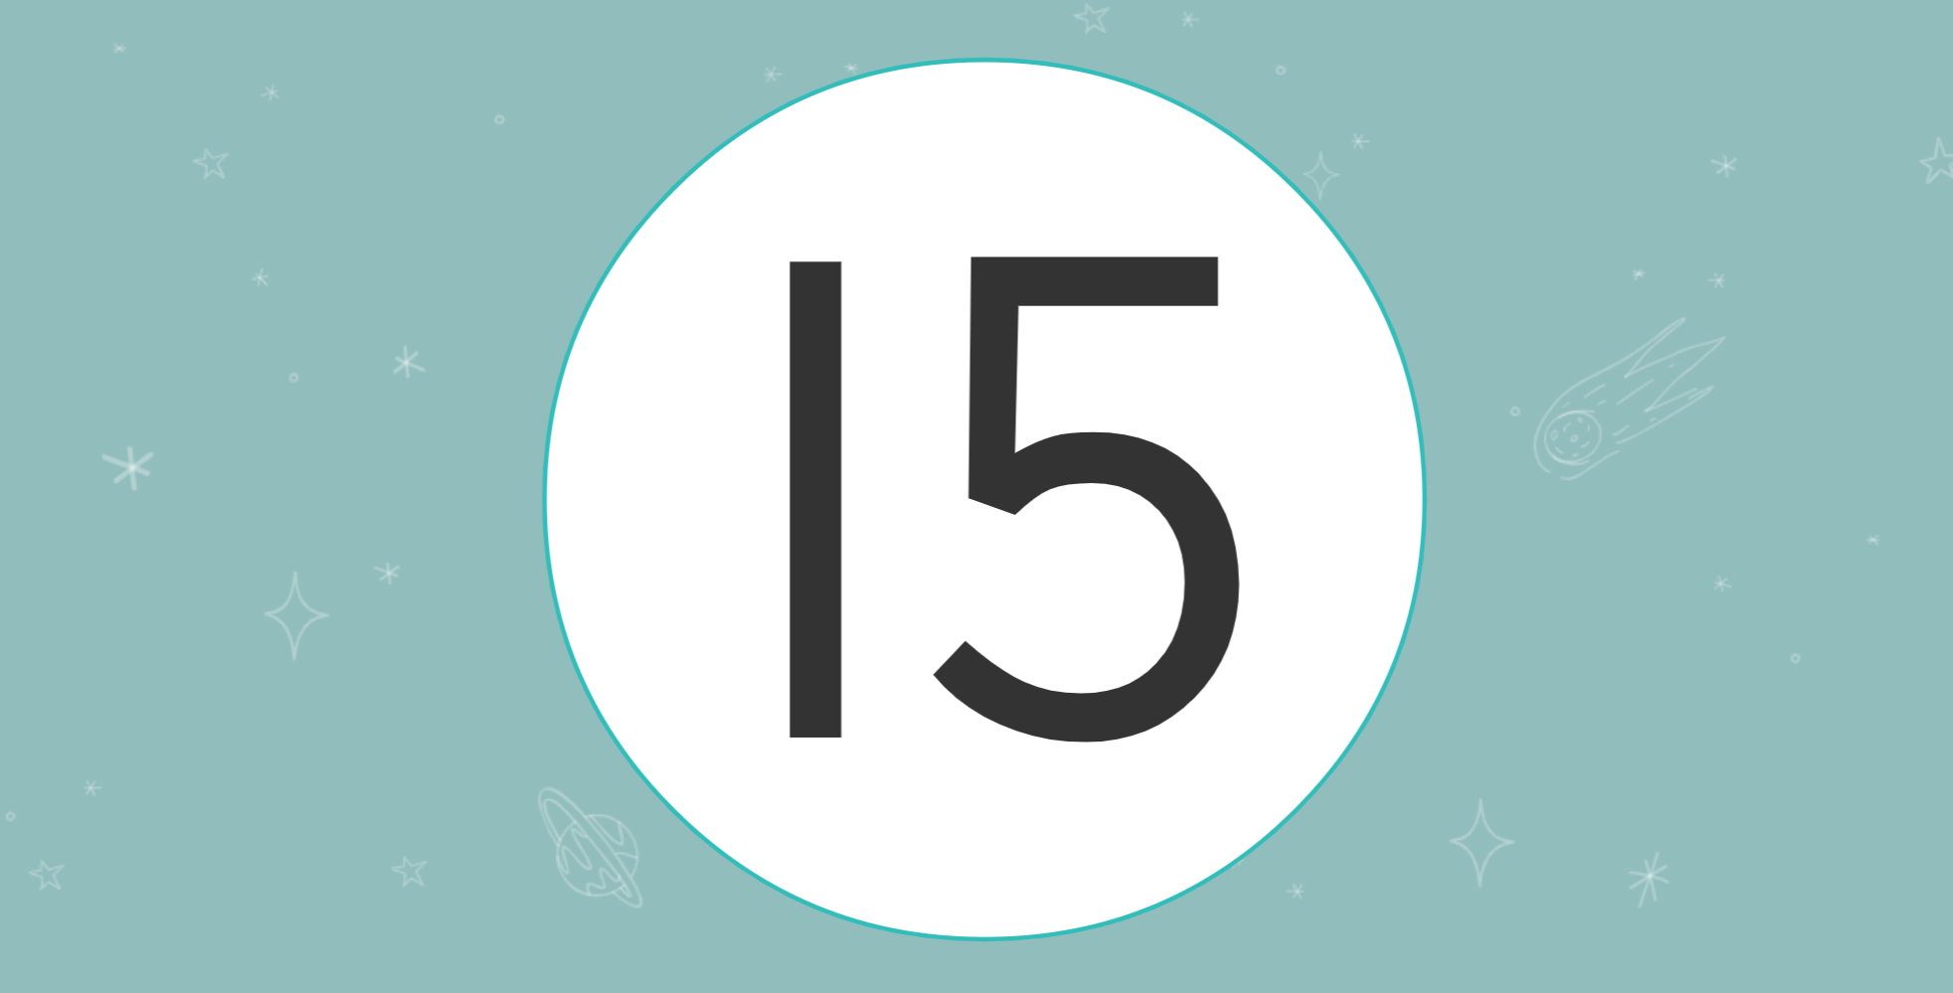
Digital Activity: Counting to 15
edco.ie/89tq

Slide 8
Counting & Numeration
1 | 2 | 3 | 4 | 5 | 6 | 7 | 8 | 9 | 10
11 | 12 | 13 | 14 | 15 | 16 | 17 | 18 | 19 | 20
Count forwards
Count backwards
Count forwards and clap hands
Count backwards and stamp feet

Slide 9
Counting & Numeration
1 | 2 | 3 | 4 | 5 | 6 | 7 | 8 | 9 | 10
11 | 12 | 13 | 14 | 15 | 16 | 17 | 18 | 19 | 20
Count forwards to 15
Count backwards from 15
Clap hands 15 times
Stamp feet 15 times
Slap knees 15 times

Slide 10
Counting & Numeration
1 | 2 | 3 | 4 | 5 | 6 | 7 |  | 9 | 10
11 | 12 | 13 | 14 | 15 | 16 | 17 | 18 | 19 | 20
What is missing?

Slide 11
Counting & Numeration
1 | 2 | 3 | 4 | 5 | 6 | 7 | 8 | 9 | 10
11 | 12 | 13 | 14 | 15 | 16 | 17 | 18 | 19 | 20
Put something on the number after __
Put something on the number before __
Put something between __ and __

Slide 12



Number Patterns
6
7
8
What number comes next?
Notes:
Needed: number path per child (0-10 or 0-20 number path)

Slide 13
Number Patterns
6
7
8
9
What number comes next?
Notes:
Needed: number path per child (0-10 or 0-20 number path)

Slide 14
Number Patterns
8
9
10
What number comes next?
Notes:
Needed: number path per child (0-10 or 0-20 number path)

Slide 15
Number Patterns
8
9
10
11
What number comes next?
Notes:
Needed: number path per child (0-10 or 0-20 number path)

Slide 16
Number Patterns
10
11
12
What number comes next?
Notes:
Needed: number path per child (0-10 or 0-20 number path)

Slide 17
Number Patterns
10
11
12
13
What number comes next?
Notes:
Needed: number path per child (0-10 or 0-20 number path)

Slide 18
Number Patterns
12
13
14
What number comes next?
Notes:
Needed: number path per child (0-10 or 0-20 number path)

Slide 19
Number Patterns
12
13
14
15
What number comes next?
Notes:
Needed: number path per child (0-10 or 0-20 number path)

Slide 20
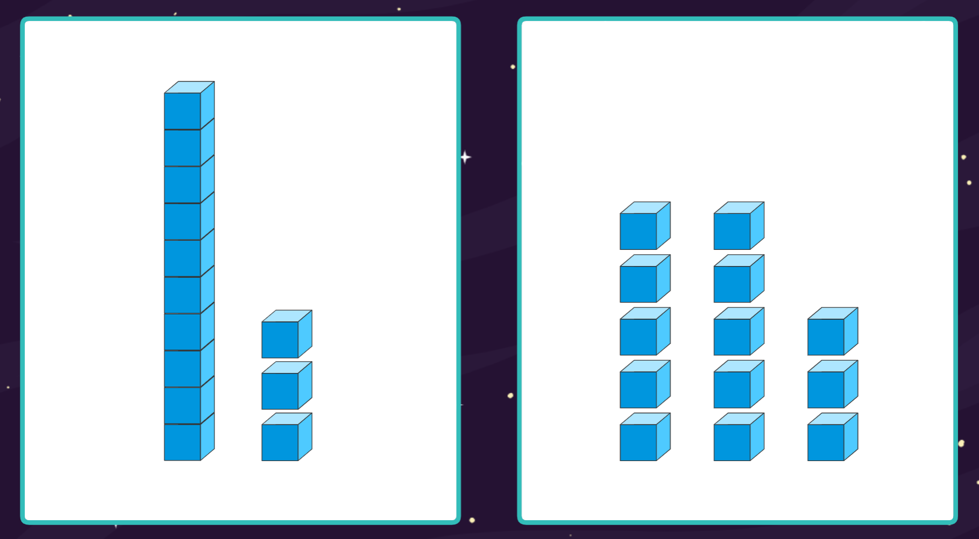
Digital Activity: Same But Different – Numbers to 15
edco.ie/2rtt

Slide 21

Interactive Web Activity
Today's Number Up to 20 | edco.ie/px4d

Slide 22

Clapping
Listen to me clap.
How many times did I clap? Show me with your fingers.
How many times did I clap? Show me with your frame and counters.
How many times did I clap? Show me on your number fan.
How many times did I clap? Write the numeral on your MWB.

Slide 23
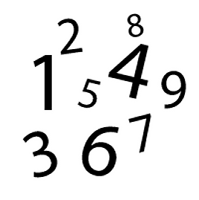
Sound of a Number
Listen to me drop coins into this tin.
How many coins did I drop in? Show me with your fingers
How many coins did I drop in? Show me with your frame and counters
How many coins did I drop in? Show me on your number fan
How many coins did I drop in? Write the numeral on your MWB

Slide 24
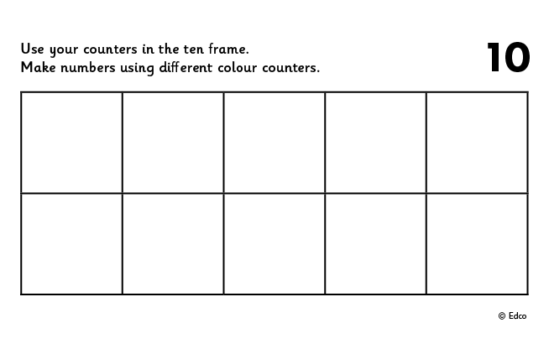
Use Counters and 2 Ten Frames
Put 11 in the frame.
How many on the 1st frame?
How many on the 2nd frame?
Put 11 in the frame a different way.
If I take away ___ how many will be left?
Put __ in the frame. How many more to make 11?
Put 11 in the frame. How many do I need to take away to leave __?
Repeat with 12, 13, 14 and 15

Slide 25
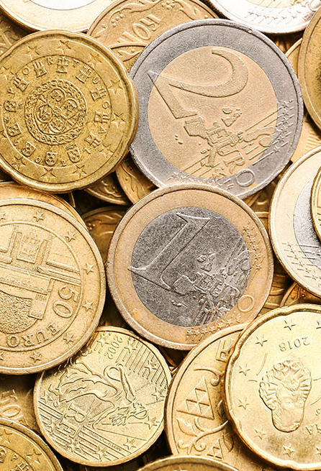
Sound of a Number
Using money make 11c. Draw what coins you used.
Show different ways.
Using money make €11. Draw what you used.
Show different ways.
Repeat with 12, 13, 14 and 15
Interactive Money: https://toytheater.com/play-money-europe/

Slide 26
Picture Books & Read Alouds

Slide 27

Picture Books & Read Alouds via Internet Archive
There are many counting and number related books on https://archive.org
This is an online digital library/archive that is free to access. Just click on the link, register/log in for FREE, and then simply "borrow" the required book for an hour. After an hour you can choose to borrow it again if required.

Slide 28
Picture Books & Read Alouds
Anno’s Counting Book by Mitsumasa Anno
Downloadable at edco.ie/cfyz
Suitable for Junior Infants and Senior Infants
This book takes the reader on a journey through the four seasons of the year with numbers 1 to 12.
Numbers are represented by numerals, cubes and many sets of objects in the beautiful scenes depicted in this wordless counting book.
Notes:
https://earlymath.erikson.edu/numbers-and-fun-with-annos-counting-book-best-preschool-books-for-math/
https://earlymath.erikson.edu/different-uses-numbers-annos-counting-book/

Slide 29
Picture Books & Read Alouds
12 Ways to Get to 11 by Eve Merriam
Downloadable at edco.ie/w7tq
Suitable for Senior Infants and 1st Class
Each double page illustrates ways to make 11.

Slide 30
Picture Books & Read Alouds
One Wolf Howls by Scotti Cohn
Downloadable at edco.ie/kjvg
Suitable for Senior Infants and 1st Class
The months of the year and the numbers 1 through 12 are used in rhyming text to introduce children to the behaviour of wolves in natural settings.

Slide 31
Picture Books & Read Alouds
On the Launch Pad by Michael Dahl
Downloadable at edco.ie/zyu3
Suitable for Senior Infants and 1st Class
A countdown from twelve to one as a space shuttle awaits liftoff

Slide 32
Picture Books & Read Alouds
The Mousier, the Merrier! by Eleanor May
Downloadable at edco.ie/2qbg
Suitable for Senior Infants and 1st Class
Albert has the rainy-day blues. Mom's suggestion that he and Wanda invite some friends over starts to snowball when Albert invites one mouse after another until there are fifteen mice!

Slide 33
Picture Books & Read Alouds
One… Two… Three… Sassafras! by Stuart J Murphy
Downloadable at edco.ie/d4ue
Suitable for Senior Infants and 1st Class
At a family reunion, the cousins line up in order of their ages to get their pictures taken.
Introduces the concept of numerical order (numbers within 15).

Slide 34
Games and Cognitively Challenging Tasks

Slide 35
Pair Game: Throw and Build!
Needed: 15 cubes (unifix or multilink), one or two dice, per player.
Each player, in turn, chooses to throw one or two dice and then builds a stack of that number
of cubes.
The players add to their stack of number of cubes.
The first player to build a stack of 15 cubes wins
the game.

Slide 36
Pair Game: Tower Splits!
Needed: 15 cubes and tokens (could be counters, links, paperclips, etc.)
Player A makes a tower of 15 cubes.
Player B closes their eyes and calls SPLIT!
Player A splits the tower in 2 parts and hides one part behind their back.
Player B looks at the part of the tower they can see and says how many cubes are hidden. If correct, Player B takes a token.
Swap roles and keep playing until time is up.
The winner is the person with the most tokens when the time is up.

Slide 37
Frame Fillers!
Needed: 1 dice, 2 ten frames and 15 items per player
The first player throws the dice and places that number of items in their frame.
Each player throws and places in turn.
The winner is the player who places 15 (or more) in their ten frame first.

Slide 38

Interactive Web Activity
Teddy Numbers | edco.ie/p86c

Slide 39
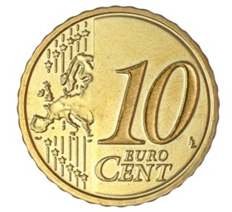
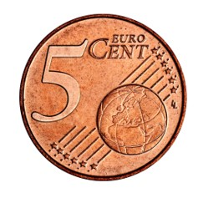
Money Swap
Dara has a 10c coin and a 5c coin. He swaps these two coins with his mam, who gives him 15c in other coins.
What might she have given him?
Notes:
How could you model this story and what could be done? (i.e. mathematical modeling)
Could you build a model using things from the classroom?
Could you draw a model?
Could you model it using a number path?
Could you model this using numerals? e.g. a part-whole model, a branching bond, a number sentence

Slide 40
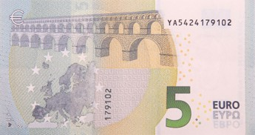
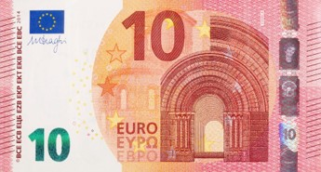
Money Swap
Mia has a €5 note and a €10. She swaps the two notes with her dad. He gives her other paper money worth the same amount. What did he give her?
Mia then swaps her €15 with her mam. Her mam gives her €15 all in coins. What might Mam have given Mia?
Notes:
How could you model this story and what could be done? (i.e. mathematical modeling)
Could you build a model using things from the classroom?
Could you draw a model?
Could you model it using a number path?
Could you model this using numerals? e.g. a part-whole model, a branching bond, a number sentence

Slide 41
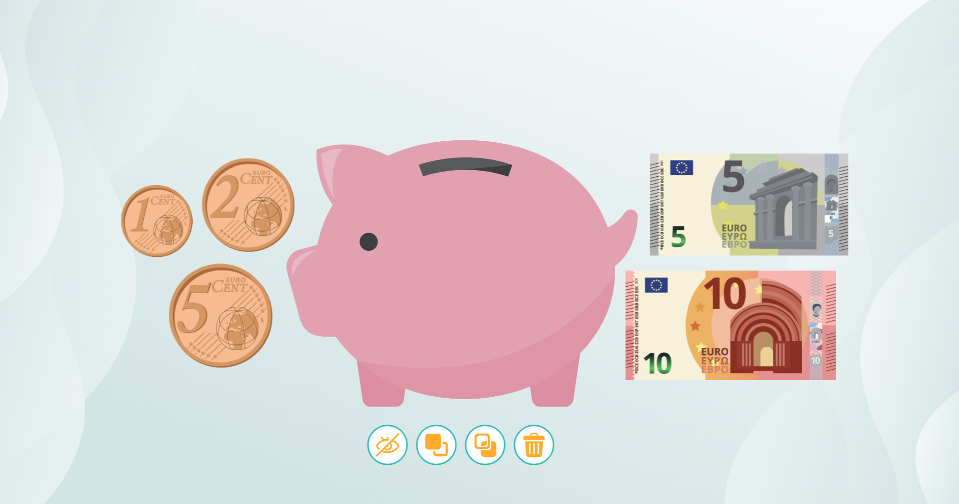
Toolkit: Money
edco.ie/3xts

Slide 42
Image Credits
Shutterstock

