Slide 2
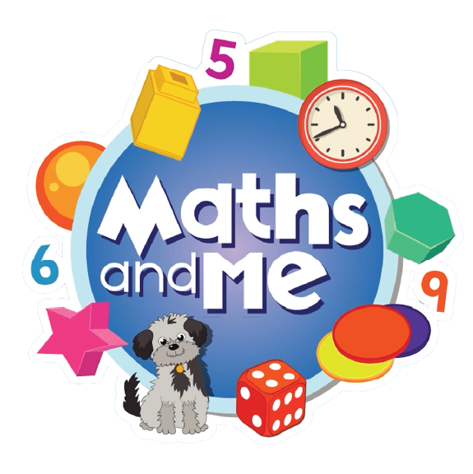
Contents
How to Use These Slides
Rationale
Counting & Numeration
Picture Books & Read Alouds
Games

Slide 3
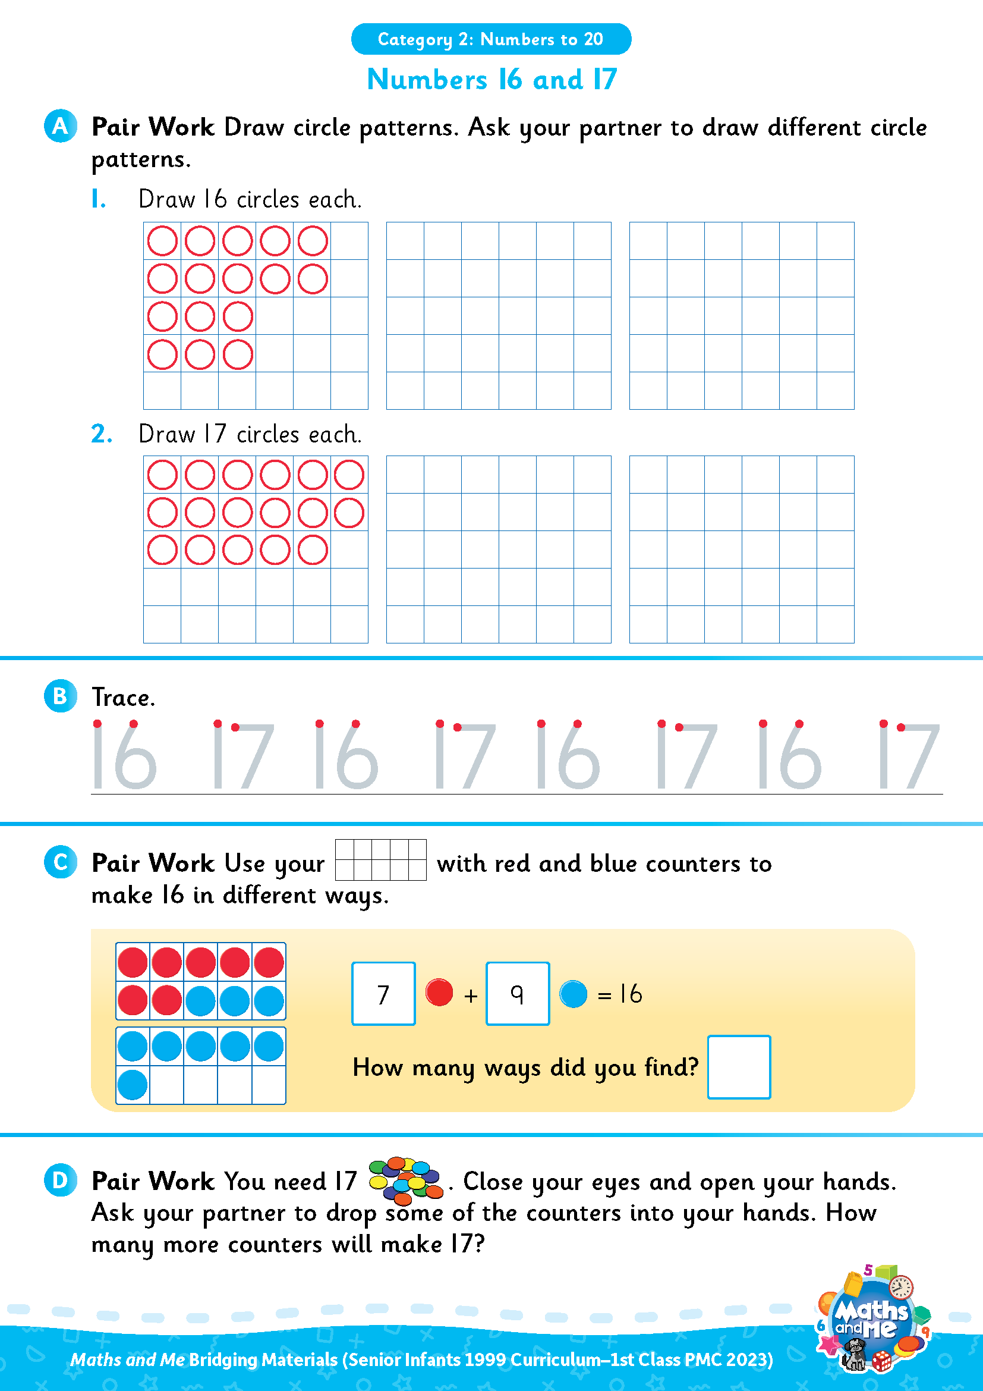
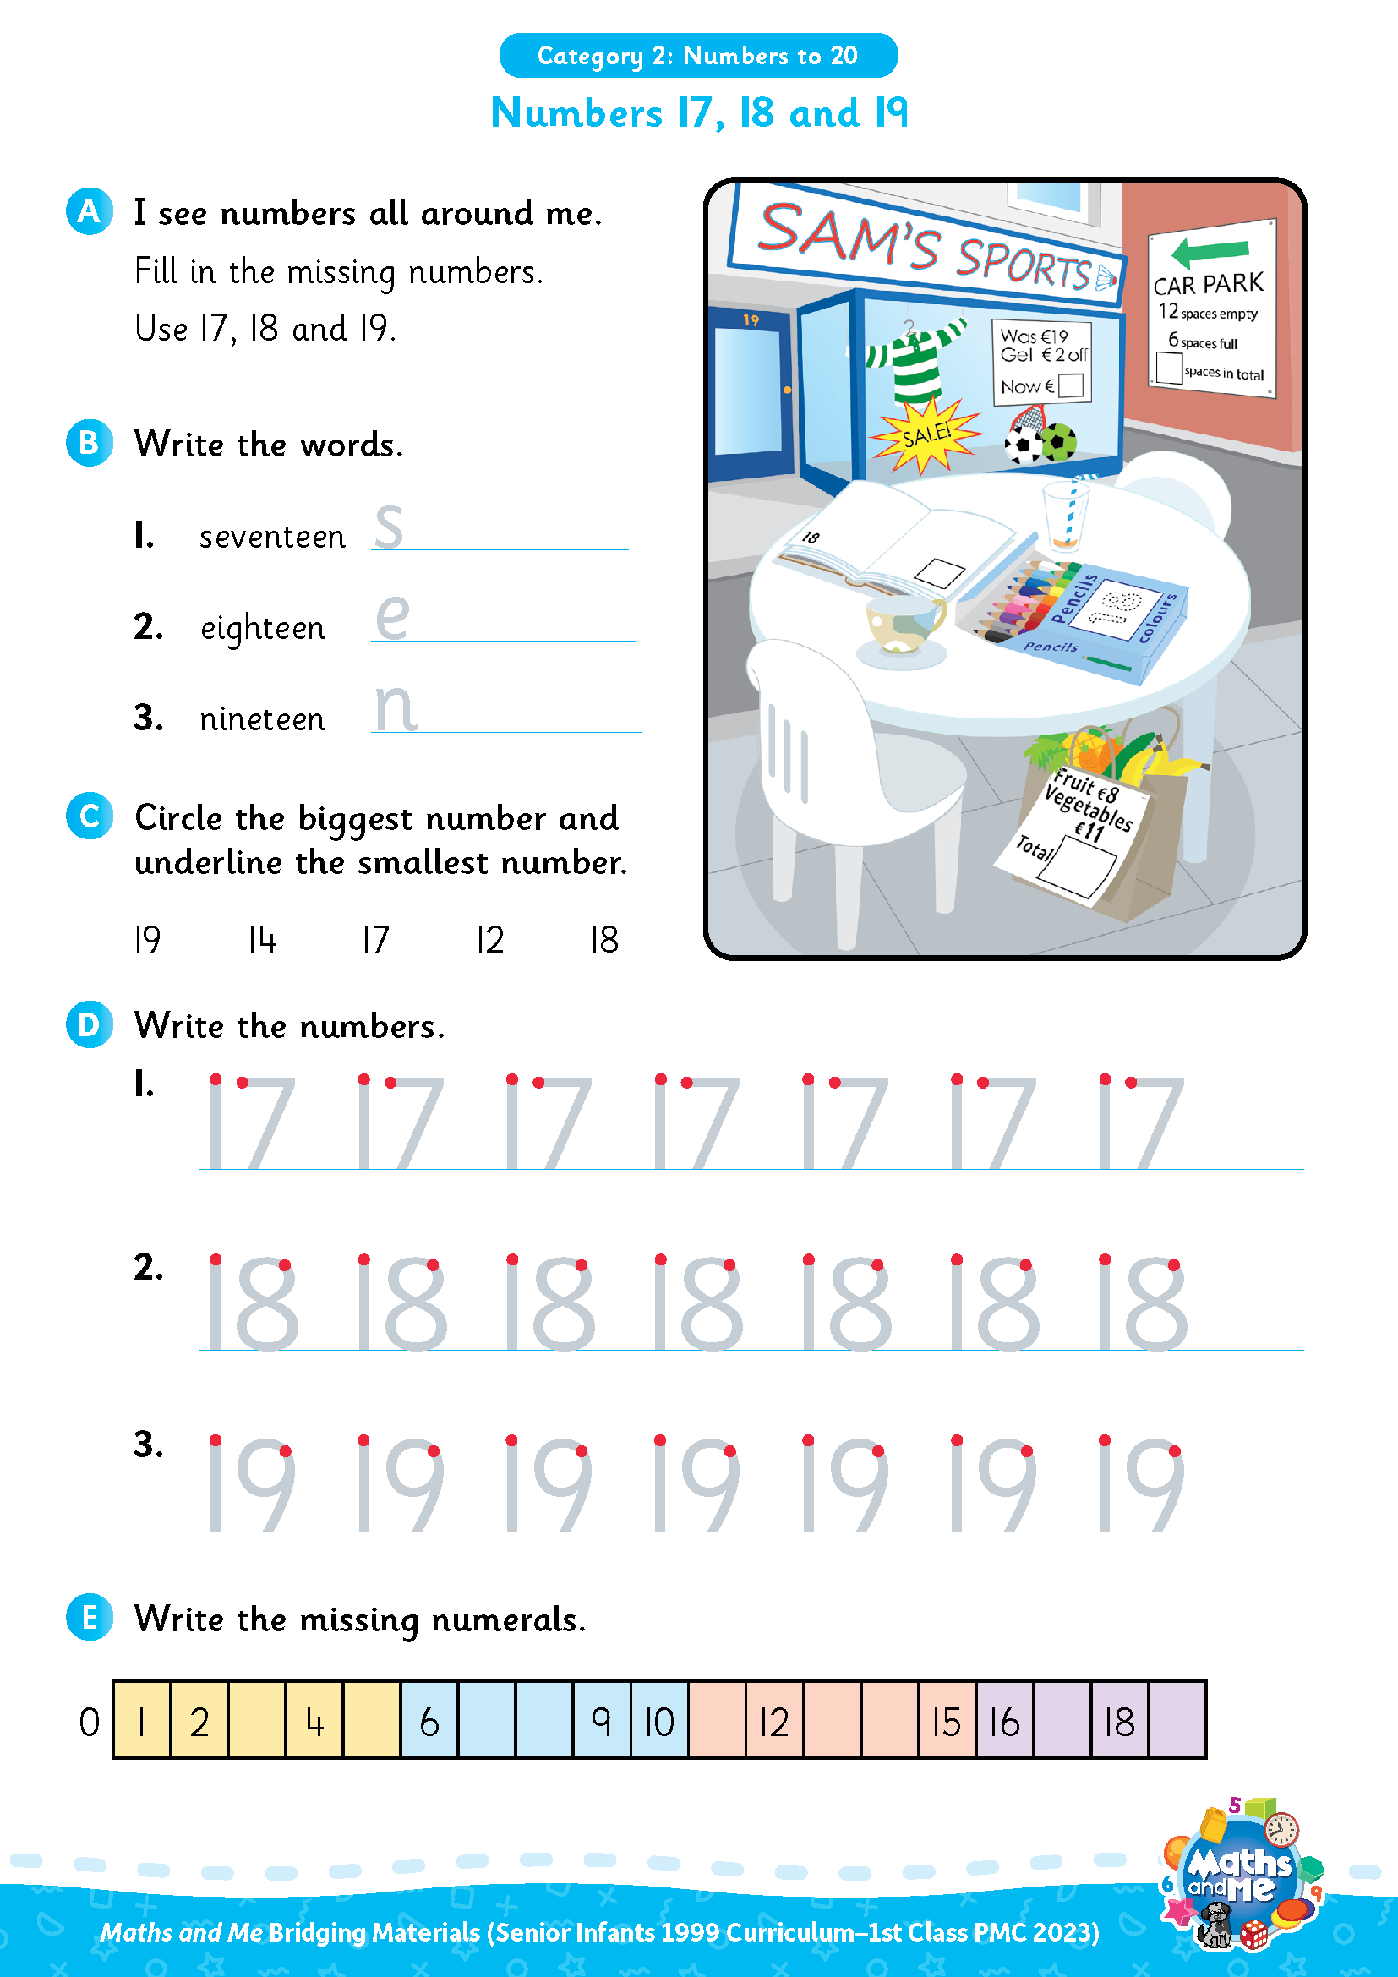
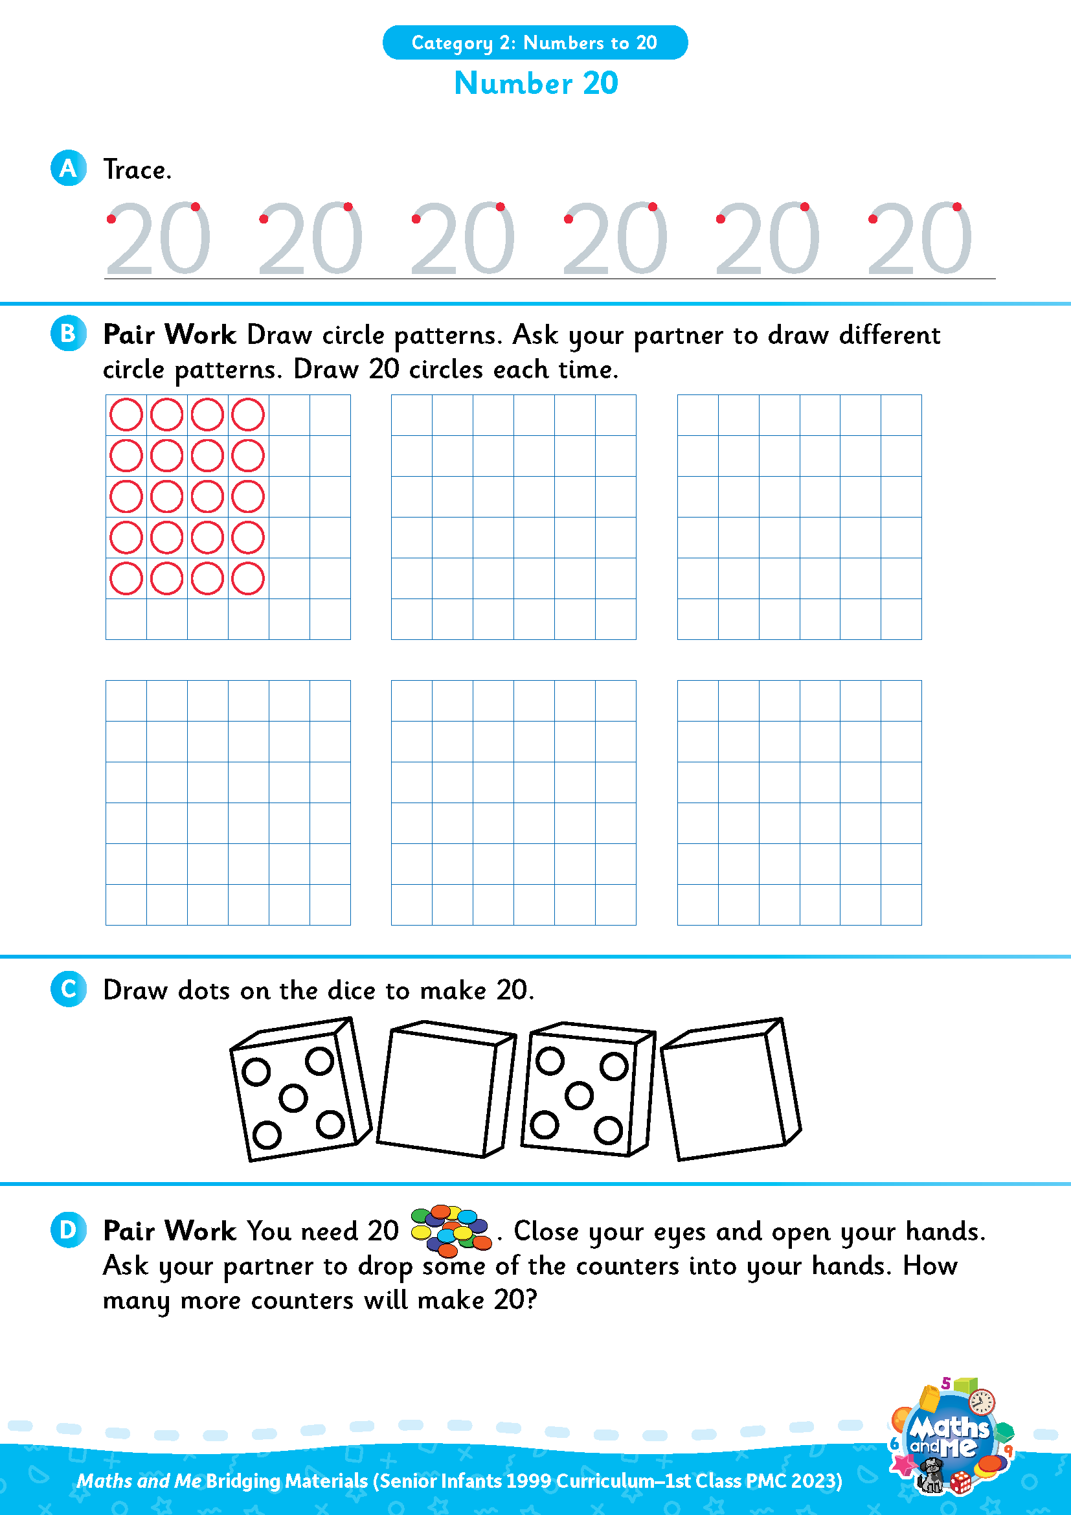
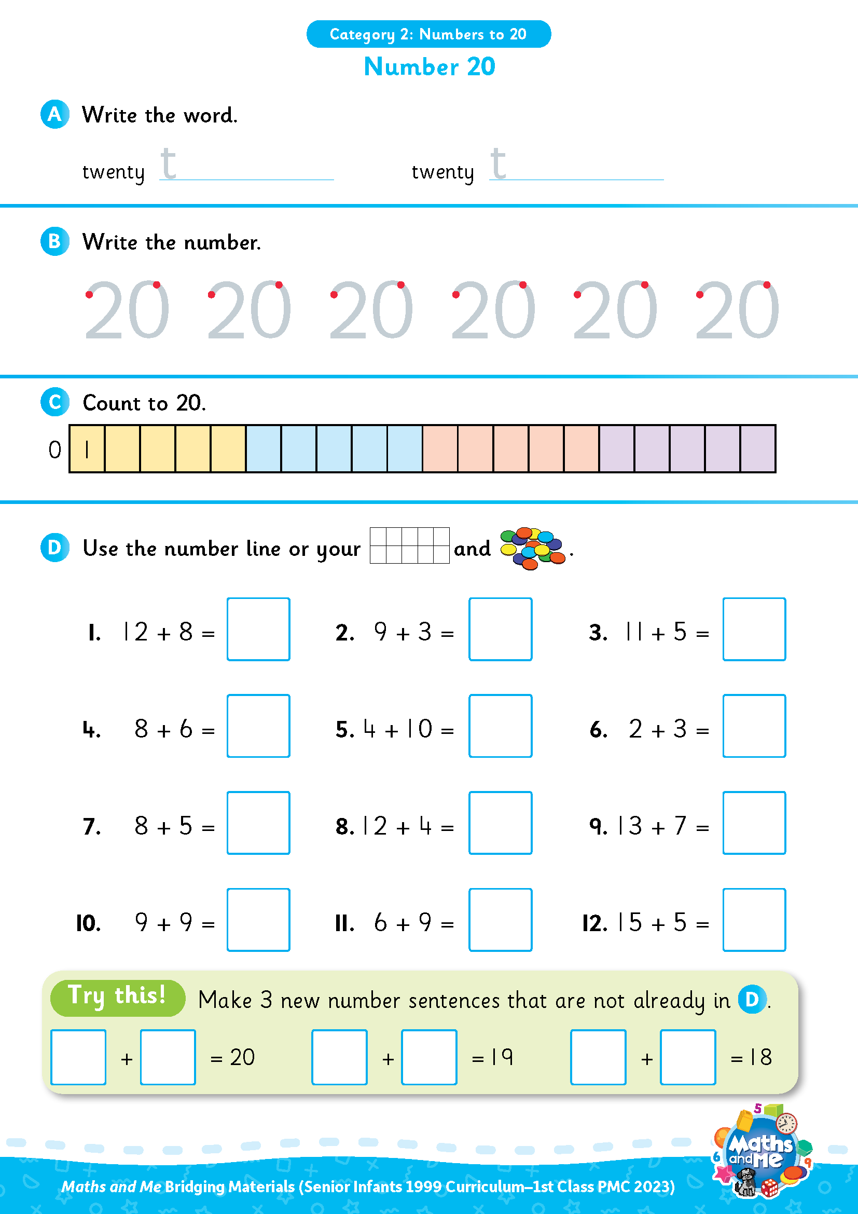
Introduction
This is the first of three presentations prepared to support teachers with the transition to the PMC. It covers Numbers to 20.
Activity sheets are also available on Edco Learning to support this category.
Use these slides as they are or edit them to suit the needs of your class.

Slide 4
Rationale
These resources have been selected to offer children a gentle introduction to numbers up to 20, which they may not have encountered formally in their current Senior Infants maths book. The resources will make them more prepared for the Maths and Me First Class programme.
That being said, it is not essential that teachers use these materials prior to starting the Maths and Me First Class programme. The content of Maths and Me for First Class has been carefully considered to provide cohesive and structured learning experiences for the children, that are also playful and engaging. When in First Class, the numbers up to 20 will be constantly revised and consolidated alongside new learning.

Slide 5
Rationale
The low-threshold, high-ceiling approach that typifies Maths and Me is designed to support children and enable them to comfortably work with numbers outside the traditional number limits.
Ultimately, at the end of the Maths and Me First Class programme, we are confident that the children will be much more capable and confident mathematicians!

Slide 6
Counting & Numeration

Slide 7
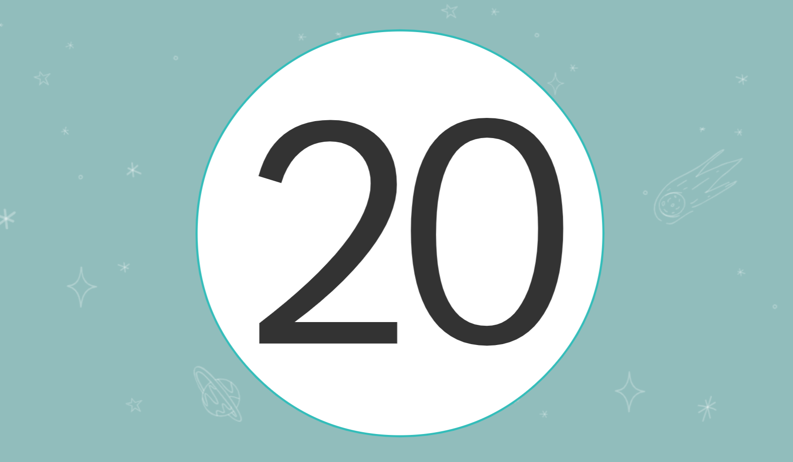
Digital Activity: Counting to 20
edco.ie/r3ej

Slide 8
Counting & Numeration
1 | 2 | 3 | 4 | 5 | 6 | 7 | 8 | 9 | 10
11 | 12 | 13 | 14 | 15 | 16 | 17 | 18 | 19 | 20
Count forwards
Count backwards
Count forwards and clap hands
Count backwards and stamp feet

Slide 9
Counting & Numeration
1 | 2 | 3 | 4 | 5 | 6 | 7 | 8 | 9 | 10
11 | 12 | 13 | 14 | 15 | 16 | 17 | 18 | 19 | 20
Count forwards to 20
Count backwards from 20
Clap hands 20 times
Stamp feet 20 times
Slap knees 20 times

Slide 10
Counting & Numeration
1 | 2 | 3 | 4 | 5 | 6 | 7 |  | 9 | 10
11 | 12 | 13 | 14 | 15 | 16 | 17 | 18 | 19 | 20
What is missing?

Slide 11
Counting & Numeration
1 | 2 | 3 | 4 | 5 | 6 | 7 | 8 | 9 | 10
11 | 12 | 13 | 14 | 15 | 16 | 17 | 18 | 19 | 20
Put something on the number after __
Put something on the number before __
Put something between __ and __

Slide 12



Number Patterns
11
12
13
What number comes next?
Notes:
Needed: number path per child (0-10 or 0-20 number path)

Slide 13
Number Patterns
11
12
13
14
What number comes next?
Notes:
Needed: number path per child (0-10 or 0-20 number path)

Slide 14
Number Patterns
13
14
15
What number comes next?
Notes:
Needed: number path per child (0-10 or 0-20 number path)

Slide 15
Number Patterns
13
14
15
16
What number comes next?
Notes:
Needed: number path per child (0-10 or 0-20 number path)

Slide 16
Number Patterns
15
16
17
What number comes next?
Notes:
Needed: number path per child (0-10 or 0-20 number path)

Slide 17
Number Patterns
15
16
17
18
What number comes next?
Notes:
Needed: number path per child (0-10 or 0-20 number path)

Slide 18
Number Patterns
17
18
19
What number comes next?
Notes:
Needed: number path per child (0-10 or 0-20 number path)

Slide 19
Number Patterns
17
18
19
20
What number comes next?
Notes:
Needed: number path per child (0-10 or 0-20 number path)

Slide 20
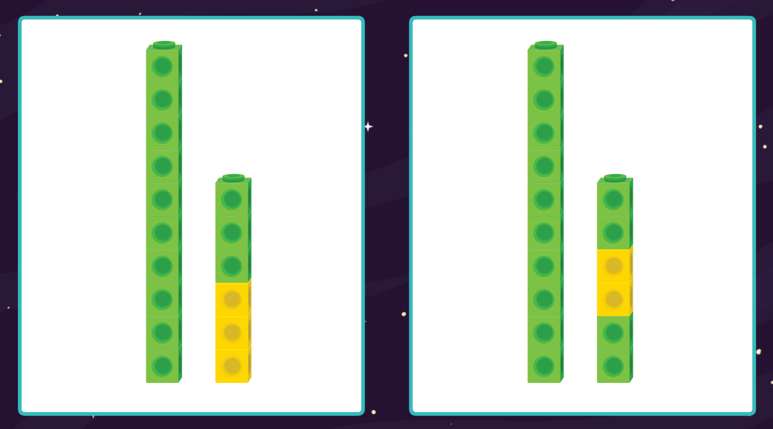
Digital Activity: Same But Different – Numbers to 19
edco.ie/ybn9

Slide 21
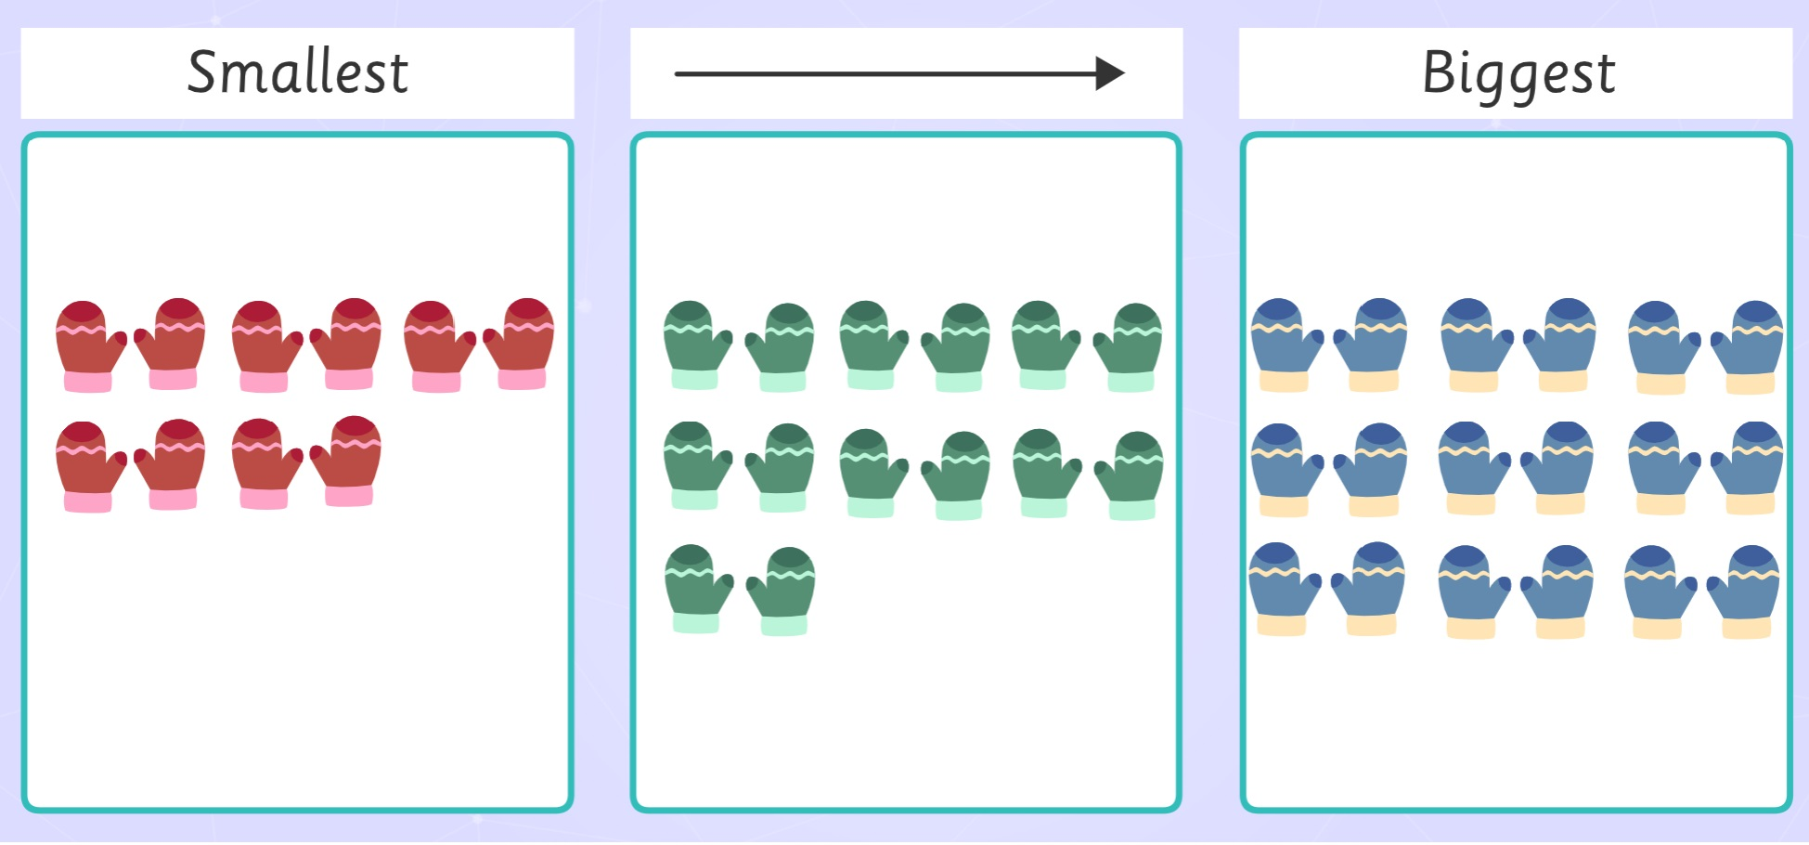
Digital Activity: Ordering Sets
edco.ie/5pra

Slide 22

Interactive Web Activity
Today's Number Up to 20 | edco.i.e./px4d

Slide 23
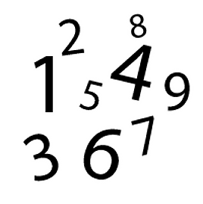
Sound of a Number
Listen to me drop coins into this tin.
How many coins did I drop in? Show me with your fingers
How many coins did I drop in? Show me with your frame and counters
How many coins did I drop in? Show me on your number fan
How many coins did I drop in? Write the numeral on your MWB

Slide 24
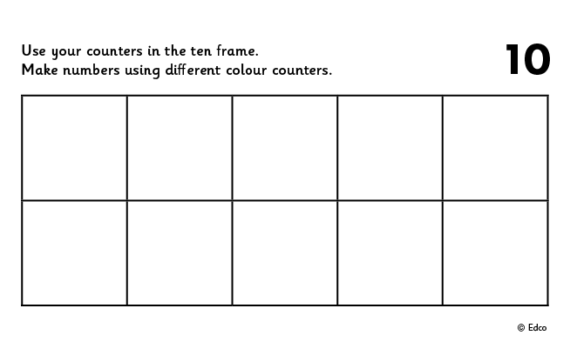
Use Counters and 2 Ten Frames
Put 16 in the frame.
How many on the 1st frame?
How many on the 2nd frame?
Put 16 in the frame a different way.
If I take away ___ how many will be left?
Put __ in the frame. How many more to make 16?
Put 16 in the frame. How many do I need to take away to leave __?
Repeat with 17, 18, 19 and 20

Slide 25
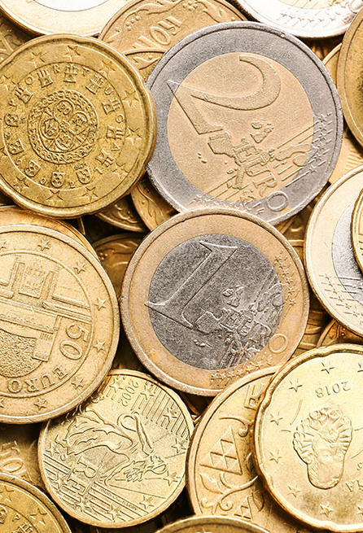
Sound of a Number
Using money make 16c. Draw what coins you used.
Show different ways.
Using money make €16. Draw what you used.
Show different ways.
Repeat with 17, 18, 19 and 20
Interactive Money: https://toytheater.com/play-money-europe/

Slide 26
Picture Books & Read Alouds

Slide 27

Picture Books & Read Alouds via Internet Archive
There are many counting and number related books on https://archive.org
This is an online digital library/archive that is free to access. Just click on the link, register/log in for FREE, and then simply "borrow" the required book for an hour. After an hour you can choose to borrow it again if required.

Slide 28
Picture Books & Read Alouds
20 Hungry Piggies by Trudy Harris
Downloadable at edco.i.e./rxfk
Suitable for Senior Infants and 1st/2nd Class
The wolf from ‘The Three Little Pigs’ shows up at a party attended by lots of piggies, but his plans for dinner are disrupted by the pigs from ‘This Little Piggy Went to Market’.
Ordinal numbers 1st to 20th, words and numbers

Slide 29
Picture Books & Read Alouds
Have You Seen My Dragon? by Steve Light
Downloadable at edco.i.e./e4bk
Suitable for Senior Infants and 1st Class
Readers are asked to spot the glorious beast, plus an array of big-city icons they can count.
Numbers 1–20

Slide 30
Picture Books & Read Alouds
How Many Snails? by Paul Giganti
Downloadable at edco.i.e./p8ey
Suitable for Senior Infants and 1st Class
‘I went walking and I wondered…’
Children could be asked to estimate and count the amount of items.
Amounts up to 37

Slide 31
Picture Books & Read Alouds
Pie for Piglets by Michael Dahl
Downloadable at edco.i.e./xvwd
Suitable for 1st and 2nd Class
Introduces counting by twos (to 20)
Readers are invited to find hidden numbers on an illustrated activity page.
Another counting by twos book from the same author is Footprints in the Snow.

Slide 32
Games and Cognitively Challenging Tasks

Slide 33
Frame Fillers!
Needed: 1 dice, 2 ten frames and 20 items per player
The first player throws the dice and places that number of items in their frame.
Each player throws and places in turn.
The winner is the player who places 15 (or more) in their ten frame first.

Slide 34
Pair Game: Throw and Build!
Needed: 20 cubes (unifix or multilink), one or two dice, per player.
Each player, in turn, chooses to throw one or two dice and then builds a stack of that number of cubes.
The players add to their stack of number of cubes.
The first player to build two stacks of 10 cubes wins the game.

Slide 35
Pair Game: Tower Splits!
Needed: 20 cubes and tokens (could be counters, links, paperclips, etc.)
Player A makes a tower of 20 cubes.
Player B closes their eyes and calls SPLIT!
Player A splits the tower in 2 parts and hides one part behind their back.
Player B looks at the part of the tower they can see and says how many cubes are hidden. If correct, Player B takes a token.
Swap roles and keep playing until time is up.
The winner is the person with the most tokens when the time is up.

Slide 36

Interactive Web Activity
Helicopter Rescue | edco.i.e./tprv

Slide 37

Interactive Web Activity
Chopper Squad | edco.i.e./5x8a

Slide 38

Interactive Web Activity
Blast Off | edco.i.e./x2xs

Slide 39

Interactive Web Activity
Caterpillar Ordering | edco.i.e./wknc

Slide 40

Interactive Web Activity
Placing Numbers on a Number Line | edco.i.e./3jj4

Slide 41

Interactive Web Activity
Coconut Ordering | edco.i.e./54fq

Slide 42
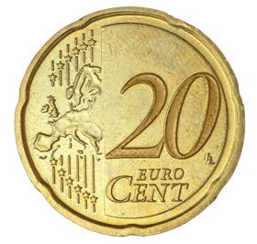
Money Swap
Jay has a 20c coin. He swaps the 20c with his mam, who gives him 20c in other coins.
What might she have given him?
Notes:
How could you model this story and what could be done? (i.e. mathematical modeling)
Could you build a model using things from the classroom?
Could you draw a model?
Could you model it using a number path?
Could you model this using numerals? e.g. a part-whole model, a branching bond, a number sentence

Slide 43
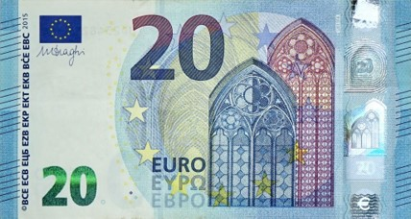
Money Swap
Lexi has a €20 note. She swaps the €20 note with her dad. He gives her other paper money. What did he give her?
Lexi then swaps her €20 with her mam. Her mam gives her €20 all in coins. What might Mam have given Lexi?
Notes:
How could you model this story and what could be done? (i.e. mathematical modeling)
Could you build a model using things from the classroom?
Could you draw a model?
Could you model it using a number path?
Could you model this using numerals? e.g. a part-whole model, a branching bond, a number sentence

Slide 44
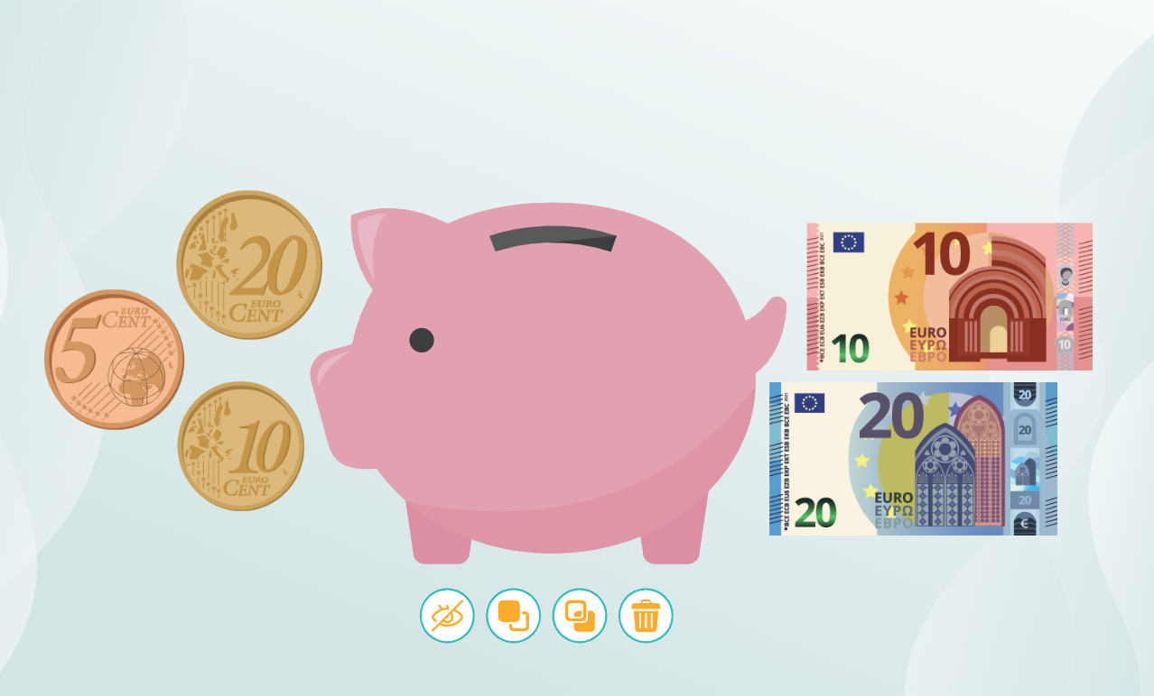
Toolkit: Money
edco.ie/3xts

Slide 45
Image Credits
Shutterstock

